Slide 1
User Awareness & Training:
LAND
Bucharest, Romania – 7th November 2013
GAF AG

Slide 2
Contents
Introduction to the COPERNICUS / GMES Land development
Further developments – the Sentinels
Overview of COPERNICUS/GMES LAND Services and Products:
  Global Component
  Continental (= Pan-European) and
  Local Component
  In-situ component
Summary & Questions
Notes:
* Test Case use needs official approval from EC / Copernicus Unit to be integrated!

Slide 3

Overview of COPERNICUS LAND Services and Products
Implementation of GMES / COPERNICUS Land component
Research and Development
Research and Development
Preparatory Actions
GIO Initial Ope-rations
EU Operational Programme
2004
2005
2009
2011
2013
2023
Notes:
Presentation focused on LAND domain and to be tailored according to introduction of day 1 to not duplicate info.

Slide 4
Overview of COPERNICUS LAND Services and Products
The future of the COPERNICUS Land Service
Space Segment Sentinels to contribute
  Main contributions are expected from the Sentinel 2 and 3 optical Satellites:
    Esp. Sentinel 2 contributing to Land Monitoring through
      Higher spatial and
      Higher temporal resolution Data for Global, PAN and Local Products → continuation and comparable to LANDSAT Programme for time series (even in the past)
    Sentinel 3 will contribute to global land monitoring, including jointly with other contributing missions (e.g. PROBA-V)
Notes:
Presentation focused on LAND domain + Sentinels to be tailored according to introduction of day 1 to not duplicate info.

Slide 5
Overview of COPERNICUS LAND Services and Products
There are basically four levels of data and products available:
  Global Land Products
  Continental or Pan-European Land Products
  Local Land Products
  In-situ component

Slide 6
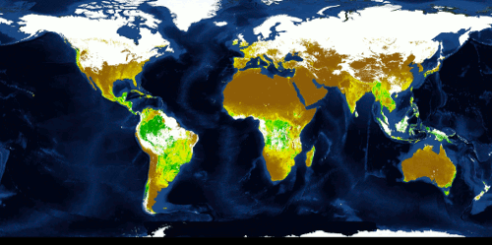
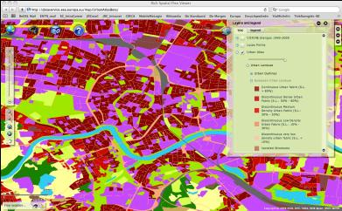
Introduction
Global component
Global component
  LAND Components / Core Products:
  Global → JRC
  bio-geophysical parameters (terrestrial Essential Climate Variables (ter. ECVs), food security (Africa) etc.)
  Continental → EEA
  pan-European products (Corine LC 2012, five HRLs: imperviousness, forest, grassland, wetland, water)
  Local → EEA
  zooming on ‘hot spots’ (e.g. urban atlas, riparian areas,..)
  In-situ-component → EEA
  (nat. contribution,
  in-situ measures
  like hydro-stat. …)
Global LAI: Leaf Area Index
EU component
Local component
Reference:
European Environment Agency

Slide 7
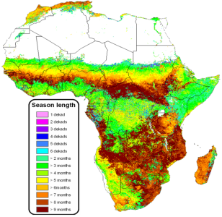
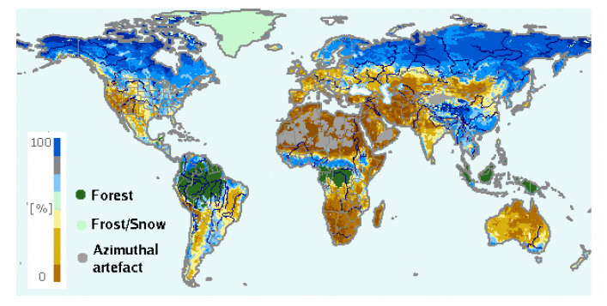
Intro – The Global Component
Global component
Global component
Bio-geophysical Parameters derived from Satellite Sensor Data for global and continental monitoring
Spatial Resolution of the parameters range: 300m to 5km (Pixel size of Rasterdata rel. to GSD)
Spatial Resolution of the parameters range:
  300m to 5km (Pixel size of raster data)
  rel. to Ground Sampling Distance of Satellites
Temporal Resolution time series:
  over several years (past)
  every 10 days
  NRT not yet planned but will be an asset
High temporal resolution vs. Low spatial resolution for Monitoring and Alerts
Soil Water Index
  Source: http://land.copernicus.eu/global/?q=products
  Auteursrecht 2013 VITO NV

Slide 8
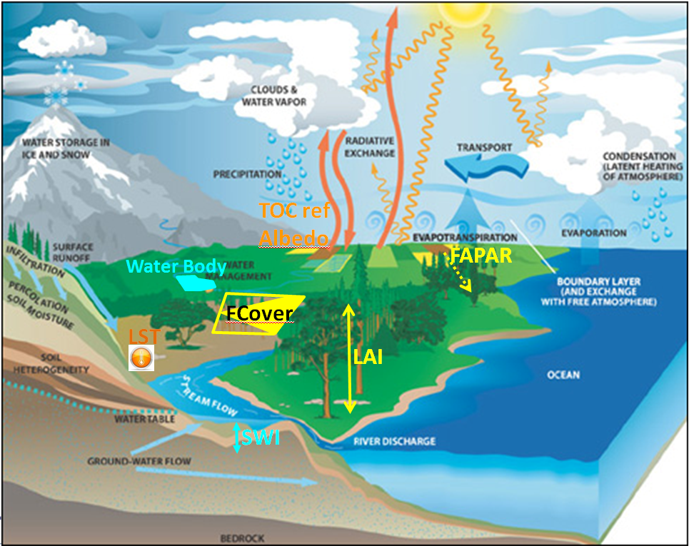
Concept of the Global Component
COPERNICUS GLOBAL LAND component is providing global bio-geophysical parameters describing energy fluxes within the general WATER CYCLE.
They are contributing
to monitor and model
the water cycle.
  Source: R. Lacaze, HYGEOS (2013) and B. Smets, VITO NV(2013)

Slide 9
The Global Component
Bio-geophysical Parameters:
Leaf Area Index (LAI)
Fraction of green Vegetation Cover (FCover)
Fraction of Absorbed Photosynthetically Active Radiation (FAPAR)
Dry Matter Productivity (DMP)
Normalized Difference Vegetation Index (NDVI)
Vegetation Condition Index (VCI)
Vegetation Productivity Index (VPI)
Top Of Canopy Reflectances (TOC-r)
Surface Albedo (SA)
Land Surface Temperature (LST)
Soil Water Index (SWI)
Burnt Area (BA)
Water Bodies (WB)
  Source: http://land.copernicus.eu/global/?q=products
  Auteursrecht 2013 VITO NV

Slide 10
The Global Component - Example
Examples for Global LAND Component Products:
Leaf Area Index (LAI)
  The LAI is defined as half the total area of green elements of the canopy per unit horizontal ground area. Basically, the LAI quantifies the amount of foliage material in an ecosystem. The satellite-derived value corresponds to the total green LAI of the all the canopy layers, including the understory which may represent a very significant contribution, particularly for forests
Soil Water Index (SWI)
  The SWI quantifies the moisture condition within the underlying soil profile. It is mainly driven by the precipitation via the process of infiltration. Soil moisture is a very heterogeneous variable and varies on small scales with soil properties and drainage patterns. Satellite measurements integrate over relative large-scale areas, with the presence of vegetation adding complexity to the interpretation
  Source: http://land.copernicus.eu/global/?q=products
  Auteursrecht 2013 VITO NV

Slide 11
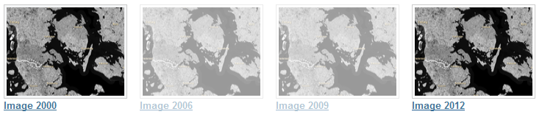
The Pan-European Component
Image Products
High Resolution satellite imagery forms the input for the creation of many information products and services; such as land cover maps or high resolution layers on land cover characteristics. Having all the satellite imagery available, it is worthwhile to process the individual image scenes into a seamless pan-European ortho-rectified mosaic.
Image 2000 - Image 2006 – Image 2009 – Image 2012

Slide 12
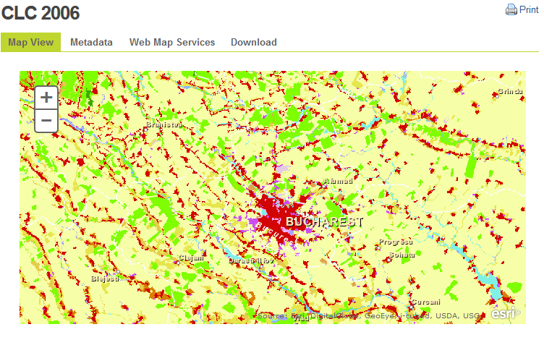
The Pan-European Component
Corine Land Cover
Land Cover Data Sets of 1990 - 2000 - 2006 – 2012 and
Land Cover Changes
  The Corine Land Cover inventory was initiated in 1985 (reference year 1990). Updates have been produced in 2000 and 2006, and the latest 2012 update is under production. It consists of an inventory of land cover in 44 classes. CLC uses a Minimum Mapping Unit (MMU) of 25 ha for areal phenomena and a minimum width of 100 m for linear phenomena. The time series are complemented by change layers, which highlight changes in land cover with an MMU of 5 ha.

Slide 13
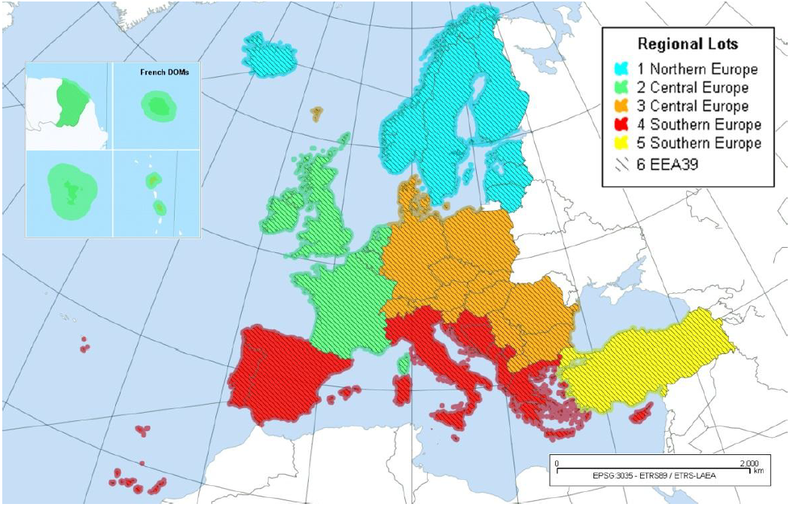

Pan-European: Initial Operations
Land Services: 5 High-Resolution Layers
Operational implementation 2011-2014 contracted by the European Environment Agency (EEA) to industrial consortias
Mapping of 5 thematic “High-Resolution Layers” of land cover for all of Europe from high-resolution optical EO data
The GIO-Land services covers 5.8 mio km² in 39 countries (EU-28 + collaborating states + EEA member states)
Notes:
Correct Image

Slide 14
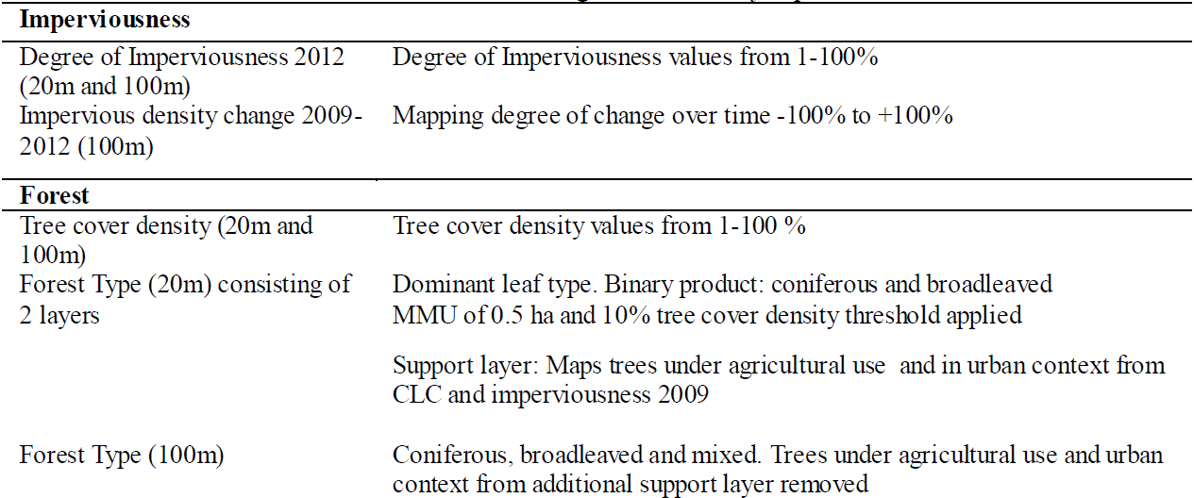
Pan-European Continental Component: HRL’s (1)

Slide 15
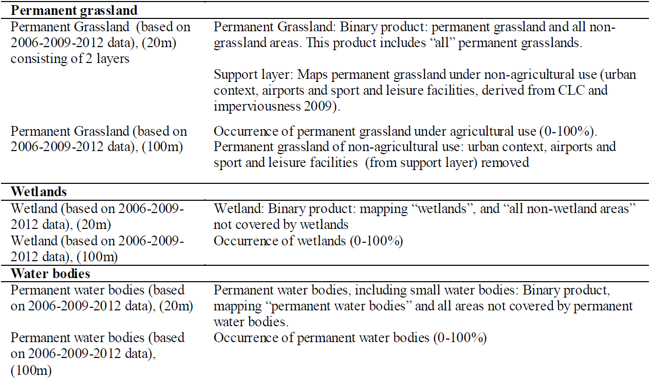
Pan-European Continental Component: HRL’s (2)

Slide 16
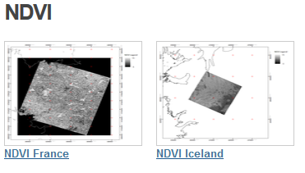
The Pan-European Component
Bio-geophysical variables
Bio-geophysical variables are typically calculated at the beginning of many classification processes. A broad range of variables can be calculated, depending on the thematic domain one is dealing with (e.g. vegetation, energy budget or water cycle). In the context of the pan-European component of the Copernicus land monitoring service, the NDVI is commonly used for the HRL production.

Slide 17
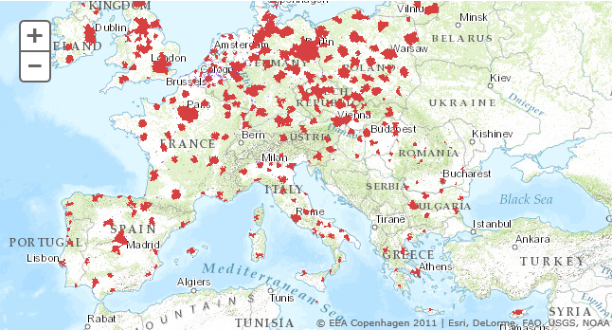
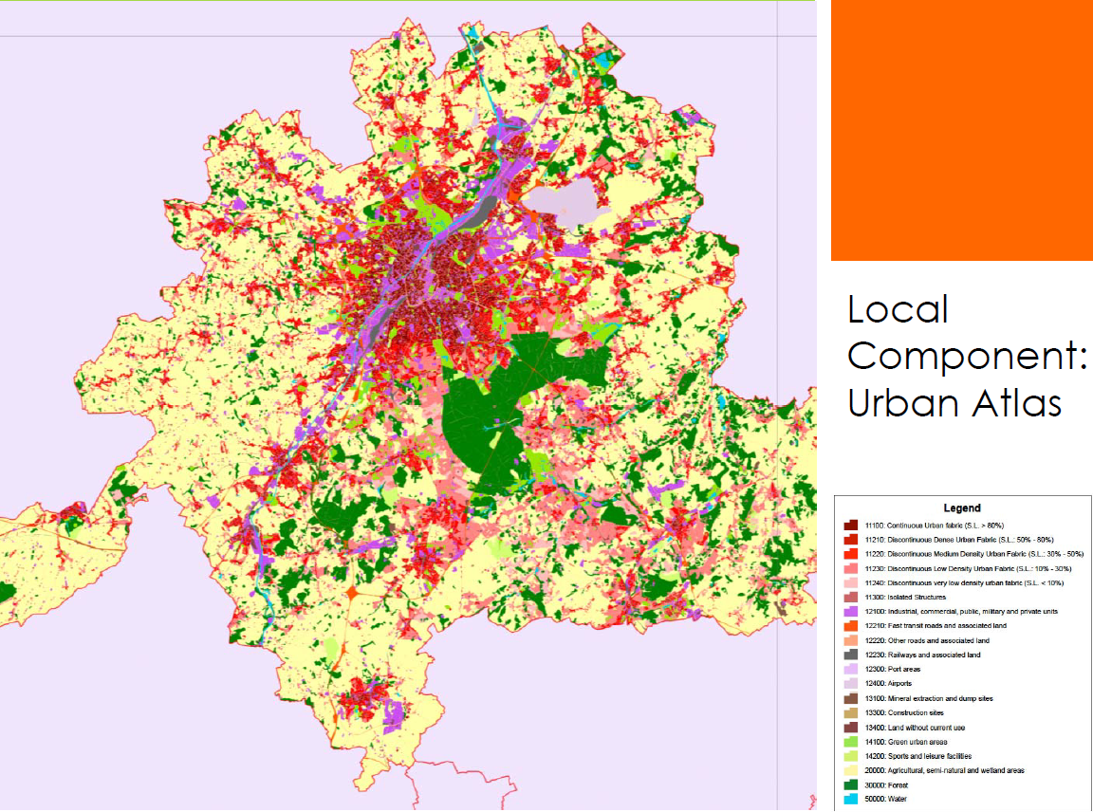
The Local Component
URBAN ATLAS
  Land use and cover data of
  European urban areas:
    Cities larger 100,000 inhabitants
    High Resolution Data (1:10,000,
    0,25 rep. 1ha MMU)
    Years 2006 and 2012 (under preparation)
  Purpose mainly on urban planning e.g.
    Information on risks and opportunities
    Improvement and infrastructure needs
Riparian Zones (not yet available)
Notes:
>100.000 inhabitants first version now <100.000 added since 2013

Slide 18
The Local Component
Notes:
Different MMU in city centre (imperv.) and outside city

Slide 19
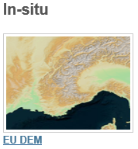
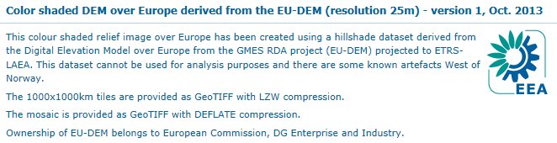
The In-Situ Component
In-Situ Component is managed by EEA
Source: http://sdi.eea.europa.eu/catalogue/srv/eng/search?uuid=e2cac092-4cbf-4765-a06e-0271f382d4a4
EU-DEM is a 3D raster dataset with elevations captured at 1 arc second postings (2.78x10-4 degrees) or about every 30 metres.
Hybrid product based on SRTM and ASTER GDEM data fused by a weighted averaging approach.
Notes:
Different MMU in city centre (imperv.) and outside city

Slide 20
Feedback Forms
&
Questions
Notes:
Feedback forms will be distributed and people will be encouraged to complete them in this time.
Open floor up to questions.

