Slide 1
User Awareness & Training: LAND Bucharest, Romania – 8th November 2013 GAF AG

Slide 2
Day 2 - Contents LAND (1)
General Introduction to EO and the COPERNICUS Sentinel Programme
Overview of COPERNICUS/GMES LAND Services and Products:
Global, Continental (= Pan-European) and Local Component
Test Cases and success stories
Use of Global Land Component:
for Soil-erosion in Spain (EOLAB/Junta de Andalusia)
for Pasture Monitoring /Farm Management (EOLAB/Junta de Andalusia)
for Drought Monitoring / Water Availability (EOLAB/Junta de Andalusia)
…
Notes:
* Test Case use needs official approval from EC / Copernicus Unit to be integrated!

Slide 3
Day 2 - Contents LAND (2)
…
Use of Pan EU Component:
Downstream Services for Sub-National Forest Administrations based on COPERNICUS HR Forest Layer – Thuringia Case (GAF, Germany)
Use of Local Component and Pan EU:
Italian Case Studies: Soil Sealing and Imperviousness Layer (PAN EU) for national environmental reporting (ISPRA, Italy)
Summary & Questions
Notes:
* Test Case use needs official approval from EC / Copernicus Unit to be integrated!

Slide 4

Overview of COPERNICUS LAND Services and Products
Implementation of GMES / COPERNICUS Land component
Research and Development
Research and Development
Preparatory Actions
GIO Initial Ope-rations
EU Operational Programme
2004
2005
2009
2011
2013
2023
Notes:
Presentation focused on LAND domain and to be tailored according to introduction of day 1 to not duplicate info.

Slide 5
Overview of COPERNICUS LAND Services and Products
The future of the COPERNICUS Land Service
Space Segment Sentinels to contribute
Main contribution are expected from the Sentinel 2 and 3 optical Satellites:
Esp. Sentinel 2 contributing to Land Monitoring through
higher spatial and
temporal resolution Data for Global, PAN and Local Products → continuation and comparable to LANDSAT Programme for time series (even in the past)
Sentinel 3 will contribute to global land monitoring, including jointly with other contributing missions (e.g. PROBA-V)
Notes:
Presentation focused on LAND domain + Sentinels to be tailored according to introduction of day 1 to not duplicate info.

Slide 6
Overview of COPERNICUS LAND Services and Products
There are basically four levels of data and products available:
Global Land Products
Continental or Pan-European Land Products
Local Land Products
In-situ component

Slide 7
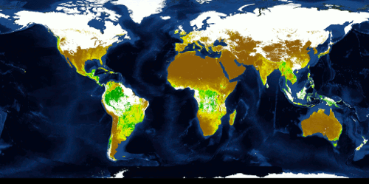
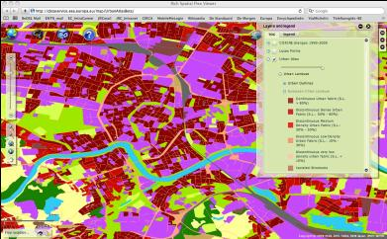
Introduction
Global component
Global component
LAND Components / Core Products:
Global → JRC bio-geophysical parameters (terrestrial Essential Climate Variables (ter. ECVs), food security (Africa) etc.)
Continental → EEA pan-European products (Corine LC 2012, five HRLs: imperviousness, forest, grassland, wetland, water)
Local → EEA zooming on ‘hot spots’ (e.g. urban atlas, riparian areas,..)
In-situ-component → EEA
(nat. contribution,
in-situ measures
like hydro-stat. …)
Global LAI: Leaf Area Index
EU component
Local component
Reference:
European Environment Agency

Slide 8
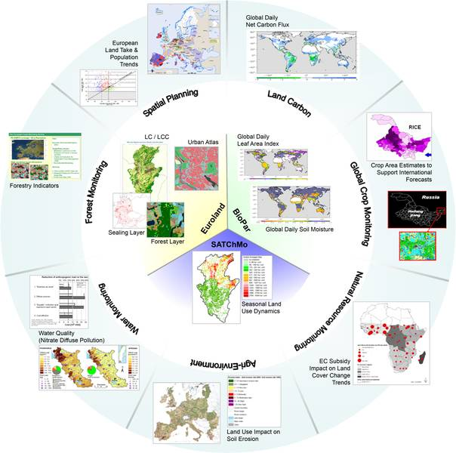
Introduction
Core Mapping Services
= land cover, land use, land cover change & a range of bio-geophysical parameters
Core Information Services
= specific information for European Environmental Policies and international treaties (Climate Change, food security and the sustainable development of Africa)

Slide 9
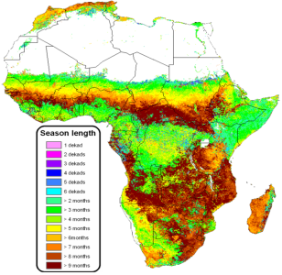
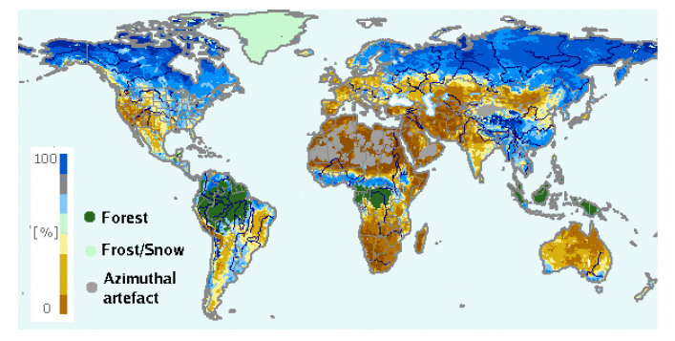
Intro – The Global Component
Global component
Global component
Bio-geophysical Parameters derived from Satellite Sensor Data for global and continental monitoring
Spatial Resolution of the parameters range: 300m to 5km (Pixel size of Rasterdata rel. to GSD)
Spatial Resolution of the parameters range:
300m to 5km (Pixel size of raster data)
rel. to Ground Sampling Distance of Satellites
Temporal Resolution time series:
over several years (past)
every 10 days
NRT not yet planned but will be an asset
High temporal resolution vs. Low spatial resolution for Monitoring and Alerts
Soil Water Index
Source: http://land.copernicus.eu/global/?q=products
Auteursrecht 2013 VITO NV

Slide 10
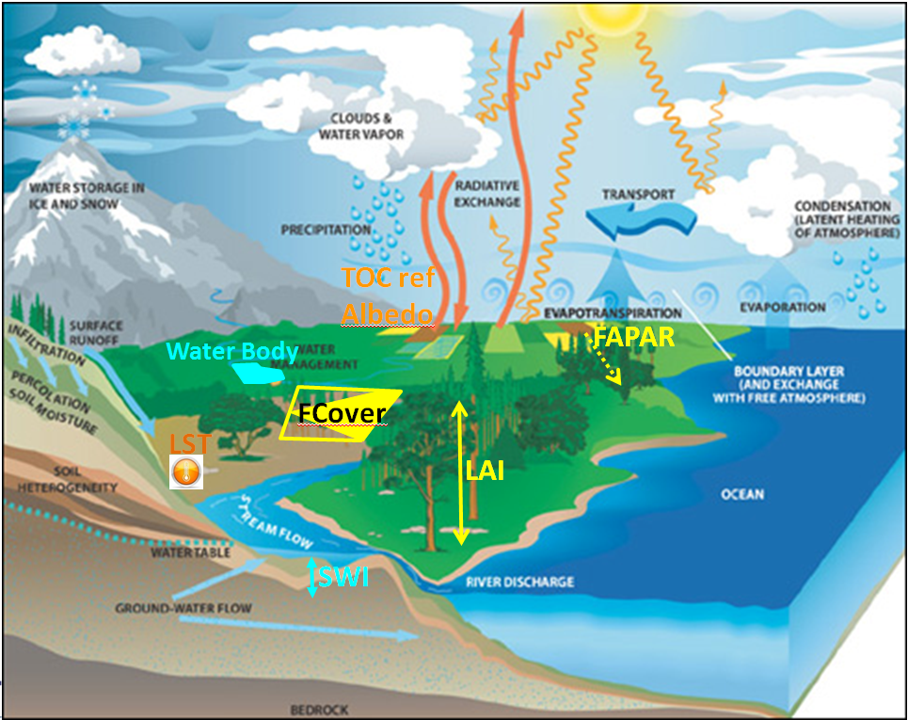
Concept of the Global Component
COPERNICUS GLOBAL LAND component is providing global bio-geophysical parameters describing energy fluxes within the general WATER CYCLE.
They are contributing
to monitor and model
the water cycle.
Source: R. Lacaze, HYGEOS (2013) and B. Smets, VITO NV(2013)

Slide 11
The Global Component
Bio-geophysical Parameters:
Leaf Area Index (LAI)
Fraction of green Vegetation Cover (FCover)
Fraction of Absorbed Photosynthetically Active Radiation (FAPAR)
Dry Matter Productivity (DMP)
Normalized Difference Vegetation Index (NDVI)
Vegetation Condition Index (VCI)
Vegetation Productivity Index (VPI)
Top Of Canopy Reflectances (TOC-r)
Surface Albedo (SA)
Land Surface Temperature (LST)
Soil Water Index (SWI)
Burnt Area (BA)
Water Bodies (WB)
Source: http://land.copernicus.eu/global/?q=products
Auteursrecht 2013 VITO NV

Slide 12
The Global Component
Detailed Overview – Global LAND
Leaf Area Index (LAI)
The LAI is defined as half the total area of green elements of the canopy per unit horizontal ground area. Basically, the LAI quantifies the amount of foliage material in an ecosystem. The satellite-derived value corresponds to the total green LAI of the all the canopy layers, including the understory which may represent a very significant contribution, particularly for forests
Fraction of green Vegetation Cover (FCover)
The Fcover corresponds to the fraction of ground covered by the green vegetation. Because it is independent from the illumination direction and it is sensitive of the vegetation amount, FCover is a very good candidate for the replacement of classical vegetation indices for the monitoring of green vegetation
Source: http://land.copernicus.eu/global/?q=products
Auteursrecht 2013 VITO NV

Slide 13
The Global Component
Fraction of Absorbed Photosynthetically Active Radiation (FAPAR)
The FAPAR quantifies the fraction of the solar radiation absorbed by live leaves for the photosynthesis activity. Then, it refers only to the green and alive elements of the canopy. The FAPAR depends on the canopy structure, vegetation element optical properties, atmospheric conditions, and angular configuration. To overcome this latter dependency, a daily integrated FAPAR value is assessed
Dry Matter Productivity (DMP)
The DMP represents the daily growth of standing biomass. It is equivalent to the Net Primary Productivity, well known in climatological studies, but DMP is customized for agronomic applications and is expressed in kilograms of dry matter per hectare and per day
Source: http://land.copernicus.eu/global/?q=products
Auteursrecht 2013 VITO NV

Slide 14
The Global Component
Normalized Difference Vegetation Index (NDVI)
The NDVI is an indicator which quantifies the amount of green vegetation. It is closely linked to the FAPAR and it is little scale dependent
Vegetation Condition Index (VCI)
The VCI compares the observed NDVI to the range of values observed in the same period in previous years. The VCI is expressed in % and gives an idea where the observed value is situated between the extreme values (minimum and maximum) in the previous years. Lower and higher values indicate bad and good vegetation state conditions, respectively
Vegetation Productivity Index (VPI)
VPI assesses the overall vegetation condition by referencing the actual value of the NDVI with the long-term statistics for the same 10-day period.
Source: http://land.copernicus.eu/global/?q=products
Auteursrecht 2013 VITO NV

Slide 15
The Global Component
Top Of Canopy Reflectances (TOC-r)
The TOC spectral reflectance refers to the portion of the incident solar radiation reflected by the surface in a given spectral band and without atmospheric interferences
Surface Albedo (SA)
The SA quantifies the fraction of the incoming solar radiation reflected by the surface of the Earth. Different albedo concepts are defined: 1) the directional albedo or directional-hemispherical reflectance (also called black-sky albedo) is the integration of the bi-directional reflectance over the viewing hemisphere
Land Surface Temperature (LST)
The LST is the radiative skin temperature of land surface. LST is determined by the land-surface energy balance and varies rapidly because of the low thermal inertia of the land surface. LST may relate to the uppermost vegetation canopy or be a mixture of canopy and ground surface temperatures.
Source: http://land.copernicus.eu/global/?q=products
Auteursrecht 2013 VITO NV

Slide 16
The Global Component
Soil Water Index (SWI)
The SWI quantifies the moisture condition within the underlying soil profile. It is mainly driven by the precipitation via the process of infiltration. Soil moisture is a very heterogeneous variable and varies on small scales with soil properties and drainage patterns. Satellite measurements integrate over relative large-scale areas, with the presence of vegetation adding complexity to the interpretation
Source: http://land.copernicus.eu/global/?q=products
Auteursrecht 2013 VITO NV

Slide 17
The Global Component
Burnt Area (BA)
The BA product maps the burnt scars and gives temporal information on the fire season The maps of BA are recognized as an Essential Climate Variable (ECV) by the Global Climate Observing System (GCOS)
Water Bodies (WB)
The WB product refers to the detection of the inland water along the year providing the maximum and the minimum extent of the water surface as well as the seasonal dynamics.
The area of water bodies is identified as an Essential Climate Variable (ECV) by the Global Climate Observing System (GCOS).
Source: http://land.copernicus.eu/global/?q=products
Auteursrecht 2013 VITO NV

Slide 18
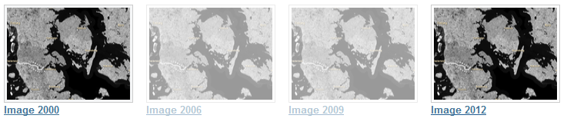
The Pan-European Component
Image Products
High Resolution satellite imagery forms the input for the creation of many information products and services; such as land cover maps or high resolution layers on land cover characteristics. Having all the satellite imagery available, it is worthwhile to process the individual image scenes into a seamless pan-European ortho-rectified mosaic.
Image 2000 - Image 2006 – Image 2009 – Image 2012

Slide 19
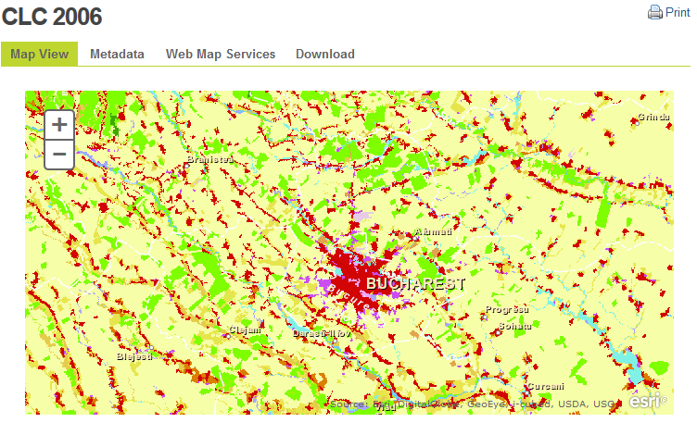
The Pan-European Component
Corine Land Cover
Land Cover Data Sets of 1990 - 2000 - 2006 – 2012 and
Land Cover Changes
The Corine Land Cover inventory was initiated in 1985 (reference year 1990). Updates have been produced in 2000 and 2006, and the latest 2012 update is under production. It consists of an inventory of land cover in 44 classes. CLC uses a Minimum Mapping Unit (MMU) of 25 ha for areal phenomena and a minimum width of 100 m for linear phenomena. The time series are complemented by change layers, which highlight changes in land cover with an MMU of 5 ha.

Slide 20
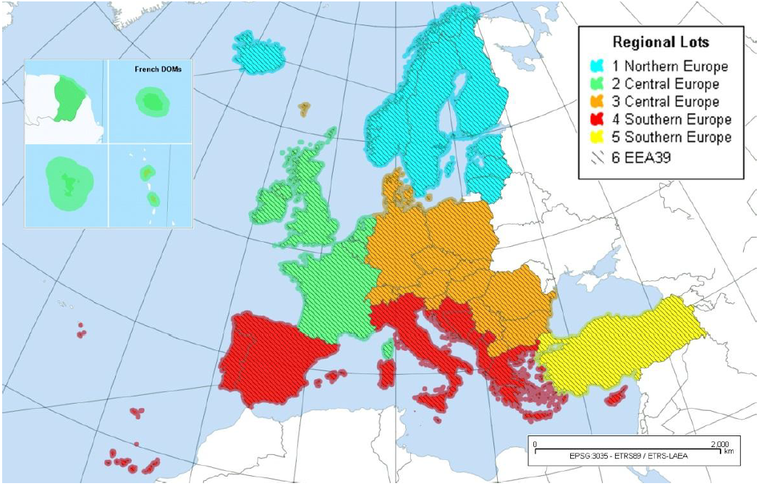

Pan-European: Initial Operations
Land Services: 5 High-Resolution Layers
Operational implementation 2011-2014 contracted by the European Environment Agency (EEA) to industrial consortias
Mapping of 5 thematic “High-Resolution Layers” of land cover for all of Europe from high-resolution optical EO data
The GIO-Land services covers 5.8 mio km² in 39 countries (EU-28 + collaborating states + EEA member states)
Notes:
Correct Image

Slide 21
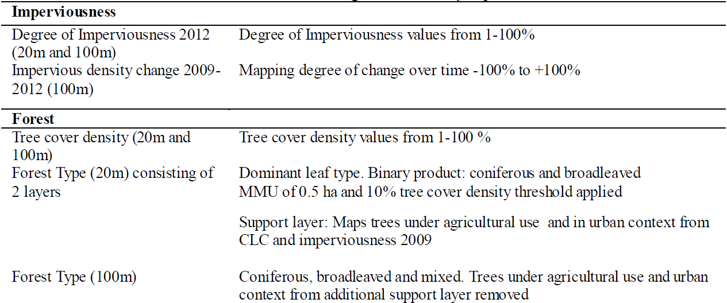
Pan-European Continental Component: HRL’s (1)

Slide 22
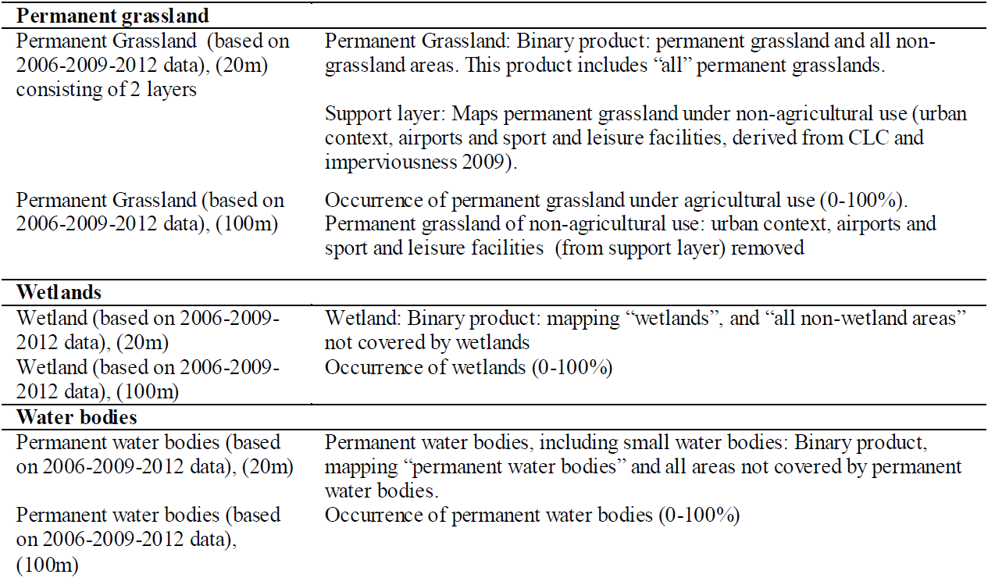
Pan-European Continental Component: HRL’s (2)

Slide 23
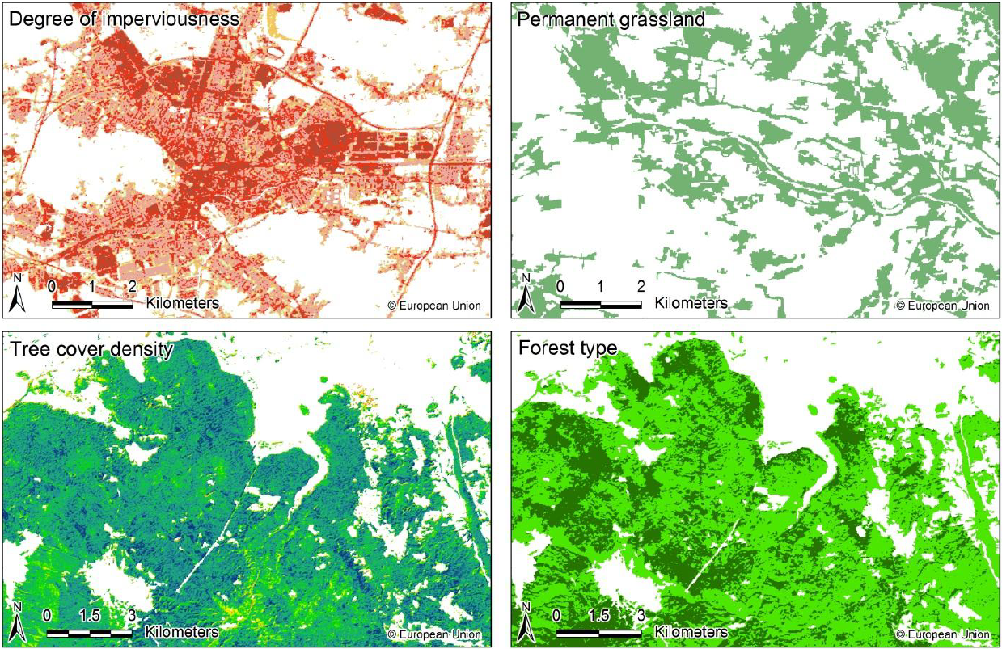
Pan-European Continental Component: HRL’s (Examples)
Ref.:

Slide 24
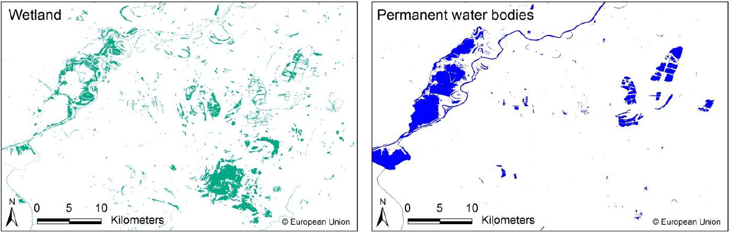
Pan-European Continental Component: HRL’s (Examples)
Non-validated examples of the HRLs illustrating the products.
Ref.:

Slide 25
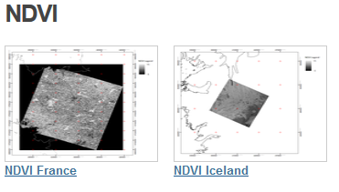
The Pan-European Component
Bio-geophysical variables
Bio-geophysical variables are typically calculated at the beginning of many classification processes. A broad range of variables can be calculated, depending on the thematic domain one is dealing with (e.g. vegetation, energy budget or water cycle). In the context of the pan-European component of the Copernicus land monitoring service, the NDVI is commonly used for the HRL production.

Slide 26
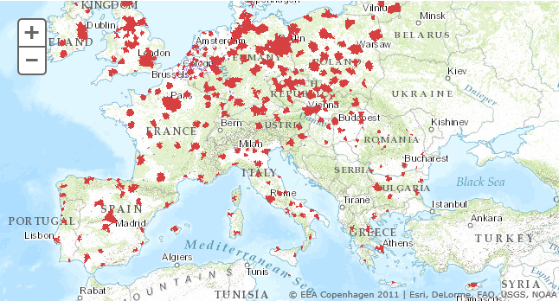
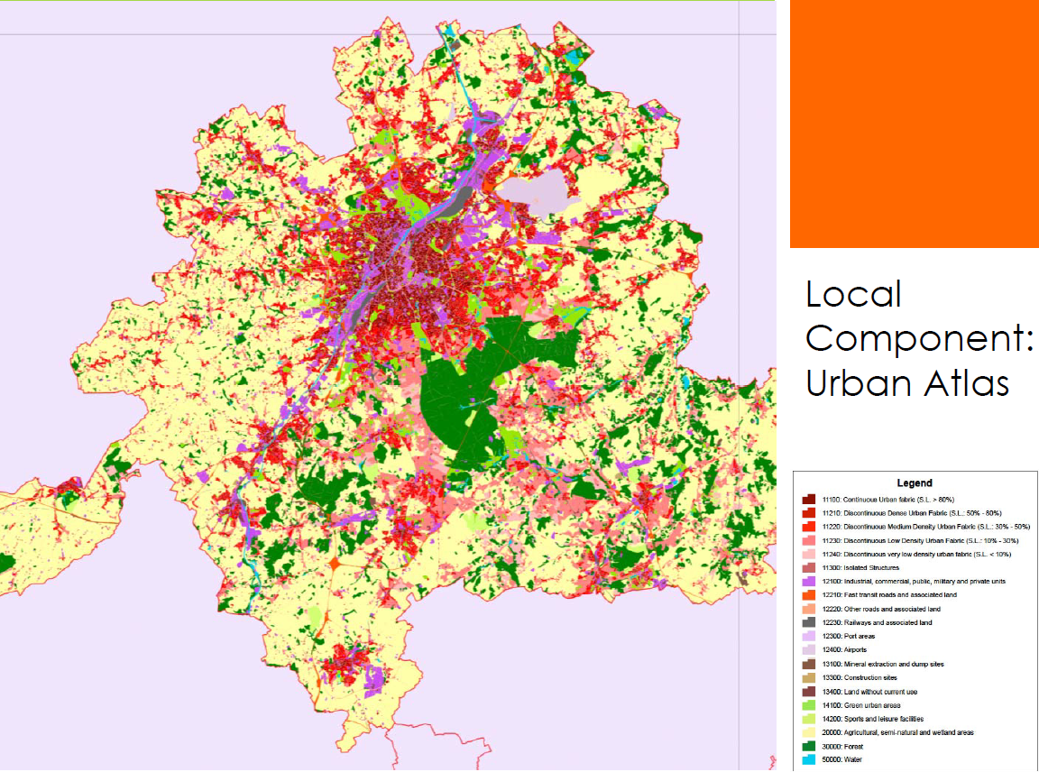
The Local Component
URBAN ATLAS
Land use and cover data of
European urban areas:
Cities larger 100,000 inhabitants
High Resolution Data (1:10,000,
0,25 rep. 1ha MMU)
Years 2006 and 2012 (under preparation)
Purpose mainly on urban planning e.g.
Information on risks and opportunities
Improvement and infrastructure needs
Riparian Zones (not yet available)
Notes:
>100.000 inhabitants first version now <100.000 added since 2013

Slide 27
The Local Component
Notes:
Different MMU in city centre (imperv.) and outside city

Slide 28
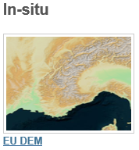
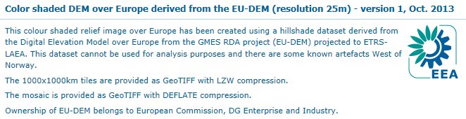
The In-Situ Component
In-Situ Component is managed by EEA
Source: http://sdi.eea.europa.eu/catalogue/srv/eng/search?uuid=e2cac092-4cbf-4765-a06e-0271f382d4a4
EU-DEM is a 3D raster dataset with elevations captured at 1 arc second postings (2.78x10⁻⁴ degrees) or about every 30 metre.
Hybrid product based on SRTM and ASTER GDEM data fused by a weighted averaging approach.
Notes:
Different MMU in city centre (imperv.) and outside city

Slide 29
Feedback Forms
&
Questions
Notes:
Feedback forms will be distributed and people will be encouraged to complete them in this time.
Open floor up to questions.

