Slide 1
Marine Core Service Overview
Antonio Guarnieri (Istituto Nazionale di Geofisica e Vulcanologia, It)
Glenn Nolan (Marine Institute, Ir)
Pierre Bahurel (Mercator Ocean, Fr)
Nadia Pinardi (Istituto Nazionale di Geofisica e Vulcanologia, It)

Slide 2
Contents
  Brief History of the Service Genesis
  The Core Service
    Describe the ocean
    Deliver the Data
    Propose Information
  Examples of applications
  Conclusions

Slide 3
Context and brief history
What is the COPERNICUS Marine Service?
  It is a service providing information on the state of the physical oceans and regional seas
  Why?
    To sustain and allow the development of a whole set of activities at sea in the domains of marine resources, marine safety, coastal and marine environment, weather, climate and seasonal forecasting
  How?
    Through the infrastructure built and provided by MyOCEAN and MyOCEAN2 EU funded Projects

Slide 4
The Service Today
  Within Copernicus and its Marine Service Fast Track, the EU consolidated past experiences and expertise in pre-operational ocean monitoring and forecasting capacity in Europe developed through precursor European projects:
    MERSEA (http://w3.mersea.eu.org/)
    BOSS4GMES (http://www.boss4gmes.eu/)
    GSE MARCOAST (http://www.marcoast.eu/)
    POLAR VIEW (http://www.polarview.org/)
    MyOCEAN and MyOCEAN2 (http://www.myocean.eu)

Slide 5
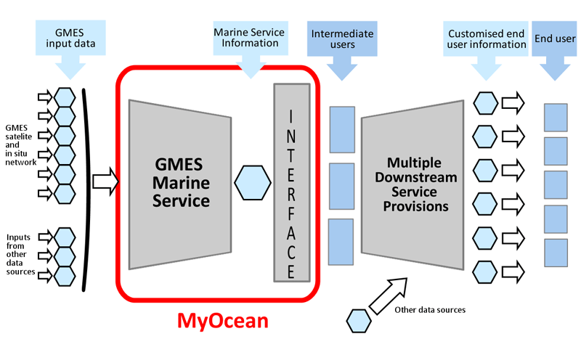
The Service Today
  The need for synthesis, continuation and consolidation of all these precursor activities has arisen in order to:
Describe the Ocean
Deliver the Products
Propose Information on the products

Slide 6
The Approach
  Integrated – system of systems
  Open and Free – username and password
  Reliable – quality and availability
  Direct access – direct request of account, direct response
  User-Driven – fact sheets, questionnaires, workshops, dedicated WPs for User requirements

Slide 7

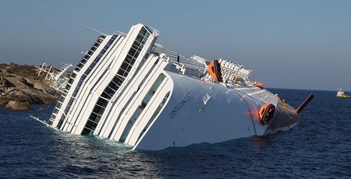
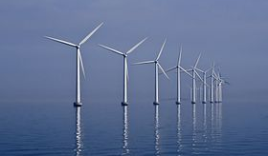
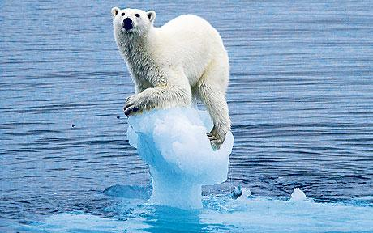
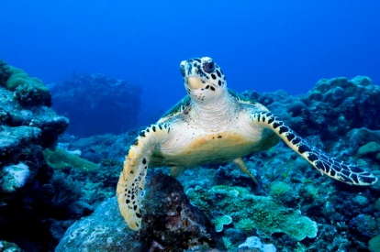
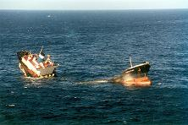
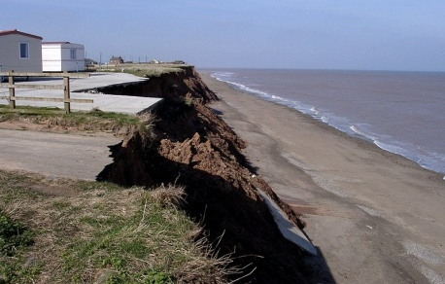

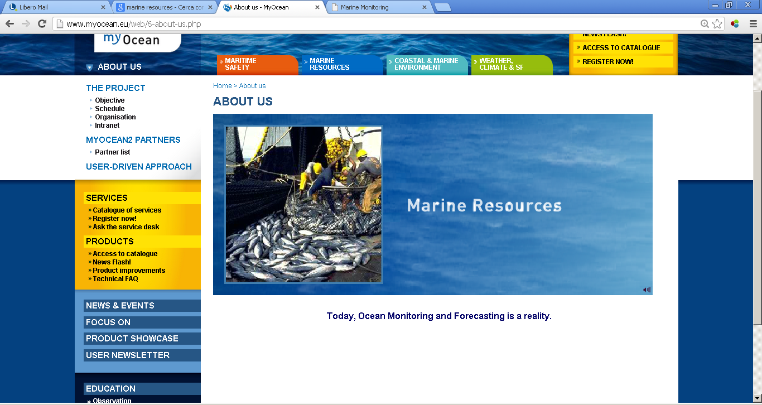
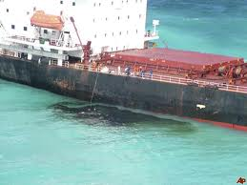
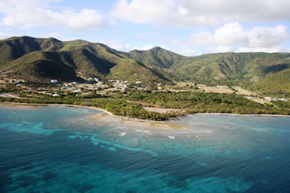
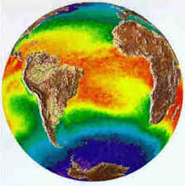
The domains of Activity
Coastal and Marine Environment
Marine Resources
Marine Safety
Climate and Seasonal Forecast

Slide 8
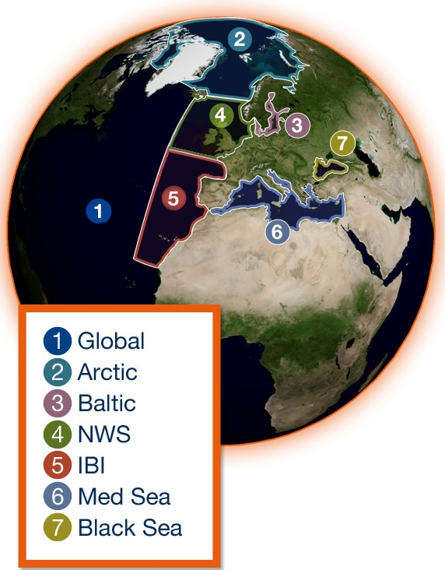
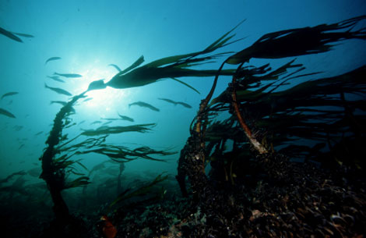
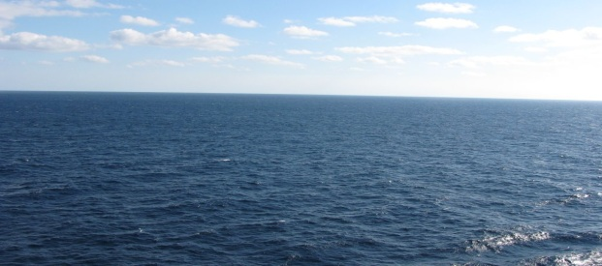
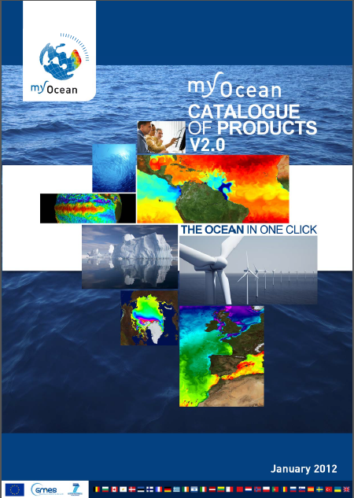
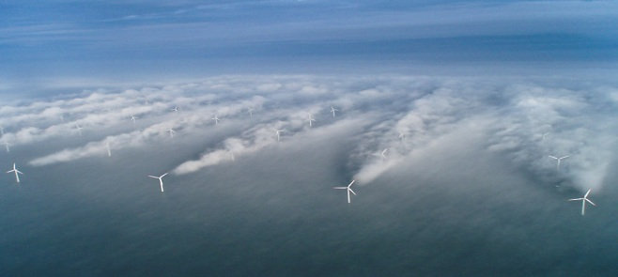
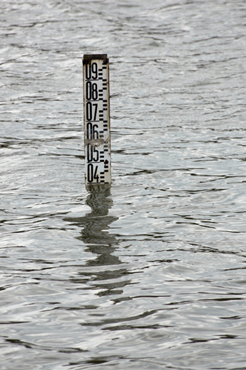
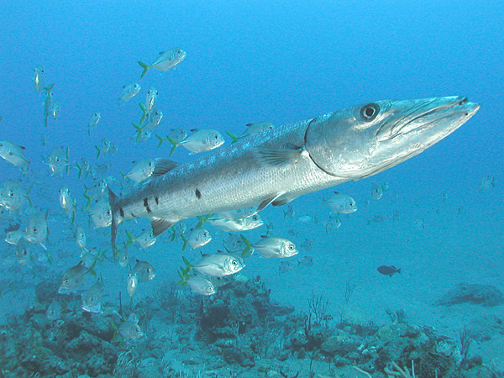
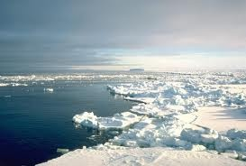
Describe the ocean (catalogue of products)
Temperature
& Salinity
Currents
Surface Wind
Sea Level
Biogeochemistry
Sea Ice
REANALYSES
10 to 45 years
REAL-TIME
Daily hourly
FORECAST
2 to 10 days

Slide 9
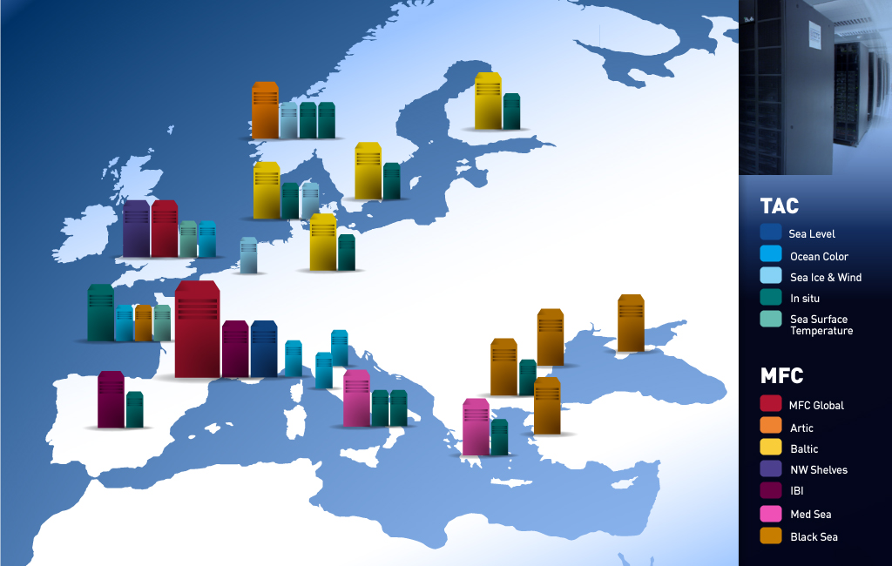
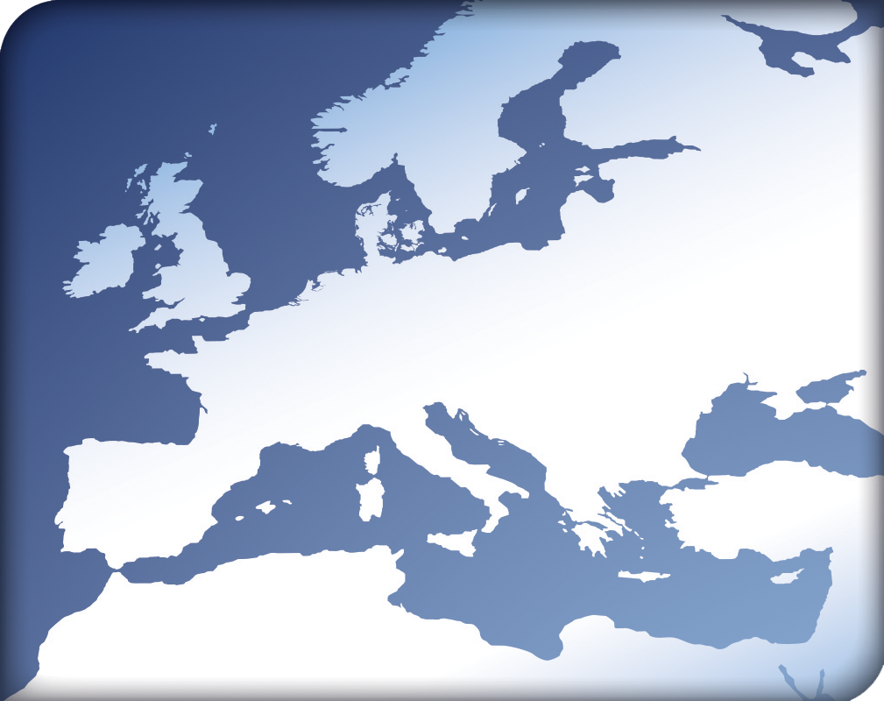
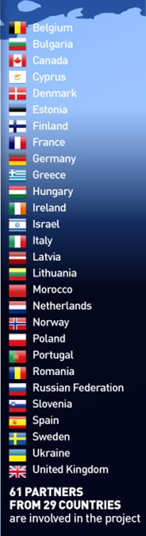
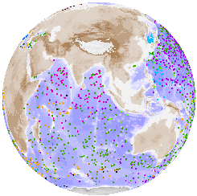
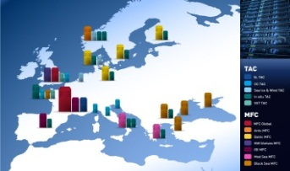















































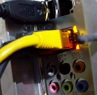

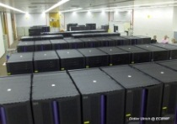


Deliver the data (distributed network)
46 inter-connected systems
300 technical interfaces
700 000 billions of ops/day on supercomputers
350 people in 29 countries
A NETWORK OF PROVIDERS
500 000
observations
per day

Slide 10
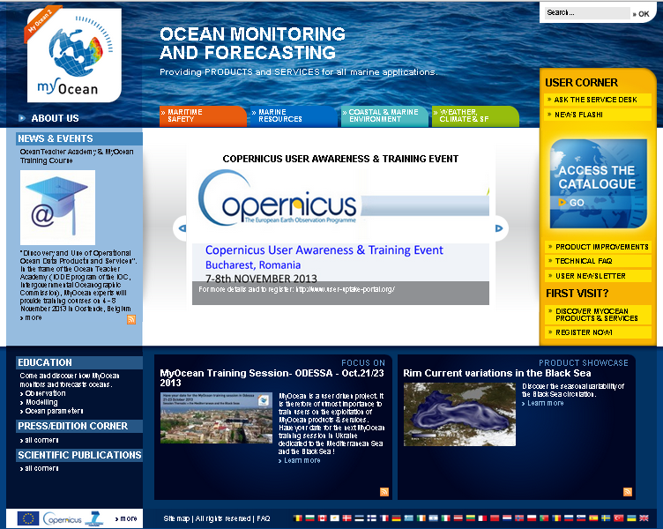
Propose Information
Information on the service is available in many different ways
Direct human assistance through a service desk
Network of experts of each single product provided
Central Portal
Specific documentation from scientifical, technical and quality point of view
New-generation like applications (IPHONE APPS)

Slide 11
Results of the service (status and evolution)

Slide 12
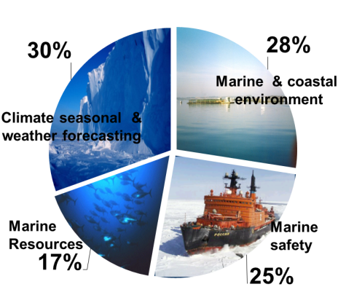
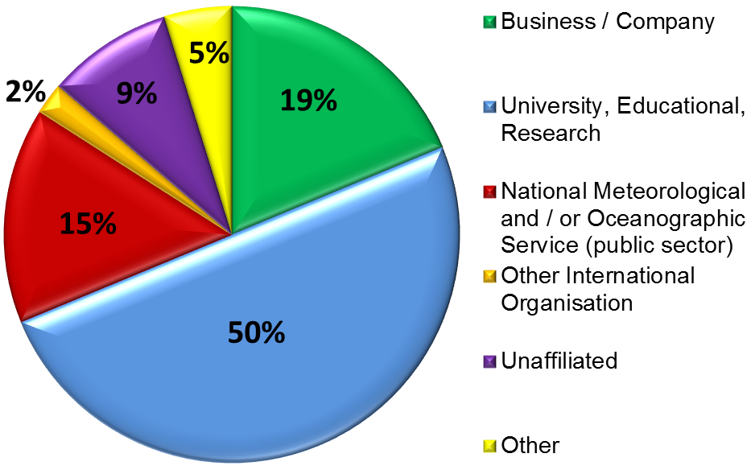
Results of the service (status and evolution)
Types of users, areas of benefit

Slide 13
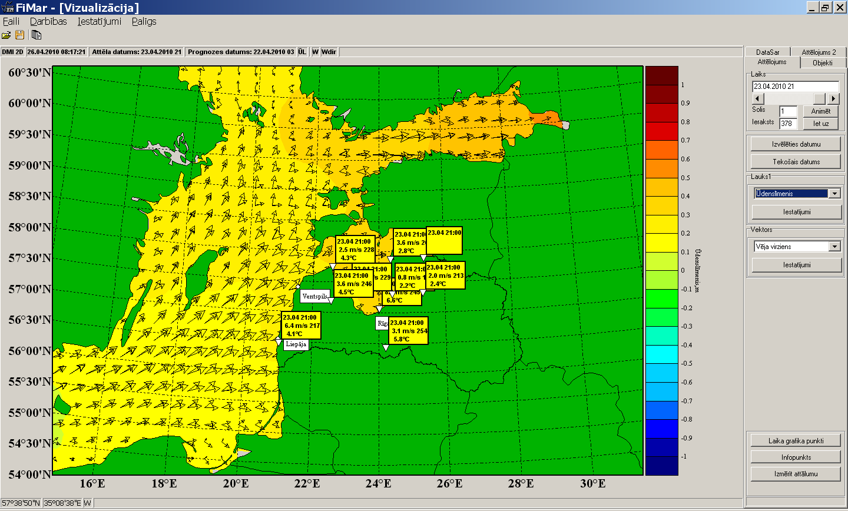
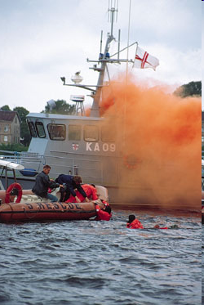
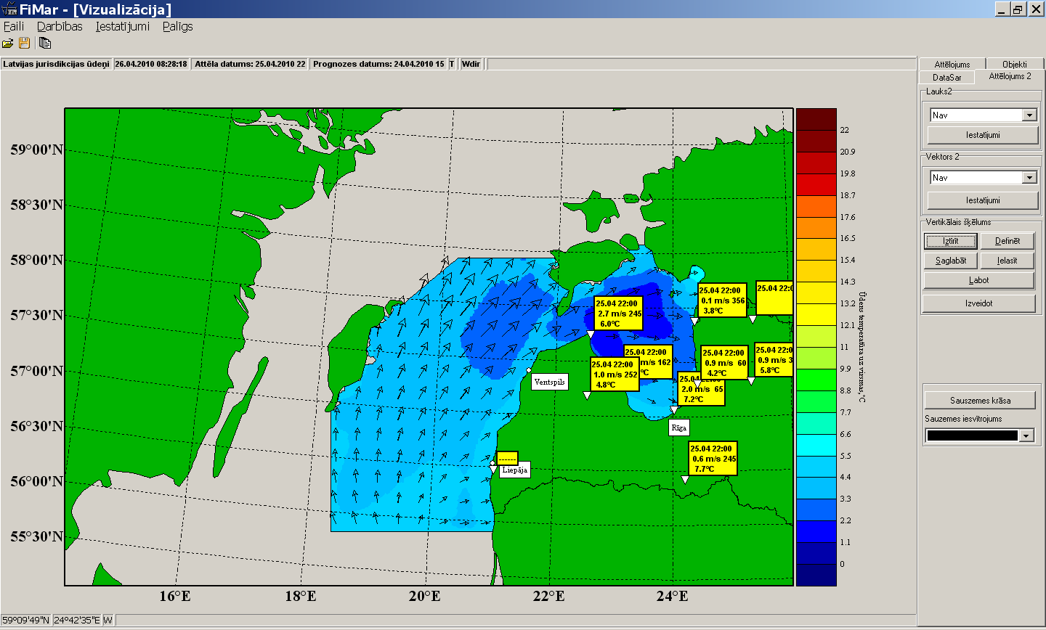

Some Applications: Baltic → Latvia search & rescue, navy, hydro&meteo
MyOcean Baltic
Local Model (Latvia)
courtesy:
Uldis Bethers
(UL, Riga)

Slide 14
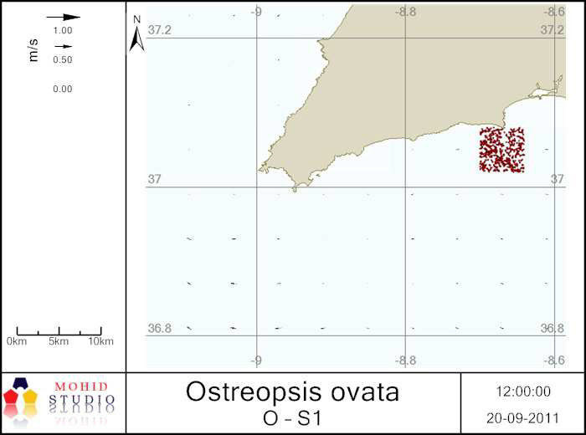
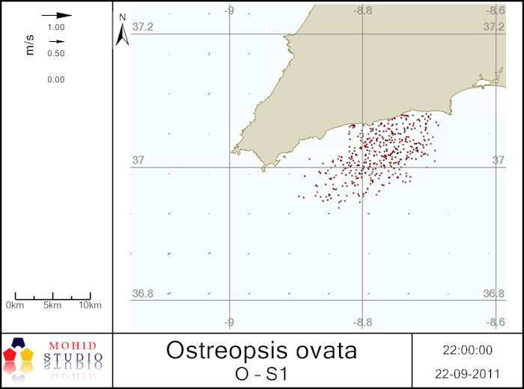
Some Applications: IBI→ Portugal
integrated coastal management
First bloom of Ostreopsis cf. ovata in the Iberian Upwelling system (south Portugal)
Nowcasting bloom transport
Genetic identification of the species. Sequences revealed 99% similarity with Mediterranean strains (1).
Bloom transport and aggregation/dispersion were forecasted by the MOHID hydrodynamic model developed for the south Portuguese Coast (2). Management decisions were based on model predictions.
Bloom epicentre
D.Ana beach
The factor mainly favouring this algal bloom is the presence of nutrients coming from the rivers
Portugal
Portugal
(1) David et al. 2012
(2) Mateus et al. 2013

Slide 15



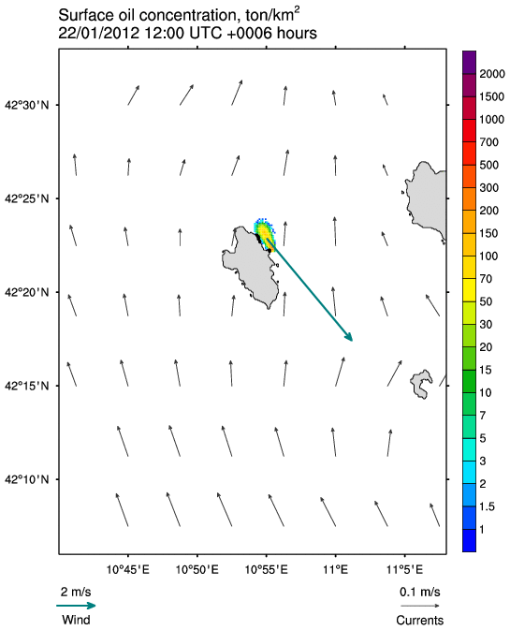
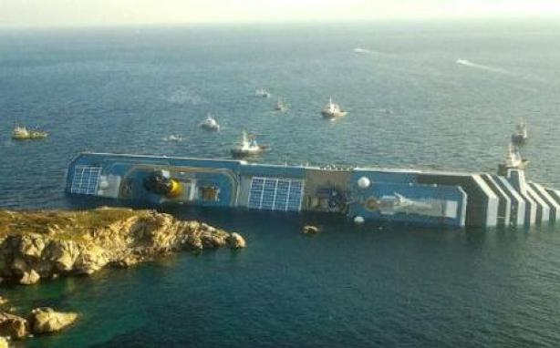
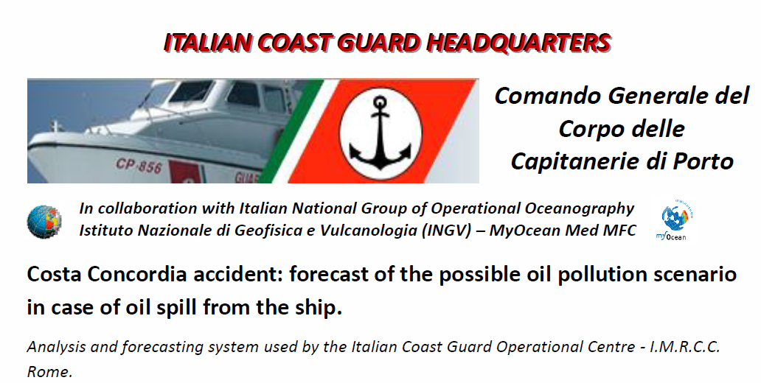
Some Applications: Med → Italy
marine service for emergency management
The stream-flow of the systems from the Eropean Marine Core Service to the local Italian Coast Guard.
  Currents forecasted in the area
Oil spill scenario
derived locally
Decision support for operations
13th Jan 2012

Slide 16
CONCLUSIONS
In recent years, the COPERNICUS programme has developed a robust and reliable service in the domain of Marine; consolidating and continuing precursor activities and projects;
The Service is now alive and operational through the MyOCEAN2 project, producing and delivering information on the state of the oceans;
The constant increase of the number of users suggests a continuous growth of the efficiency of the service and of the interest of users;
Through the production and delivery of its products the European Marine Service supports many organizations and Institutions in the public and private sectors in all activities related to the sea (S&R, management of the marine emergencies, support to MSFD, oil spill, support to fishery and aquaculture, ICZM, and many other domains)

