Slide 1
User Awareness & Training: The COPERNICUS LAND PORTAL - Product Access - Bucharest, Romania – 8th November 2013 GAF AG

Slide 2
Contents
Overview of LAND.COPERNICUS.EU
Demonstration – Use of the Global LAND Portal
Demonstration – Use of the PAN-EU LAND Portal
Demonstration – Use of the Local LAND Portal
Summary & Questions

Slide 3
Principles for Access
A single entry point to access products
Internet access: http://land.copernicus.eu/global
Product download through two channels
Internet
Access to the full archive and near real time products/services (NRT)
Intermediate use of ‘Geoland2’ (FP7) portal + ‘DevCoCast’ website
Planned for 2014: dedicated COPERNICUS Global Land portal
Broadcast (EUMETCast for Africa and South-America)
Near Real Time products/services
Data Policy: Free full and open product access
Anonymous query
Easy and simple registration form for access (automated process)

Slide 4
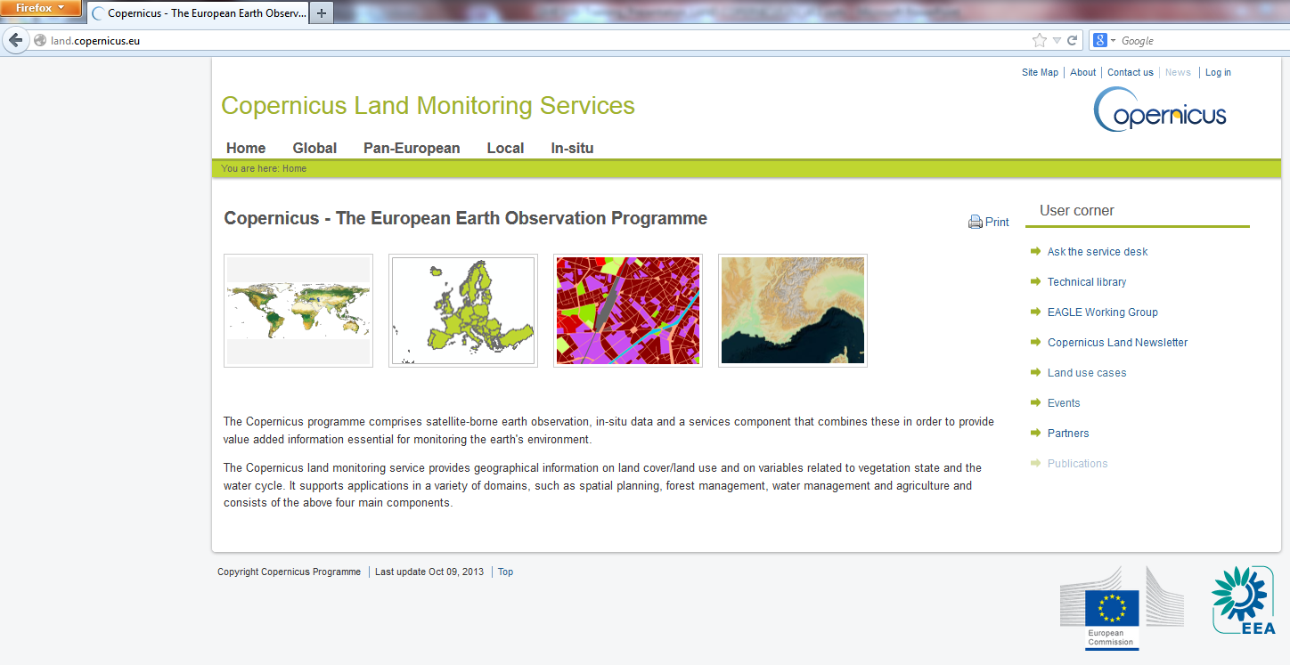
Portal Introduction http://land.copernicus.eu/
Notes:
Copernicus Land Homepage – Entry point for the Land services and products

Slide 5
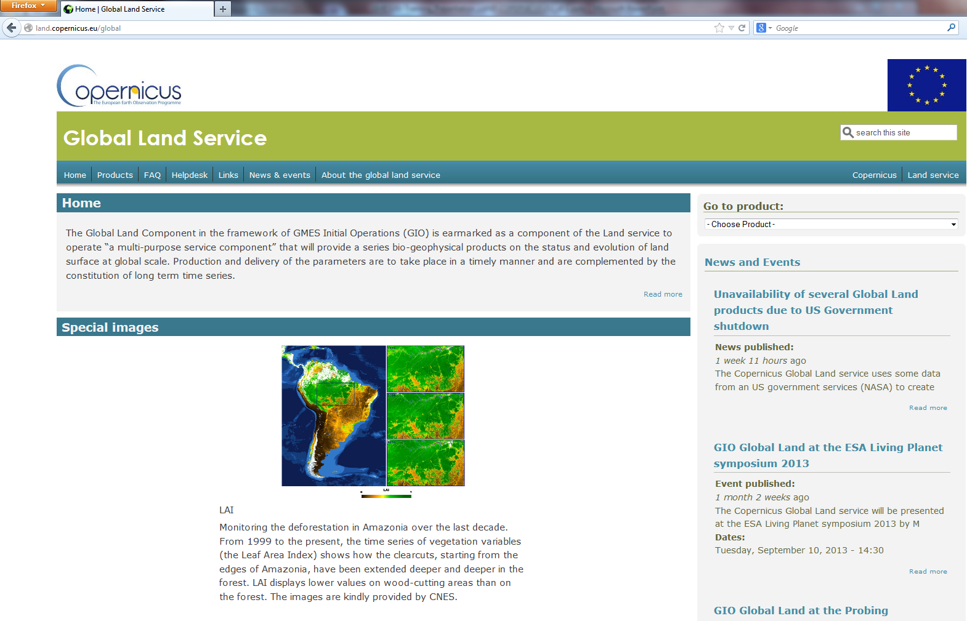
http://land.copernicus.eu/global
http://land.copernicus.eu/global/?q=/sites/default/files/g2_BIOPAR_LAI_global_2010-2011_QL_animation_fast.gif
Notes:
Global Land entry point to access the data

Slide 6
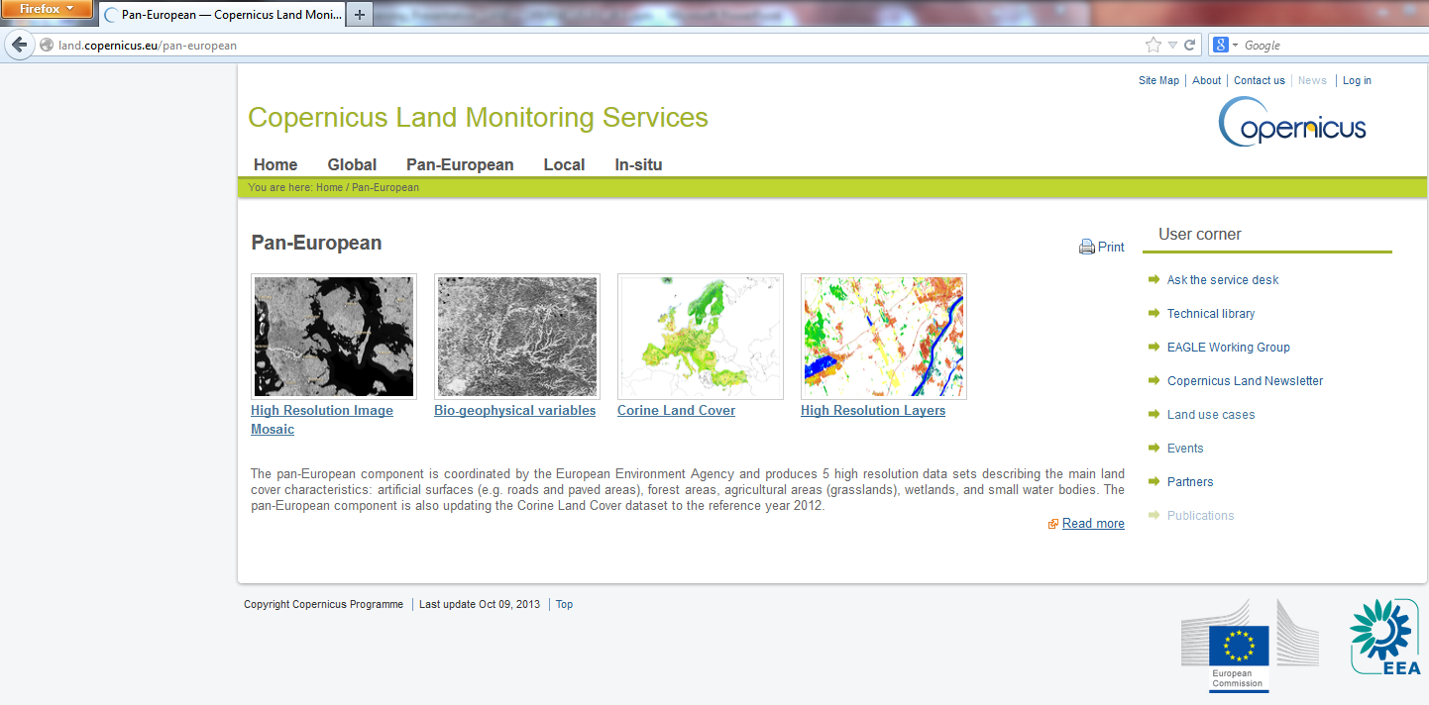
land.copernicus.eu/paneuropean/
Notes:
PAN EU entry point

Slide 7
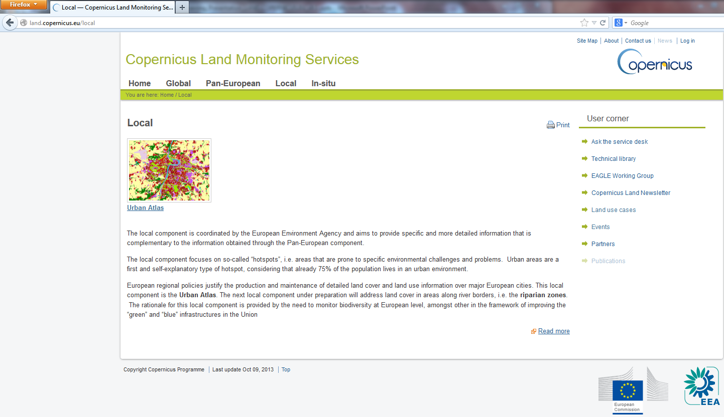
land.copernicus.eu/local/
Notes:
Entry point for Local Component

Slide 8
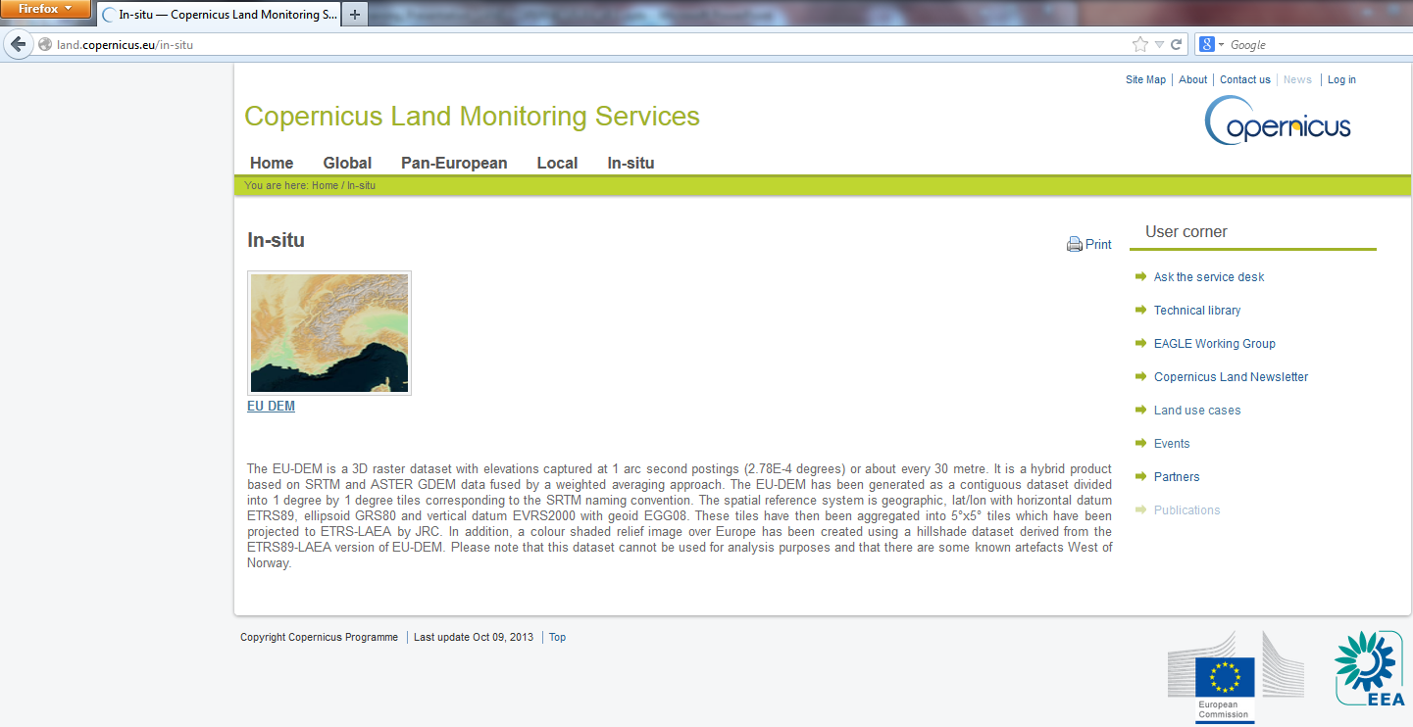
Land.copernicus.eu/in-situ/
Notes:
Entry point in-situ component

Slide 9
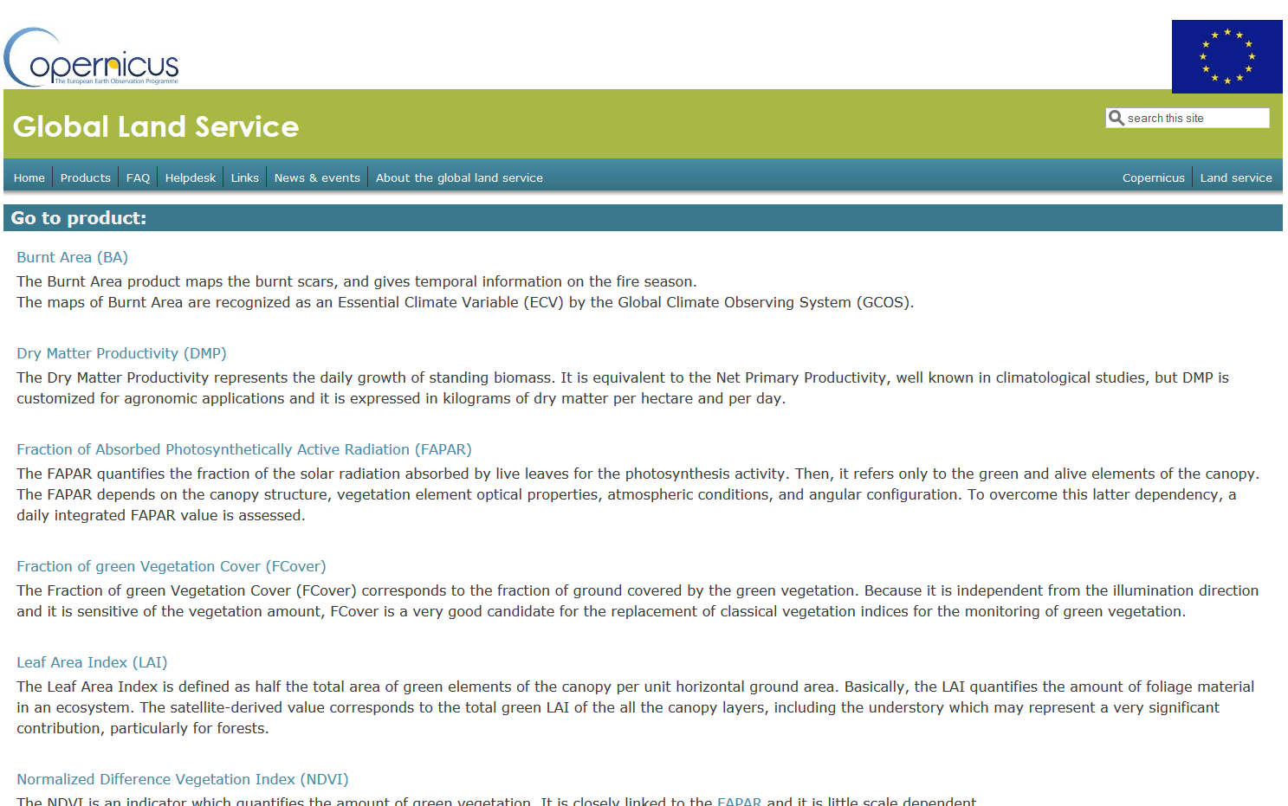
Portal Introduction / Access
Technical Descriptions on Parameter
Notes:
Global Land products overview and description

Slide 10
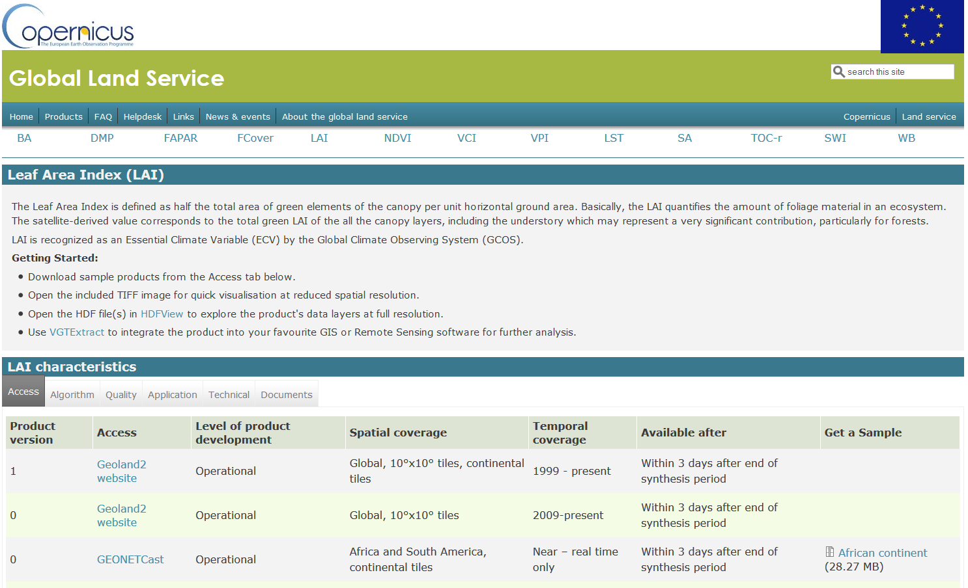
Portal Introduction / Access
Technical Descriptions on Parameter
Link to further data or alternative way to access data
Notes:
Description of technical details e.g. LAI

Slide 11
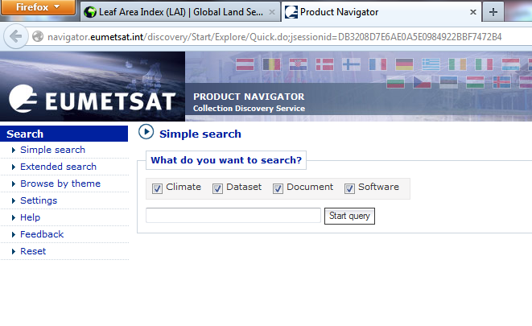
EUMETCast Alternative Access
Alternative way to access data expecially in the atmosphere / weather domain and
in the future for the Sentinel 3-5.
Notes:
EUMETSAT:
1. Alternative way to access data expecially in the atmosphere / weather domain and
2. In the future for the Sentinel 3-5.

Slide 12
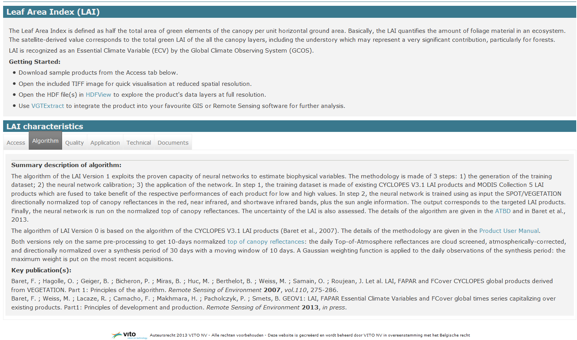
Documentation of products
Link to viewer / Free software to access and view the data
Link to handbooks and product descriptions
Short information on all relevant issues on the Index / Parameter

Slide 13
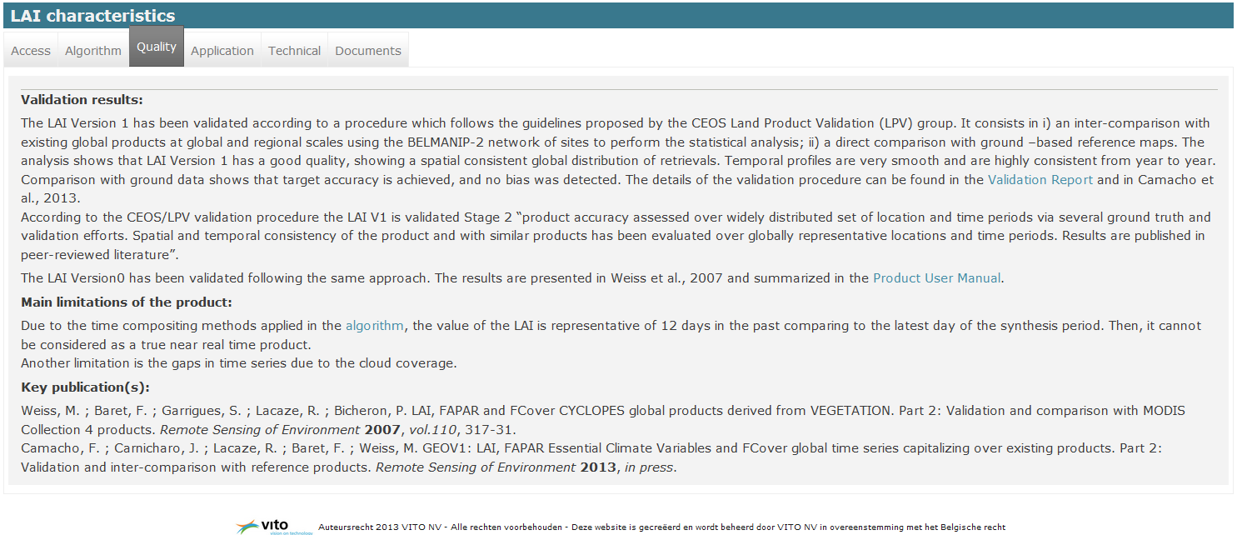
Quality Information
Quality Information provided
Link to validation report
Notes:
Quality Information on the Index / Parameter

Slide 14


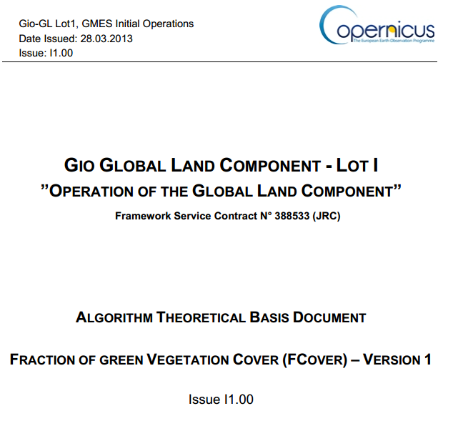
Products Documentation
Documentation for all Products:
Products User Manual(s)
Validation Report(s)
Algorithm Theoretical Basis Document

Slide 15
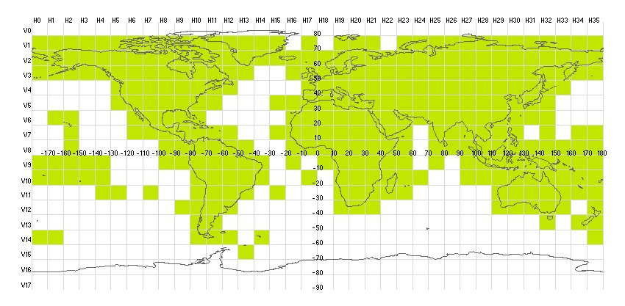
Default deliverables of Global Products
Continental coverages
Source. Vito / Hygeos Pres.
EARSC Workshop, Brussels,
26/09/2013

Slide 16
Default Product Deliverables
Variable | Temporal Coverage | Temporal resolution | Format | Default ROI
LAI/FAPAR/FCover | 1999 – present | 10 days | HDF | 10°Tiles, Continents, ~Countries
NDVI/VCI/VPI | 1999 – present | 10 days | HDF | 10°Tiles, Continents, ~Countries
Dry Matter Productivity | 2009 – present | 10 days | HDF | 10°Tiles, Continents, ~Countries
Burnt Area | 1998 – present | 1 day | HDF | 10°Tiles, Continents, ~Countries
TOC Reflectance | 2013 – present | 10 days | HDF | 10°Tiles, Continents
Surface Albedo | 1999 – present | 10 days | HDF | 10°Tiles, Continents
Land Surface Temperature | 2009 – present | 1 hour | HDF | 10°Tiles
Soil Water Index | 2007 – present | 1 day | HDF | Globe
Water bodies | 1999 – present | 10 days | GTiff | 10°Tiles, Continents, ~Countries
Source. Vito / Hygeos Pres.
EARSC Workshop, Brussels,
26/09/2013

Slide 17
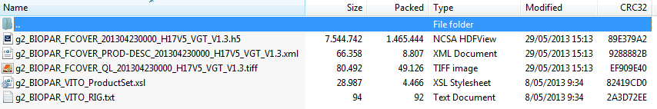
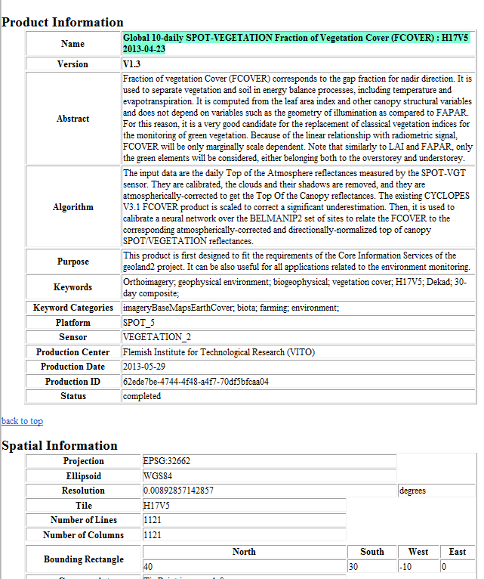
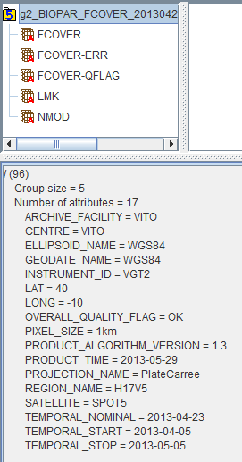
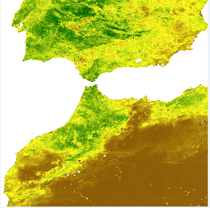

Content of Products
Tools:
hdf
gdal
vgtExtract
Source. Vito / Hygeos Pres.
EARSC Workshop, Brussels,
26/09/2013

Slide 18
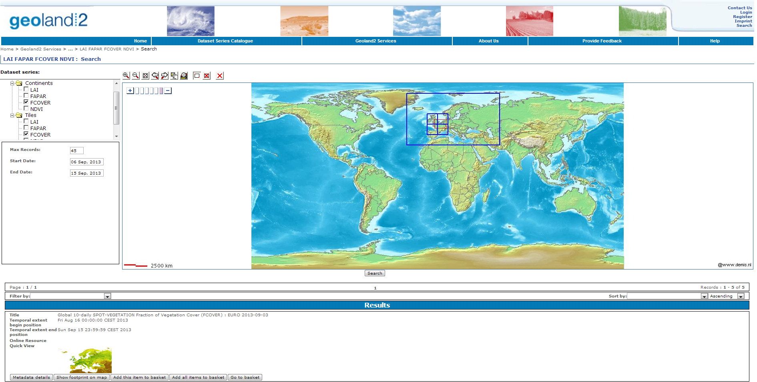
GL: FTP download (intermediate solution)
Continental Tiles and 10°x10° Tiles
Source. Vito / Hygeos Pres.
EARSC Workshop, Brussels,
26/09/2013

Slide 19

GL Application Fields
Weather forecast & Climate change
Carbon flux forecast
Agriculture:
Crop monitoring
Yield forecasting
Health conditions
Monitoring extreme events
Flooding and droughts
Frost conditions
Heat waves
Hydrology
Water management
River discharge

Slide 20
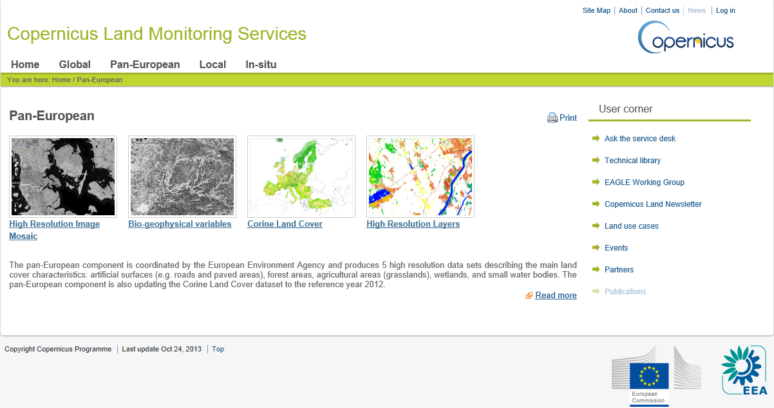
Pan-European Products
Notes:
To include detailed description of demonstrations that will make up training. This is to include screenshots of portals/products/services etc as it will be presented during the training. (NOTE: These slides will be deleted prior to training delivery and are intended to inform EC of training content only)
Remember to keep in mind the objectives by completing the following:
Objectives:
Targeted End Users:
Expected Outcome:
User benefits:

Slide 21
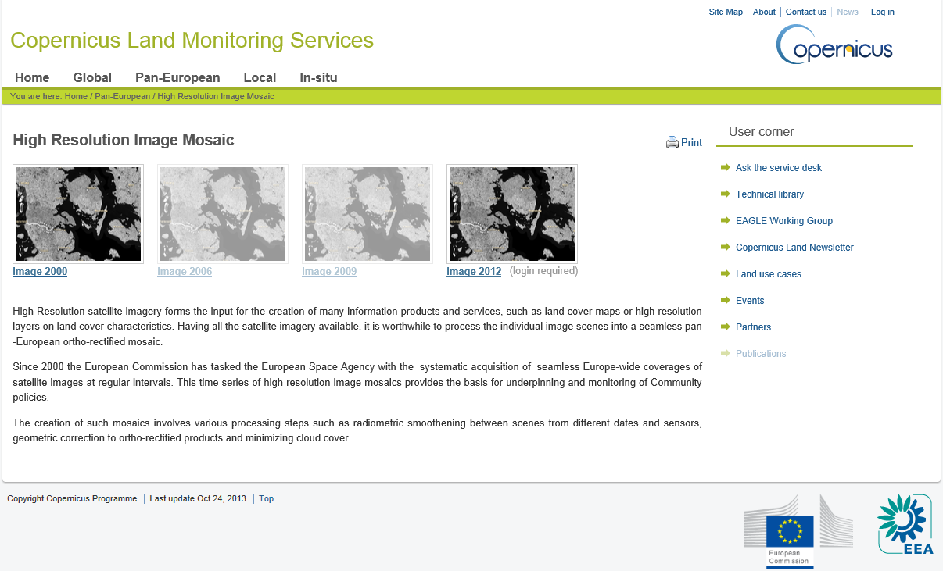
Pan-European: Image Products
Notes:
To include detailed description of demonstrations that will make up training. This is to include screenshots of portals/products/services etc as it will be presented during the training. (NOTE: These slides will be deleted prior to training delivery and are intended to inform EC of training content only)
Remember to keep in mind the objectives by completing the following:
Objectives:
Targeted End Users:
Expected Outcome:
User benefits:

Slide 22
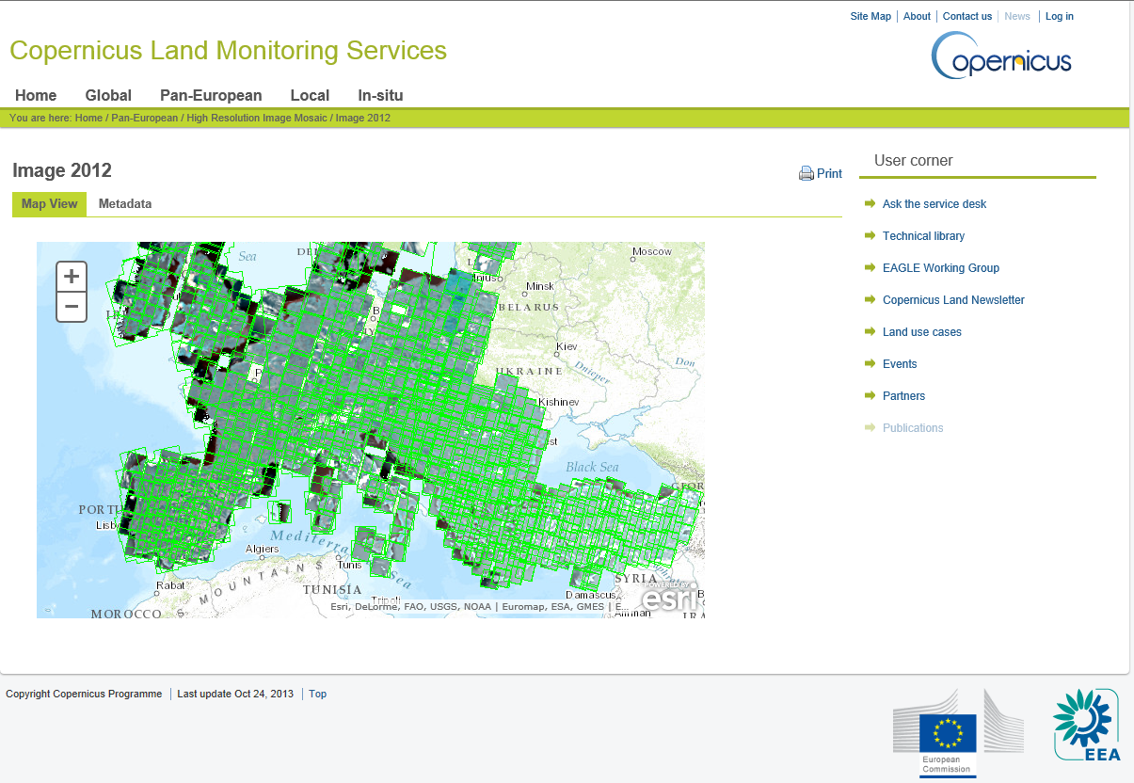
Pan European: Image 2012
Image 2012: Data Access (password required due to licenses)

Slide 23
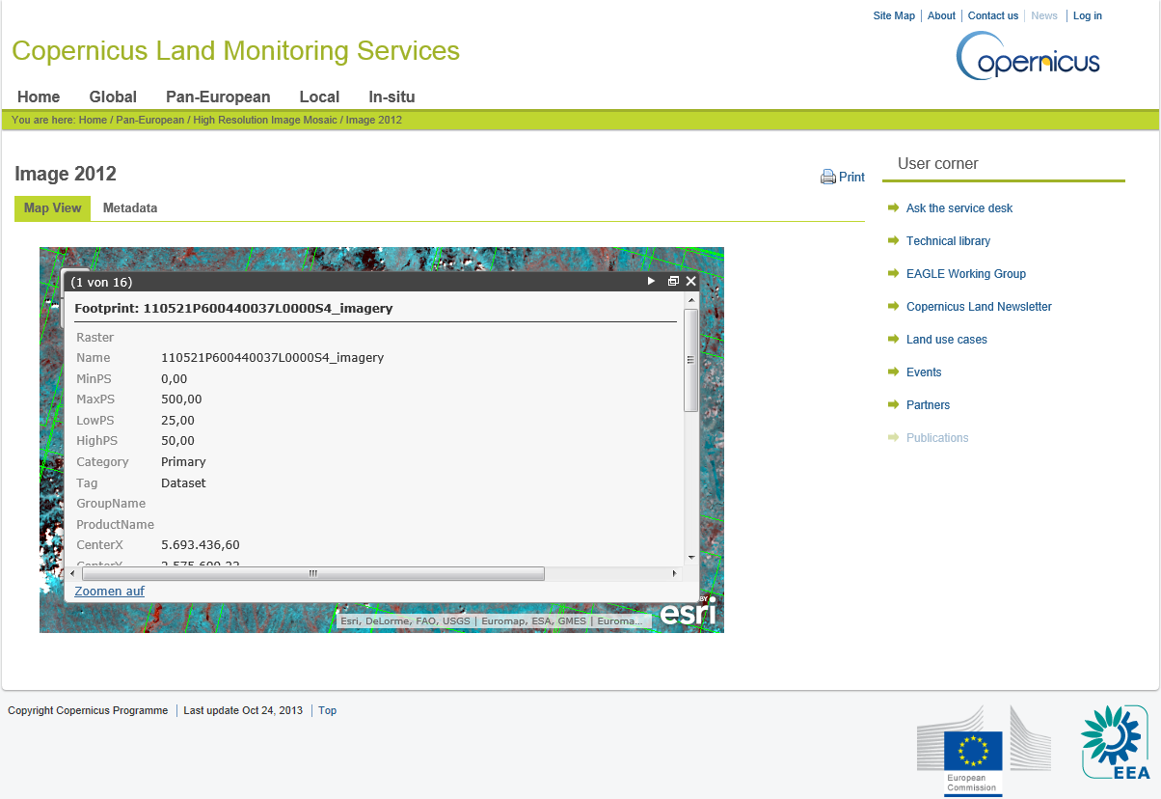
Pan European: Image 2012 Metadata
Notes:
To include detailed description of demonstrations that will make up training. This is to include screenshots of portals/products/services etc as it will be presented during the training. (NOTE: These slides will be deleted prior to training delivery and are intended to inform EC of training content only)
Remember to keep in mind the objectives by completing the following:
Objectives:
Targeted End Users:
Expected Outcome:
User benefits:

Slide 24

Pan European: NDVI
Notes:
To include detailed description of demonstrations that will make up training. This is to include screenshots of portals/products/services etc as it will be presented during the training. (NOTE: These slides will be deleted prior to training delivery and are intended to inform EC of training content only)
Remember to keep in mind the objectives by completing the following:
Objectives:
Targeted End Users:
Expected Outcome:
User benefits:

Slide 25
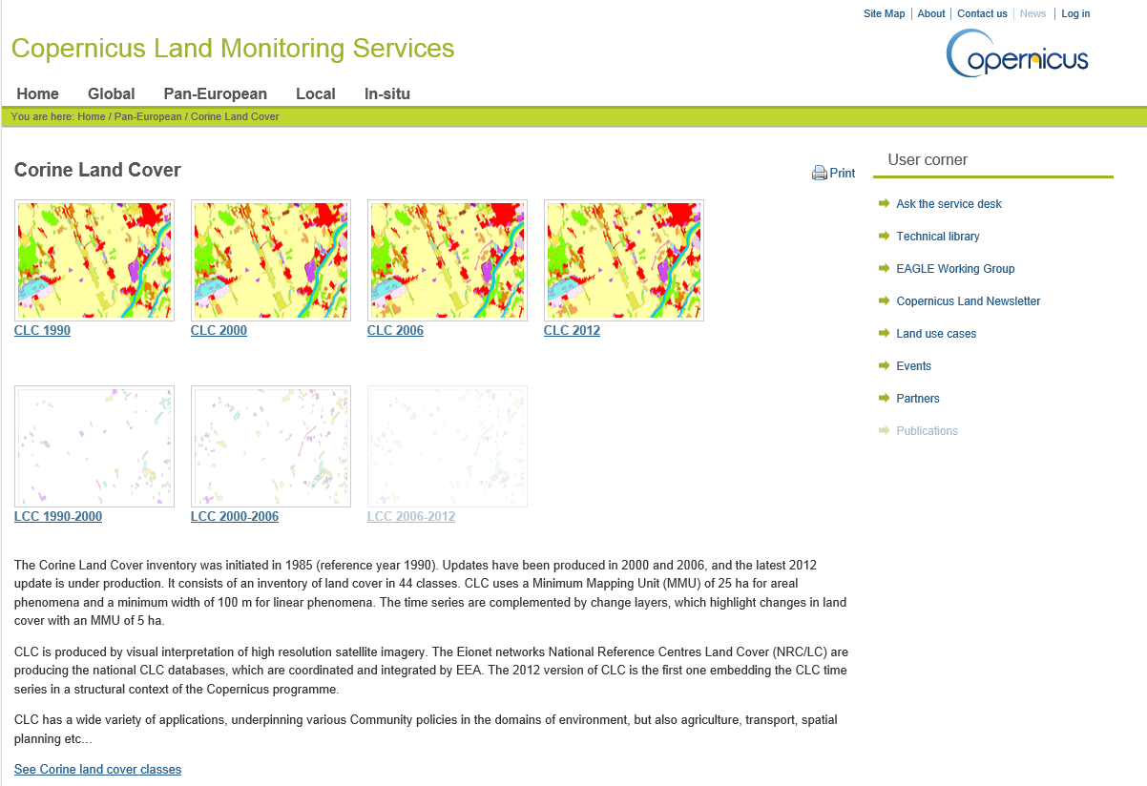
Pan European: CORINE LAND COVER
Notes:
To include detailed description of demonstrations that will make up training. This is to include screenshots of portals/products/services etc as it will be presented during the training. (NOTE: These slides will be deleted prior to training delivery and are intended to inform EC of training content only)
Remember to keep in mind the objectives by completing the following:
Objectives:
Targeted End Users:
Expected Outcome:
User benefits:

Slide 26
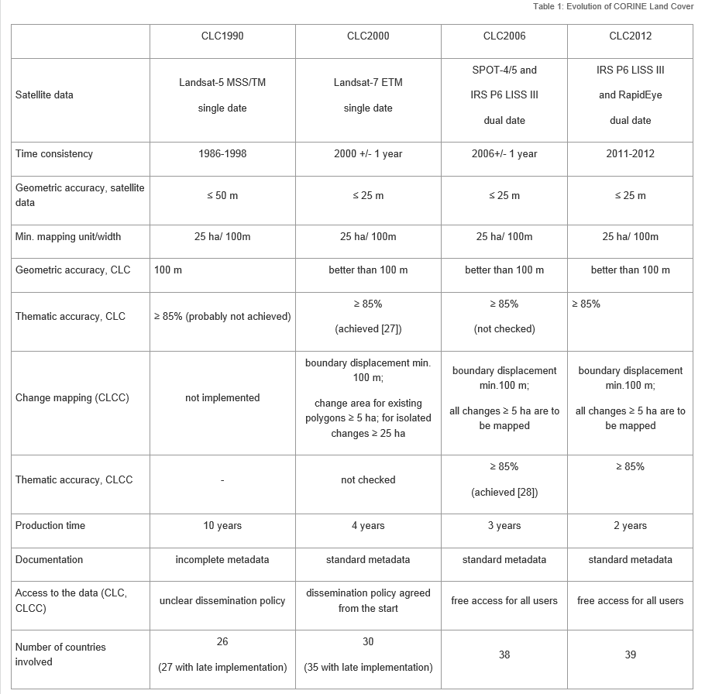
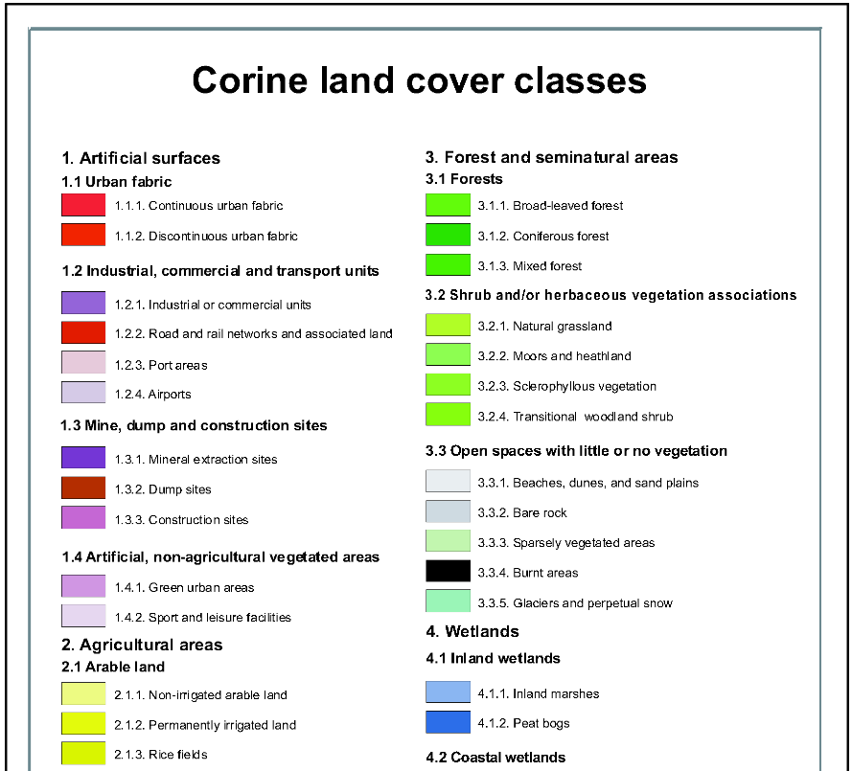
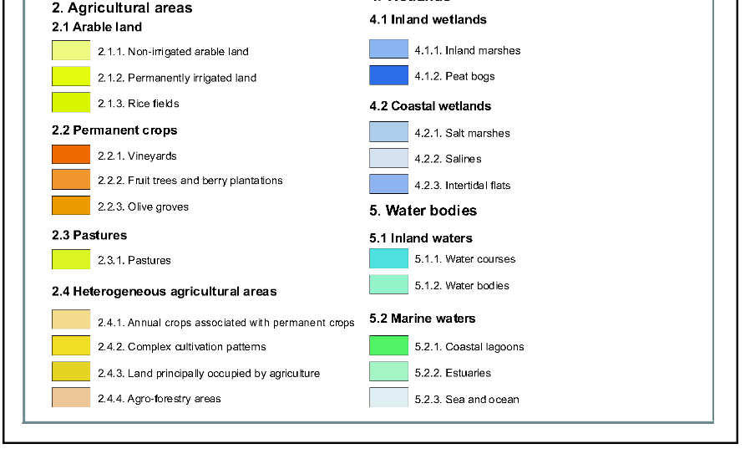
Pan European: CORINE LAND COVER
Notes:
To include detailed description of demonstrations that will make up training. This is to include screenshots of portals/products/services etc as it will be presented during the training. (NOTE: These slides will be deleted prior to training delivery and are intended to inform EC of training content only)
Remember to keep in mind the objectives by completing the following:
Objectives:
Targeted End Users:
Expected Outcome:
User benefits:

Slide 27
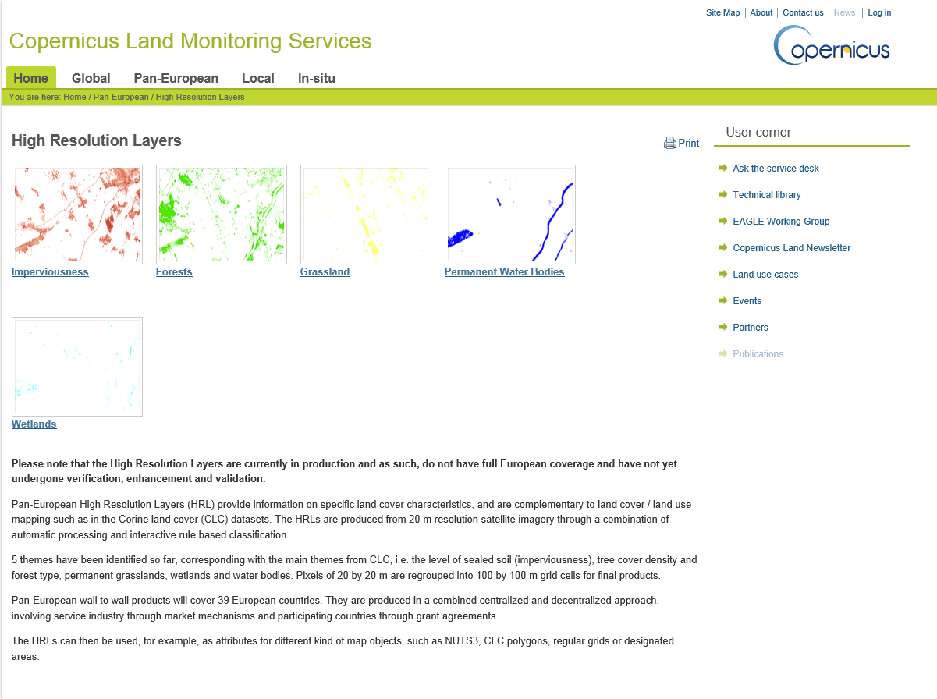
Pan European: High Resolution Layers
Notes:
To include detailed description of demonstrations that will make up training. This is to include screenshots of portals/products/services etc as it will be presented during the training. (NOTE: These slides will be deleted prior to training delivery and are intended to inform EC of training content only)
Remember to keep in mind the objectives by completing the following:
Objectives:
Targeted End Users:
Expected Outcome:
User benefits:

Slide 28
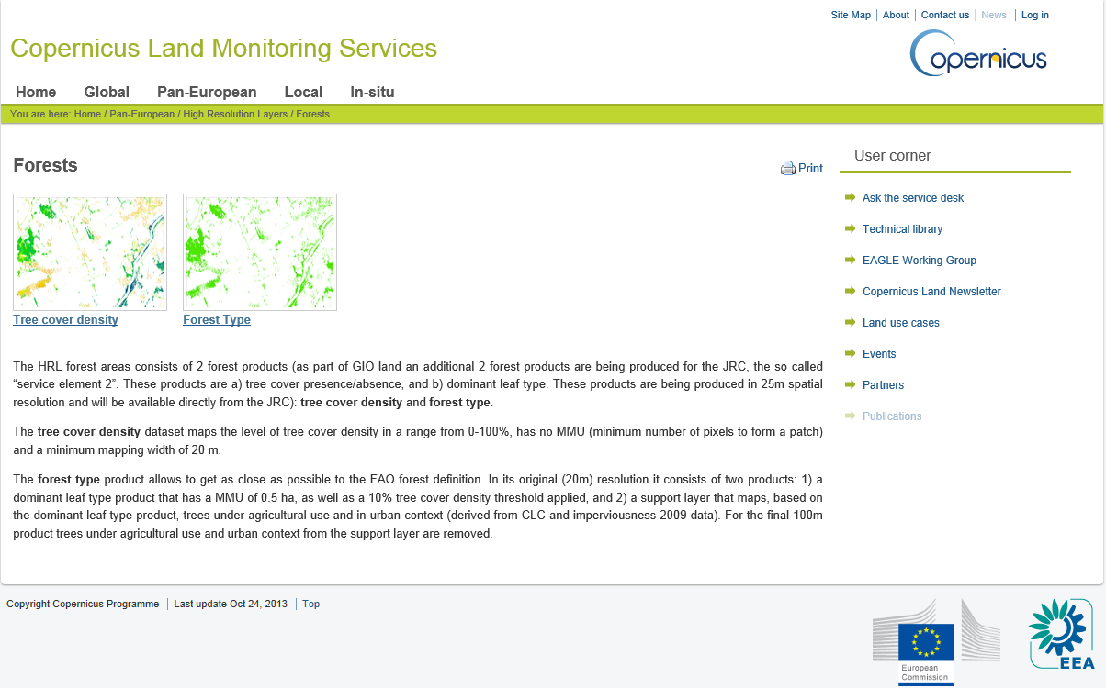
Pan European: HR Forest Layers
Notes:
To include detailed description of demonstrations that will make up training. This is to include screenshots of portals/products/services etc as it will be presented during the training. (NOTE: These slides will be deleted prior to training delivery and are intended to inform EC of training content only)
Remember to keep in mind the objectives by completing the following:
Objectives:
Targeted End Users:
Expected Outcome:
User benefits:

Slide 29
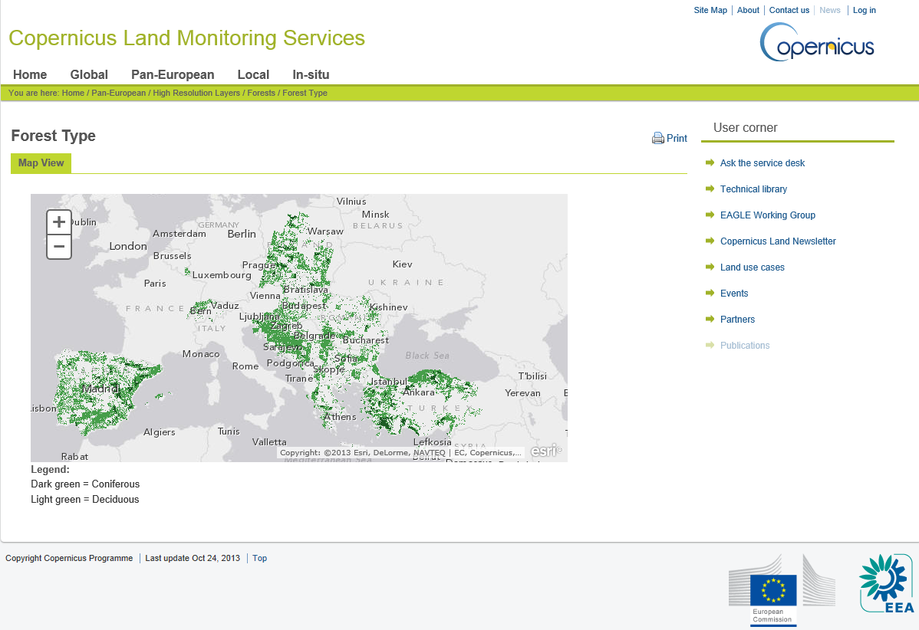
Pan European: HR Forest Type
Notes:
To include detailed description of demonstrations that will make up training. This is to include screenshots of portals/products/services etc as it will be presented during the training. (NOTE: These slides will be deleted prior to training delivery and are intended to inform EC of training content only)
Remember to keep in mind the objectives by completing the following:
Objectives:
Targeted End Users:
Expected Outcome:
User benefits:

Slide 30
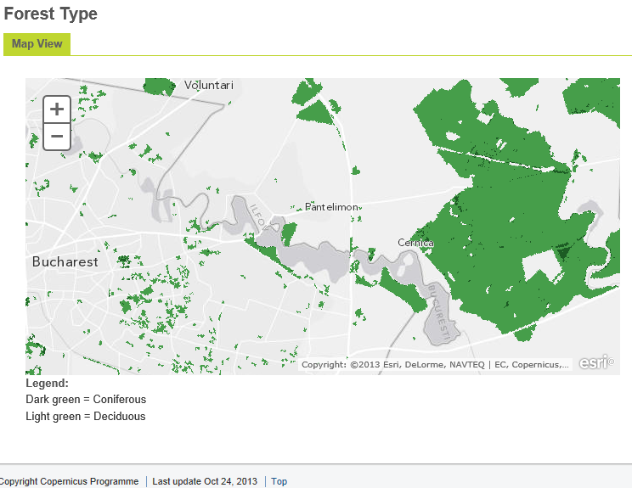
Pan European: HR Forest Type
Notes:
To include detailed description of demonstrations that will make up training. This is to include screenshots of portals/products/services etc as it will be presented during the training. (NOTE: These slides will be deleted prior to training delivery and are intended to inform EC of training content only)
Remember to keep in mind the objectives by completing the following:
Objectives:
Targeted End Users:
Expected Outcome:
User benefits:

Slide 31
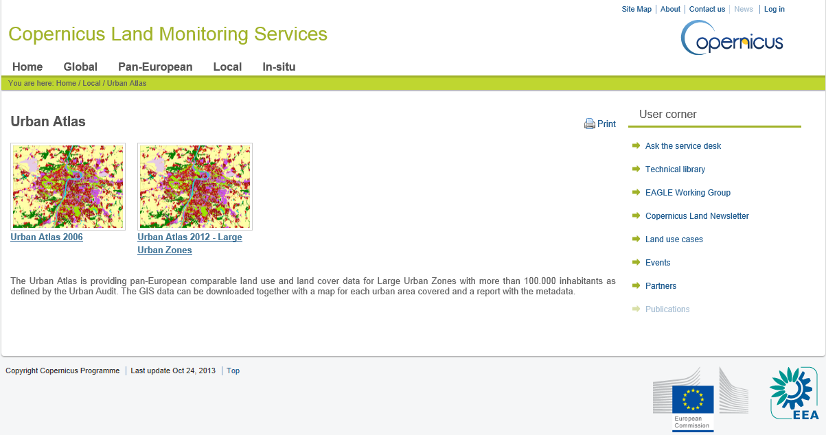
Local: Urban Atlas
Notes:
To include detailed description of demonstrations that will make up training. This is to include screenshots of portals/products/services etc as it will be presented during the training. (NOTE: These slides will be deleted prior to training delivery and are intended to inform EC of training content only)
Remember to keep in mind the objectives by completing the following:
Objectives:
Targeted End Users:
Expected Outcome:
User benefits:

Slide 32
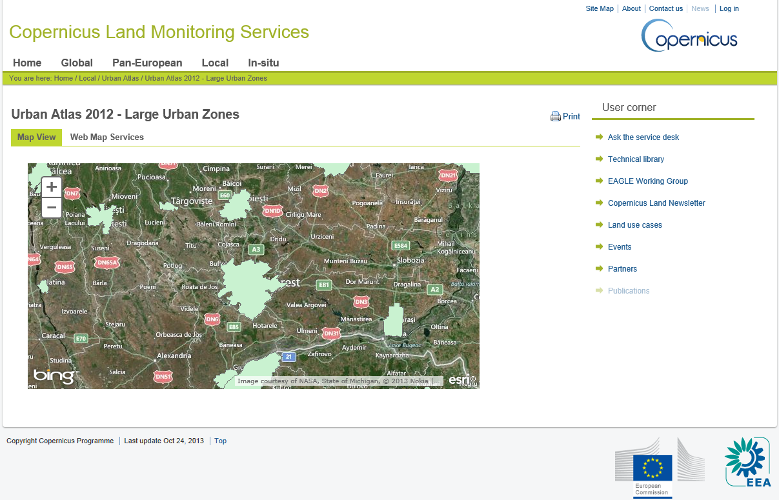
Local: Urban Atlas
Notes:
To include detailed description of demonstrations that will make up training. This is to include screenshots of portals/products/services etc as it will be presented during the training. (NOTE: These slides will be deleted prior to training delivery and are intended to inform EC of training content only)
Remember to keep in mind the objectives by completing the following:
Objectives:
Targeted End Users:
Expected Outcome:
User benefits:

Slide 33
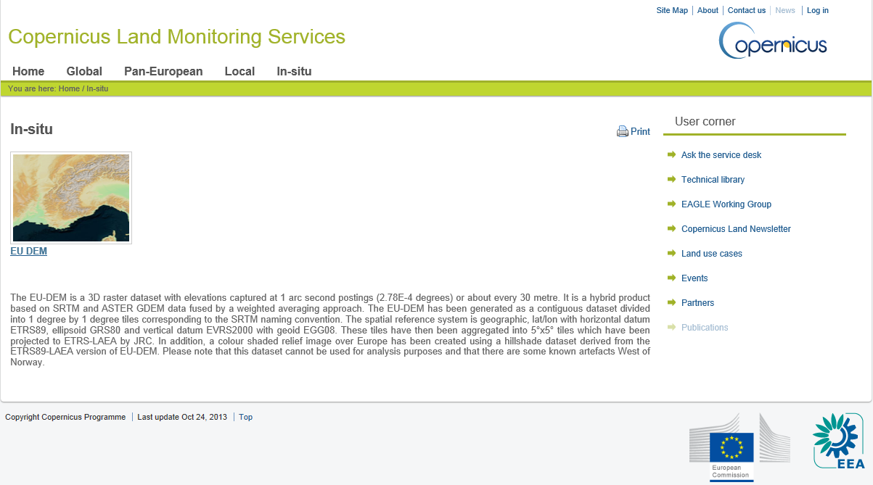
In Situ: EU DEM (30m)

Slide 34
Feedback Forms
&
Questions
Notes:
Feedback forms will be distributed and people will be encouraged to complete them in this time.
Open floor up to questions.

