Slide 1
Downstream Services for Sub-National Forest Administrations based on COPERNICUS HR Forest Layer
Service Development – Landesforst Thüringen
Thomas Kukuk, Dr. Gernot Ramminger
Bucharest, Romania - Copernicus User Uptake Event
7th-8th November

Slide 2
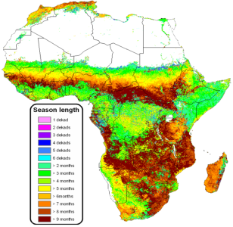
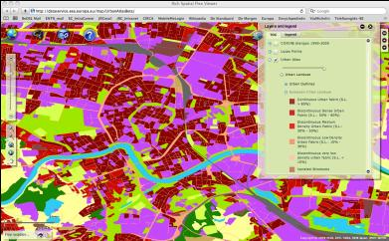
GIO-Land Components
  Global → JRC
  bio-physical parameters (Essential Climate Variables (ECVs), food security (Africa) etc.)
  Continental → EEA
  pan-European products (Corine LC 2012, five HRLs: imperviousness, forest, grassland, wetland, water)
  Local → EEA
  zooming on ‘hot spots’ (e.g. urban atlas, riparian areas,..)
Global component
EU component
Local component
Reference: European Environment Agency

Slide 3

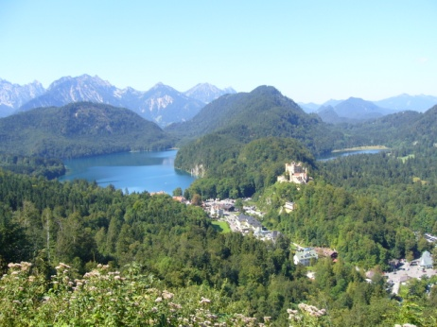
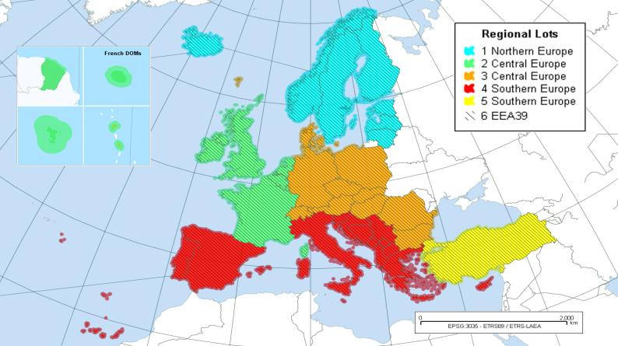



GMES Initial Operations – Land Services: High-Resolution Layers
Operational implementation 2011-2014 contracted by the European Environment Agency (EEA) to industrial consortia
Mapping of 5 thematic „High-Resolution Layers“ of land cover for all of Europe from high-resolution optical EO data
The GIO-Land services cover altogether 5.8 mio km² = 39 countries (EU-27 + collaborating states + EEA member states)
GAF and partners are mapping the High-Resolution Forest and Imperviousness Layers for 20 countries in West, Central, East and Southeastern Europe
Ref.: EEA

Slide 4
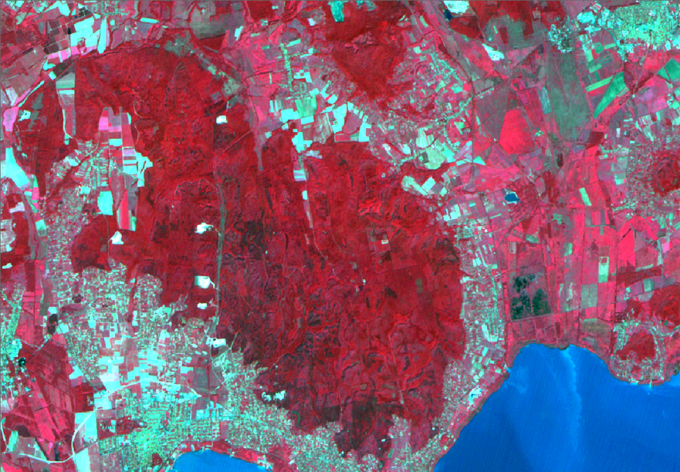
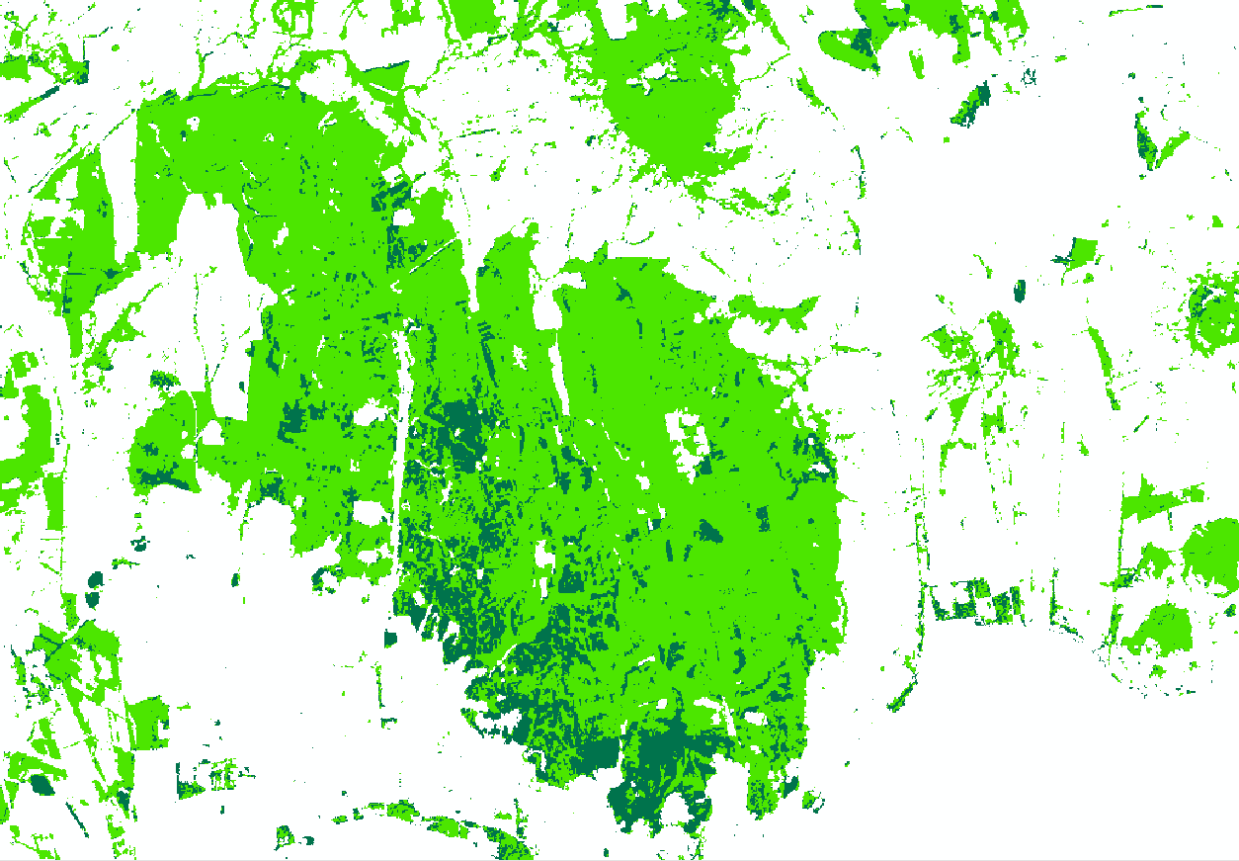
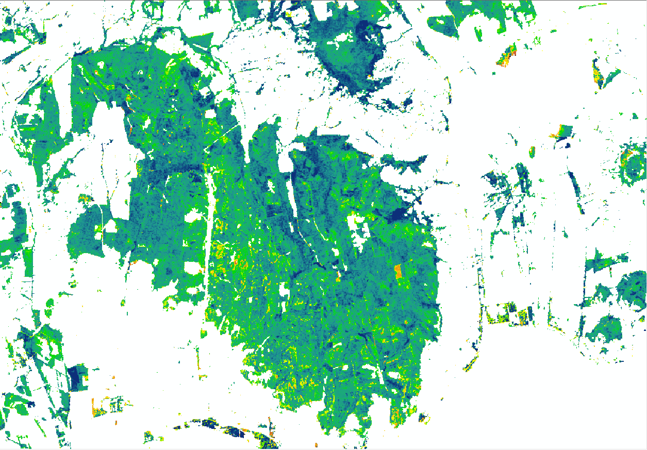
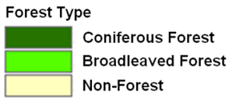


GIO-Land Product Examples
Zoom Level 1 – Scale 1:200,000
IRS-LISS III (18.08.2011)
Produced using products © Antrix Corporation Limited 2011. Distribution by Euromap GmbH, Germany, all rights reserved. Provided under EC/ESA GSC-DA.
Forest Type (Deciduous / Coniferous) 2012 (20m)
Tree Cover Density2012 (20m)
Producer:
Vonyarcvashegy / Balaton, HU

Slide 5

GIO-Land Product Examples
Zoom Level 2 – Scale 1:100,000
Produced using products © Antrix Corporation Limited 2011. Distribution by Euromap GmbH, Germany, all rights reserved. Provided under EC/ESA GSC-DA.
Forest Type 2012 (20m)
Vonyarcvashegy / Balaton, HU
Producer:
Tree Density 2012 (20m)

Slide 6
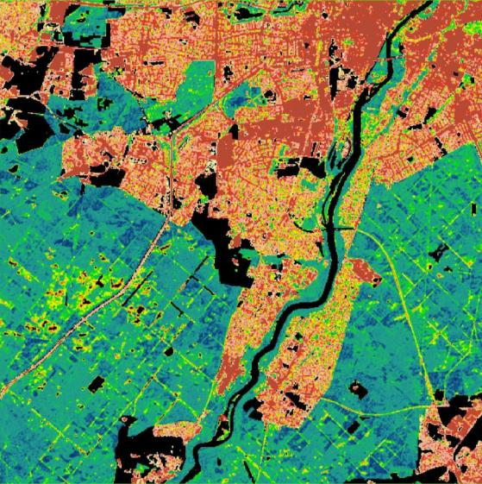
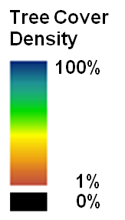
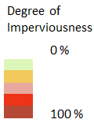
GIO-Land Product Examples
Example Core Layer: MUNICH
Combination Tree Cover Density / Imperviousness Degree
Tree Cover Density
Imperviousness Degree
Produced using products © Antrix Corporation Limited 2009. Distribution by Euromap GmbH, Germany, all rights reserved. Provided under EC/ESA GSC-DA.

Slide 7
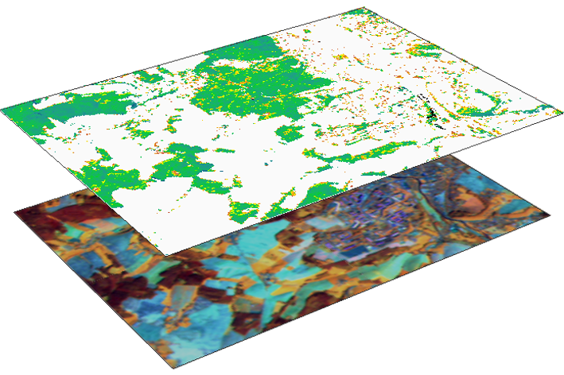
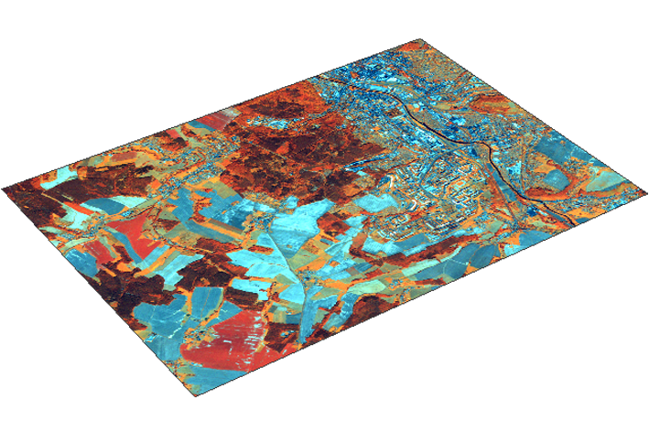
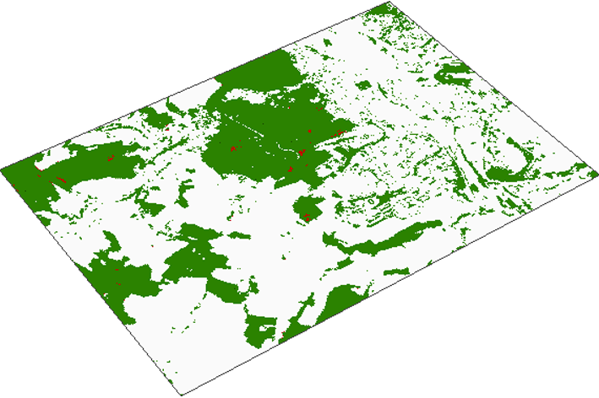
Forest Downstream Concept
COPERNICUS Core Services
  Available on European scale
  HR Forest Layer (Tree Cover Density in %, Forest Types)
  Satellite data (Image 2006 - 2012, IRS, AWiFS, SPOT, etc.)
Event-based data
  Satellite data after event (storm, snow, fire, forest management activities,...)
  Additional data (regional/national DEMs, Forest Borders, User Forest GIS, Topographic Maps,...)
Forest Downstream Services
  Tailor-made Downstream solution
  Assessment of changes/damages based on user requirements (rapid mapping, detailed assessment)
  INSPIRE compliant data provision

Slide 8

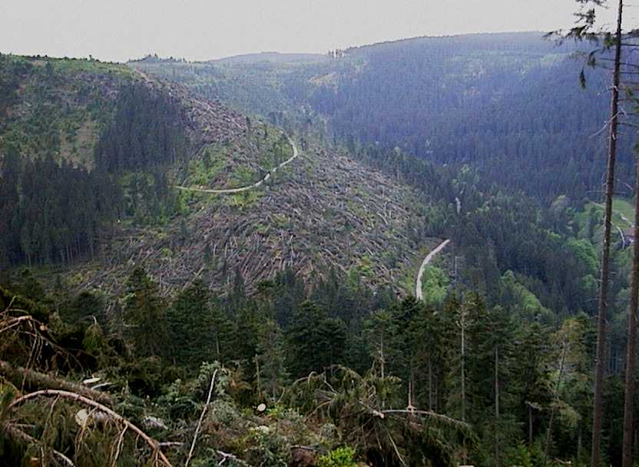
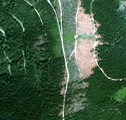
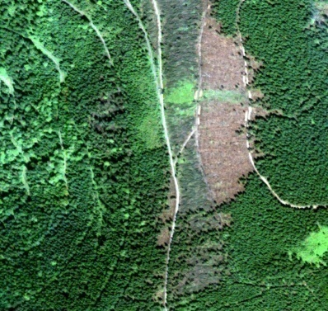
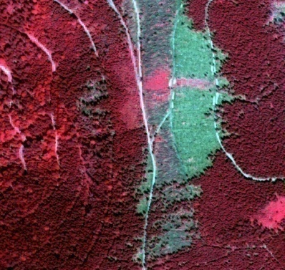
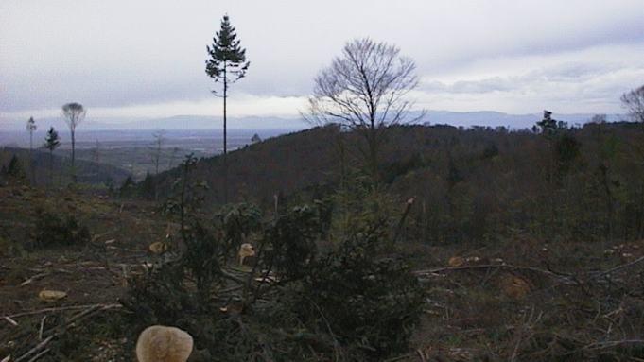
EUFODOS
Design, Development and Implementation of Downstream Services in the field of Forest Damages and Forest Structures on sub-national and regional level
© G. Ramminger
GAF responsible for the development and implementation of a satellite based system to assess storm damaged forest areas and area changes due to Forest Operations
Earth Observation based assessment of Storm damaged forest areas

Slide 9
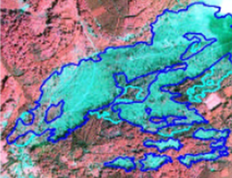
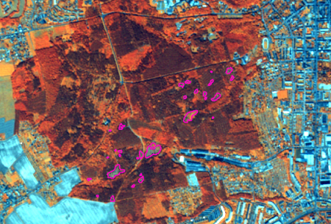
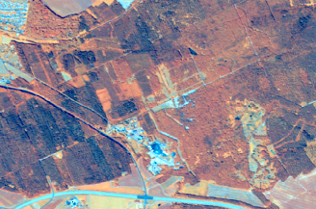
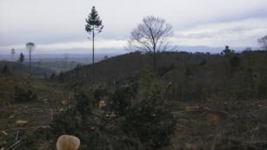
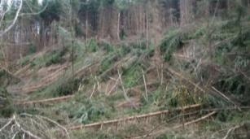
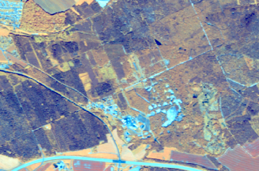
Downstream Services
Consolidated Downstream Services
Development in Progress
Non-Rush Service - Damage Assessment
Assessment of Changes due to Forest Operations
Rush Service - Damage Assessment
on request and/or
2 weeks to 2 months after EO data acquisition
MMU: 0.2 to 0.3 ha
Thematic Acc: > 90%
Geometric Acc: 5 to 10m
on request
1-2 months after EO data
acquisition
MMU: 0.2 to 0.3 ha
Thematic Acc: > 90%
Geometric Acc: 10m
3-5 days after EO image acquisition
MMU: 3 ha
Thematic Acc: > 90%
Geometric Acc: 30m
IKONOS multispectral
RapidEye data, 2012
RapidEye data, 2011
© G. Ramminger
© J. Ermert, FeLis, Univ. Freiburg
RapidEye data, 2013

Slide 10
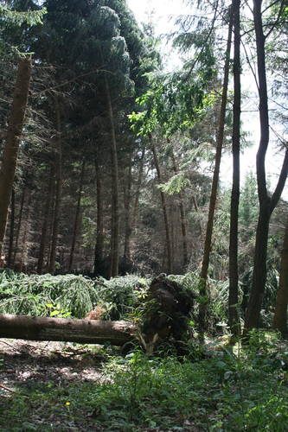
Non-Rush Service – Tornado near Gera
On 5th July 2012 a tornado caused damages in a forest near the City of Gera in Thuringia (Germany) and around 20 ha of an urban forest area was affected by this event
In consultation with the EUFODOS User ThüringenForst, the “Non-Rush Damage Assessment Service” had been activated
Source: www.otz.de

Slide 11
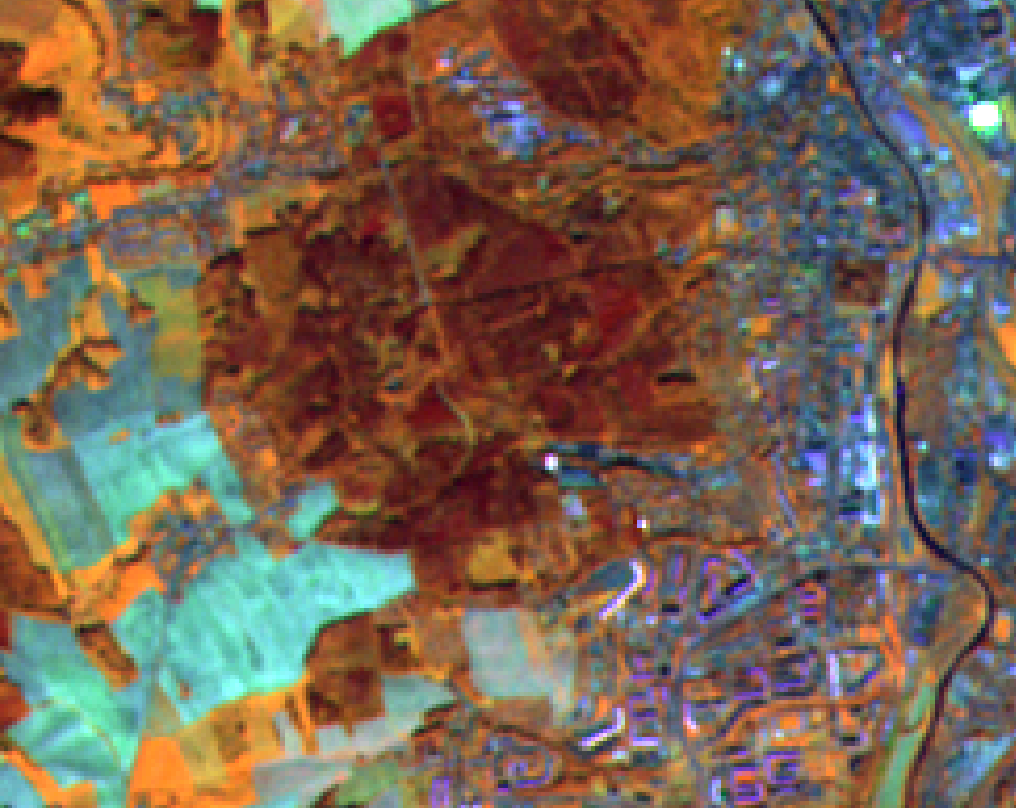
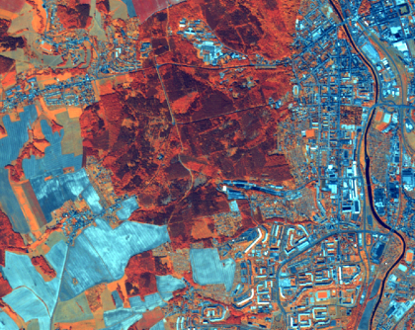
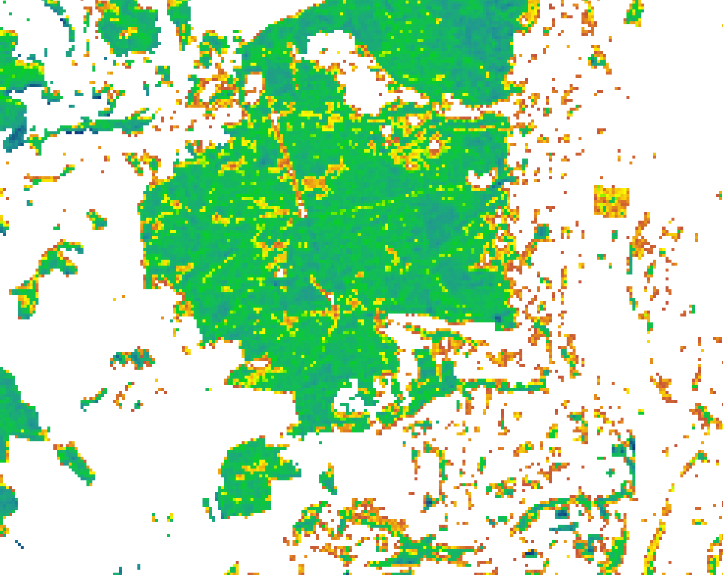
Non-Rush Service – Tornado near Gera
Data acquisition and Preparation
  EO Data
    Core Data (Image 2009 based on
    IRS) from 04.10.2010
    RapidEye data from 24.07.2012
  Additional data
    DEM (ortho-correction)
    HR Forest Core Layer:
    Tree Cover Density Product
    (based on Image2009)
    Forest GIS (Thuringia)
© RapidEye (2012);
Antrix Corporation Limited 2009 - distribution by Euromap GmbH,
Germany, all rights reserved. Provided under EC/ESA GSC-DA.

Slide 12


Non-Rush Service – Tornado near Gera
Processing
  EO Data Pre-Processing
    Input data quality Check
    Geometric correction of
    RapidEye data to Image 2009
    (below 20m)
    Radiometric/Topographic
    pre-processing not necessary
  Thematic Processing
    Segmentation (eCognition)
    based classification (difference
    image) of potential
    damaged forest areas
    Inclusion of Tree Cover Density
    and Forest Cover
    Reduction of wrong classified elements
    Manual enhancement
© RapidEye (2012);
Antrix Corporation Limited 2009 - distribution by Euromap GmbH,
Germany, all rights reserved. Provided under EC/ESA GSC-DA.

Slide 13
Non-Rush Service – Tornado near Gera
Delivery
  Via E-Mail/FTP/WMS
    AOI
    RapidEye data (as GeoTif)
    Image 2009 (as GeoTif)
    Results as Shapefile
    INSPIRE compliant
    Metadata
Accuracy Assessment
  Field work done by ThüringenForst in June 2013
  Overall Accuracy: 96%
© RapidEye (2012);
Antrix Corporation Limited 2009 - distribution by Euromap GmbH,
Germany, all rights reserved. Provided under EC/ESA GSC-DA.

