Slide 1
MARINE TEST CASE #2
Added value product for coastal ecosystem assessment
Bucharest, 7th–8th November 2013
Andrea Taramelli, Emiliana Valentini, Federico Filipponi, ISPRA
User Awareness & Training

Slide 2
Contents
  Users requirements analysis
  Overview of GMES/COPERNICUS and EO products for coastal ecosystem analysis
Test Case #2: ‘Added value products for coastal ecosystem analysis’
Applications of Test Case #2
  Marine biophysical parameters
  Coastal habitat mapping

Slide 3
Introduction
Context: For the decision and policy makers knowledge about coastal ecosystems, response to variations in external conditions and the degree to which a system is able to cope with adverse effects, is mandatory. In order to consolidate and improve existing monitoring approaches in Europe and help to identify and address gaps in currently available data and information, specific tools to support decisions are available from the context of EO and GMES/Copernicus.
Purpose: Test Case #2 shows how added value products for coastal ecosystem analysis can be obtained by integrating COPERNICUS core observation products with other EO data and insitu measurements. Observing coastal dynamics means observing complex ecosystems with multi parameter interaction and their time- (long-term visions) and space- dependent dynamics. Appropriate governance (multi-purpose) and a sustainable approach requires the implementation of durable, repeatable and self-sustainable infrastructures as well as coaxes of infrastructures. Together these will be key for future data access and handling, outreach activities, training and cooperation between member states.
Notes:
The space sector has shown an exceptional dynamism, growing in real terms at around 9% a year since 1999, showing also, at national level, spin-offs at almost 5%. The Oxford Economics (2010), suggested that such spill-over effects amount research and technological investment that will generate a social return of around 70%.

Slide 4
Policy, best practice and management through
Copernicus services, EO data and insitu measurements
CE DIRECTIVES
NATURA 2000/EUNIS
WFD 2000/60
MSFD, ICZM, MSP
RISK AND MULTI RISK ASSENSEMNT
VULNERABILITY ANALYSIS
COPERNICUS
GIS DATABASE, MAPPING AND MODELING
PROTECTION,
CONSERVATION,
MANAGEMENT,
PLANNING
NATURAL CAPITAL
ECOSYSTEM SERVICES
IN - SITU
EARTH OBSERVATION
Notes:
The interaction between the knowledge stored into the databases and the real availability of them for coastal management is an historical question. There is the understanding that sharing information means sharing standardized products but at the present, countries are not at the same level of digitalization, mapping and modeling. Quite often, the local level is the major storage of databases and the trap of environmental information due to the low technical level of staff that is not able to follow the updates of the information systems and technologies. Copernicus is a tool to simplify data access and data use for policy makers and best practice implementation.

Slide 5

User Requirements from Lazio Region (Italy) Coastal Management Authority (Facecoast)
Are there any specific ‘coastal products’ in the Coastal & Marine themes of MyOcean/Copernicus portal?
What about the possibility of built up specific calculations on erosion/accretion trends of sandy coastal areas?
How can I understand if the water quality parameters (i.e. Chl or TSM etc.) are valid for scaling down to a local/coastal management scale?
What is the level of technical skill I have to request from my technical staff to access, visualize and if possible use Copernicus products?
Are there free tools to support the integration of EO data and Copernicus products to improve the scale and the value of spatial information?
Notes:
Regional authorities and the intermediate users involved in the ICZM framework and the maritime spatial planning highlight that Copernicus products could feed decision support tools. One of the question is the availability of observation products as wells as the coverage, the frequency and the overall quality.

Slide 6
User Requirements the IHO – The International Hydrographic Organisation
The group of HOs (Germany, France and Sweden) met in Brest on 2-3 October 2013 and were joined by Geological Survey Ireland (GSI) responsible for hydrographic surveys in coastal mapping; and Institute for Environmental Protection and Research (ISPRA, Italy), that is responsible for environmental protection and research.
They discussed the need for more high quality, seamless, interoperable, accessible data on coastal areas across Europe especially bathymetry and seabed mapping
In 2007 the EU blue book also recognized the need to take a step further towards the creation of a new European Marine Observation Network (EMODnet); in order to improve the availability of high quality data and for providing data on scales defined by the regions and sub-regions of the Marine Strategy Framework Directive. The overall objective is to migrate fragmented and inaccessible marine data into interoperable, continuous and publicly available data streams for complete maritime basins.
Notes:
Nevertheless both EUROSION and EMODnet (and other data-network like Seadatanet) doesn’t still gather data at such a detail to be really useful for planning purposes (ICZM and MSP) being mainly a storage of oceanographic information collected by research institutes.
MyOcean includes aspects related to outputs in an environmental policy context (such as the MSFD or ICZM) and exchange of best practice from users. In this regard, MyOcean User Workshop has been followed at the same venue by the "Monitoring Matters workshop" (10-11/04/2013) organized by the EEA, which marked an important phase in the GMES In-Situ Coordination (GISC) project. The Monitoring Matters workshop enhanced the dialogue within the member states. At this event stakeholders showed examples of Copernicus services and products to integrate space and in situ data and critique/current achievements in services and products uptake.

Slide 7
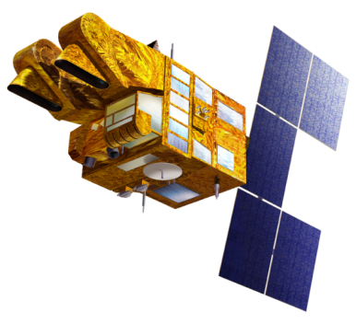
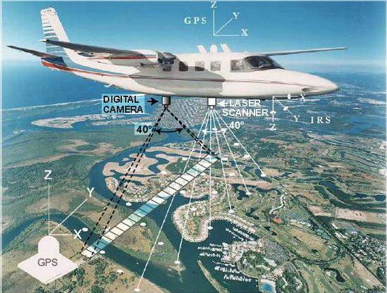
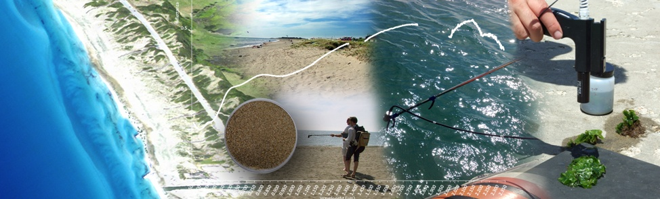
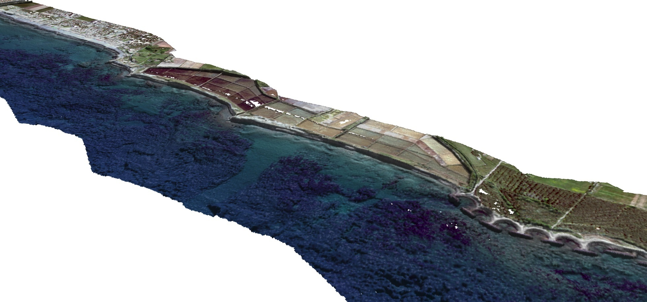
In situ Coordination
The strategy of combining high and very high resolution spectral measurements in a multisensory and multi resolution analysis. This includes different ways of data fusion to assimilate spectral and spatial variability in complex coastal mapping and modeling.
Notes:
In situ coordination (i.e airborne) requires funding for standardization and publication of data and analysis. In this way ground truth and validation of Copernicus and EO data/products can be applied in the monitoring activities of environmental regional agencies. Institutes as ISPRA can provide guidelines and alerts about the monitoring and good environmental status implementation through the European strategies context. On the other side small and medium enterprises can benefit from an enhanced use of EO products.

Slide 8
User Requirements from Santander HI
Can I use MyOcean services to have a quick overview of the physical parameters (i.e. wind direction and intensity) on a specific date? Or to study the seasonal trend in view of exploitation through multi use platforms?
Can I have coastal habitat classification starting from MyOcean products? What do I need to add to these products to obtain updated classification in transitional environment where I have very high level of protection directives from EU?
GMES/Copernicus services should be fully and openly accessible within the restrictions imposed by the overall legal and policy framework (e.g. security issues). This is in line with the principles of the European Shared Environmental Information System (SEIS), and Global Earth Observation System of Systems (GEOSS) initiatives to promote the widest possible sharing and use of Earth observation data and information.

Slide 9
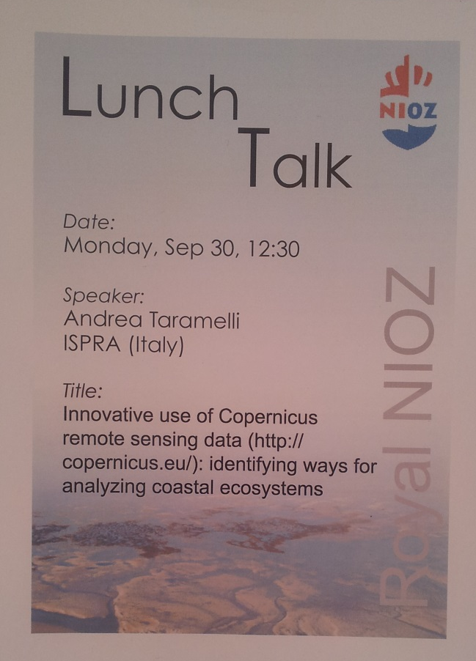
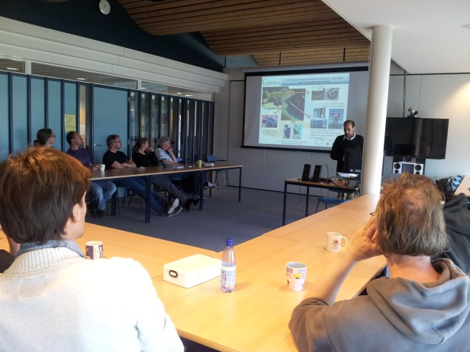
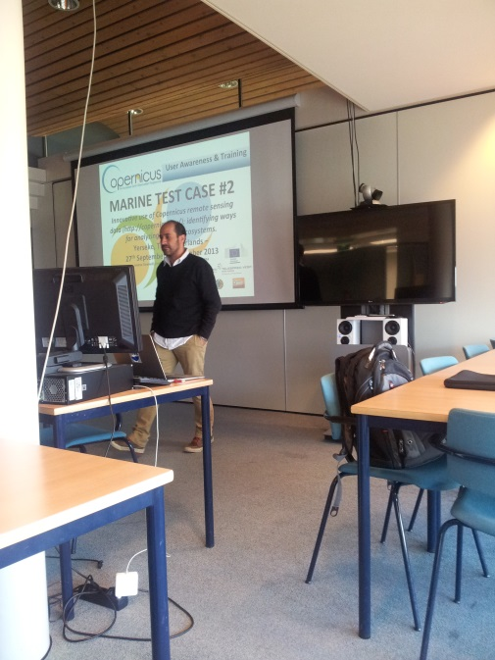
User Requirements from the Wadden Sea
Detailed habitat mapping in intertidal areas
Bathymetries for the shallower areas
Biophysical monitoring

Slide 10
EEA-ESA ONGOING ROLES AND PARTNERSHIPS
ESA is developing new satellite missions called Sentinels specifically for the operational needs of the GMES/Copernicus program.
The Sentinel missions are based on a constellation of satellites to fulfill revisit and coverage requirements from environmental monitoring and provide a unique set of observations for GMES/Copernicus Services.
The operational availability of ESA Sentinel satellites has been central in the 2013 FP7 space work programme to support space based applications such as Copernicus.
EU funding schemes have and will strongly support topics aimed at delivering new and innovative products, processes and services, with particular attention on the investments in the Sentinel satellites.
Despite the great promotion activities developed to raise interest on the incoming missions, still no Sentinel dataset is available for the scientific community. The simulations of future Sentinel data are on the way and they represent a challenge for scientists, since accurate technical specifications would be needed.

Slide 11


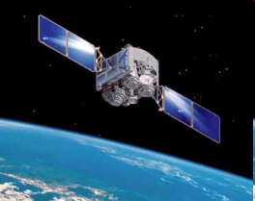







Downstreaming and Support to Decision Process
COASTS: The interface
between
Land/Sea Scape
Field Radiometry
Algorithm development
and research
ESA remote Segment +
Data in situ acquisition
Preprocessing modules
(archive search&new acquisition)
Spectral mixing analysis
Integration layer
GMES Services
Non GMES Services
Publication layer
Interferometry
Data Processing layer
Data Access
layer
From Space Systems to non EO expert End Users

Slide 12
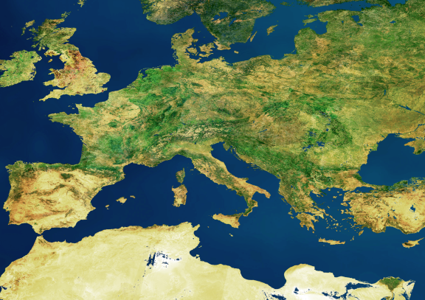
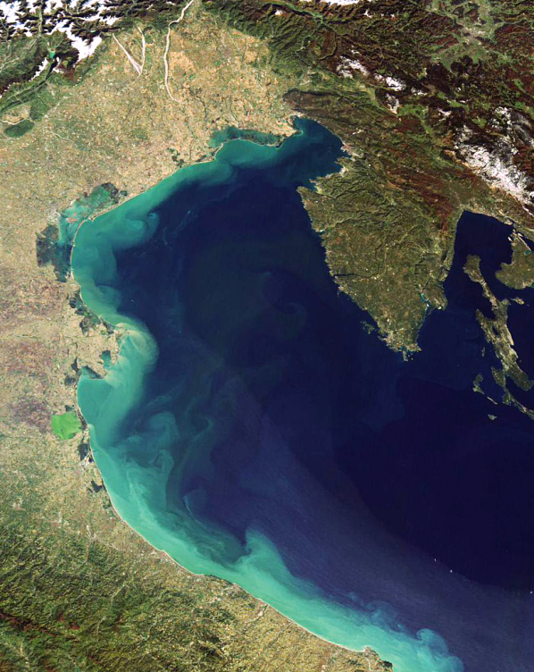
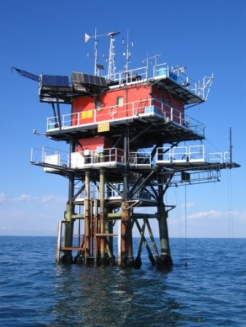
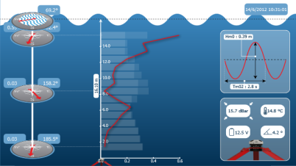
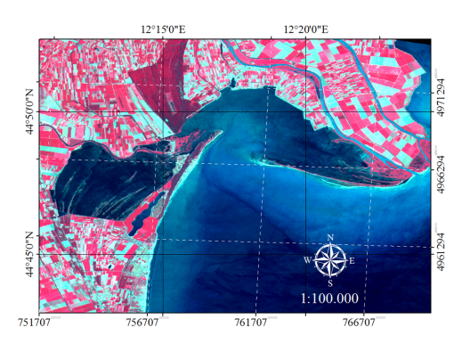
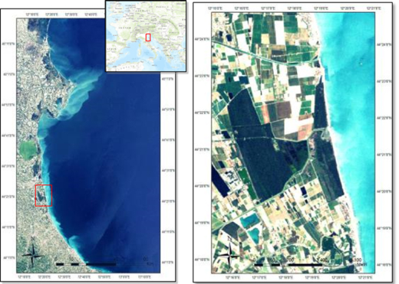
Test Case #2: COASTAL MARINE ECOSYSTEMS – NORTHERN ADRIATIC SEA AND NORTHERN SEA
Area 1: offshore Adriatic Sea, marine resources and multiuse platforms
Area 2: Sacca di Goro: natural habitat and socio- economic interests
Area 3: Bevano mouth and coastal habitat:
flooding and erosion prevention
Notes:
Along the coast line of a country a lot of ecosystems can characterize the shape and the function of the landscape. The Po Delta and the adjoin wetlands represent the gateway to the Northern Adriatic sea where marine resources are exploited for energy and aquaculture. We encounter prestigious natural heritage of residual spits and mudflat that both influence and are influenced by the internal and external circulation of waters. Moreover the lagoons offer a series of services for human wellness that generate pressures on the main indicators of environmental status. Transitional waters along the delta are generally exploited for aquaculture (Sacca di Goro, south Po Delta) and this is on of the reason of the natural capital they represents (mussels production, recreational). The management of the cost imply the use of quantitative analysis and modeling in view of intervention for risk prevention and reduction. Erosion and accretion budgets of coastal sands are i.e. important factors when coastal estuaries are embraced or water flows are changed through hard structures and replenishment (Foce Bevano). Flooding, erosion, subsidence and forest fire interact modifying the landscape.
The Adriatic sea is a source of energy, and the recent views on multi use platforms for sustainable productions of energy and biomasses are looking at the sea in terms of quantitative extraction of biological and physical resources.

Slide 13
Down Streaming Products From MyOcean
The MyOcean service is driven by quality and simplicity because the service is intended to serve any users requesting generic information on the ocean, and especially downstream service providers who will use this information as an input to their value-added services to end-users.
The interactive catalogue allows users to select products according to:
7 geographical areas : GLOBAL Ocean, ARCTIC Ocean, BALTIC Sea, Atlantic-European North West Shelf-Ocean, Atlantic-European South West Shelf-Ocean, MEDITERRANEAN Sea, BLACK Sea.
Parameters/variables : Temperature, Salinity, velocities, Sea Level, Sea Ice, Biogeochemistry and Wind (observation only).
Products from ANALYSIS & FORECAST models : FORECAST BEST ANALYSES, HINDCAST, REANALYSIS
Products from OBSERVATIONS: NEAR REAL TIME, DELAY TIME, REPROCESSING.
Users are offered different on-line downloading options:
To download the whole product
To extract and download only a part of a product ( per area, per variable, for a period of time, some depths)
To download automatically by using scripts (python) for a regular use
Notes:
We are using for this test case the products from observations that are generated for different geographical areas and temporal ranges.

Slide 14
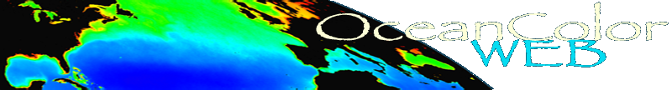


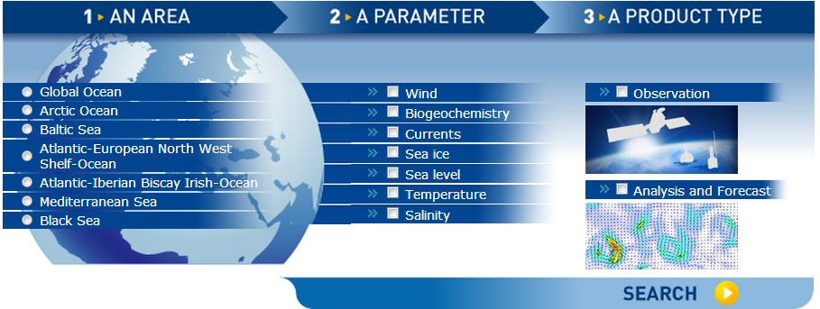
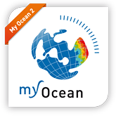
Ocean products from Earth Observation can be found on the online archives
Ocean Colour
http://oceancolor.gsfc.nasa.gov
SEAWiFS, MODIS, MERIS
MyOcean
http://www.myocean.eu.org
Notes:
Products for ocean and coastal dynamics analysis are available from different portals and countries all over the world are interested in the down streaming services implementation. This will provides in the near future the possibility real time observation, large extent of the landscape and high quality. Bio optical parameters are the main indicators of the sea waters quality and their algorithm are now implemented for a daily provision of products. This lesson has been learned from the nasa archives portals.

Slide 15
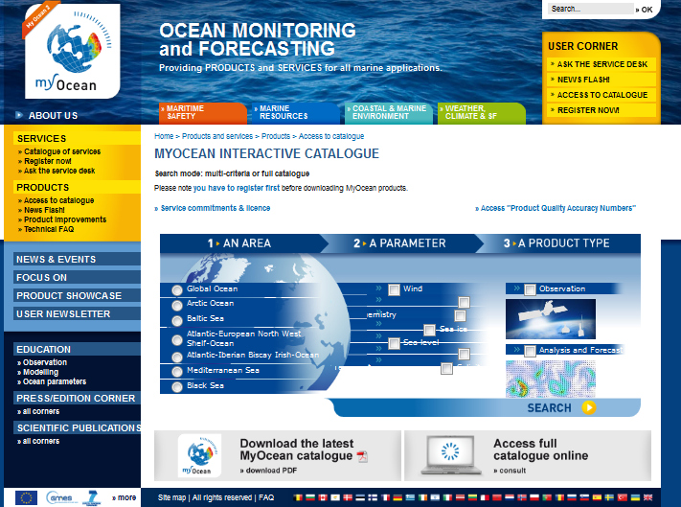
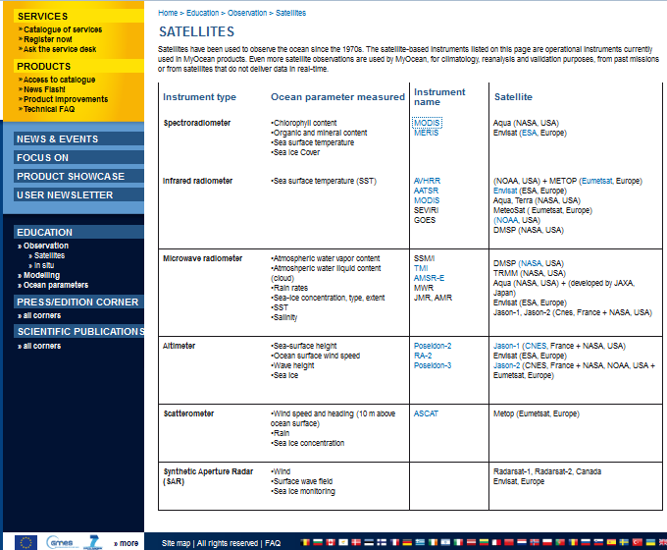
Products From MyOcean
http://www.myocean.eu/web/26-catalogue-of-services.php
MYOCEAN OFFERS A RELIABLE, VALUABLE AND EASY ACCESS OCEAN CORE INFORMATION TO USERS.
Products from OBSERVATIONS : NEAR REAL TIME,
DELAY TIME, REPROCESSING
Notes:
A set of parameters are measured in different ways and provided in different resolution. Core information are explained in technical format to ensure a specific analysis of the products needed.

Slide 16
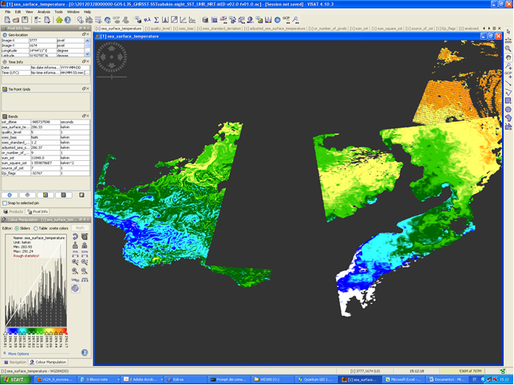
Products from MyOcean: SST
OPENING SST FROM MY OCEAN OBSERVATION
INFO CONTENT
NO DATA
PRODUCT INTERPRETATION
Notes:
The content of the files provided from MyOcean is variable on the base of the parameter and on the base the technical ability of the product providers of being detailed in the metadata compilation. In example, the aquaculture exploitation is firstly dependent from sea temperature, so that temperature can be considered part of the proxies for the feasibility of fish farming.

Slide 17
Downstreaming SST from MyOcean
MYOCEAN SEA SURFACE TEMPERATURE (SST) PRODUCTS OF MEDITERRANEAN SEA
Mediterranean Sea - High Resolution and Ultra High Resolution L3S Sea Surface Temperature (“SST_MED_SST_L3S_NRT_OBSERVATIONS_010_012”)
Mediterranean Sea High Resolution and Ultra High Resolution Sea Surface Temperature Analysis (“SST_MED_SST_L4_NRT_OBSERVATIONS_010_004”)
A single daily super-collated image (L3S) is obtained by merging different L3P images (if present); however the SST estimated from one sensor might significantly differ from that retrieved by another. This is mainly as a consequence of the differences among the sensors (number of bands, spectral resolution, scanning/viewing geometry, etc.) and/or of the different algorithms applied, which, in particular, might correct the atmospheric contribution to the measured brightness temperature very differently. Consequently, a bias adjustment procedure is applied to L3P data before super-collating.

Slide 18
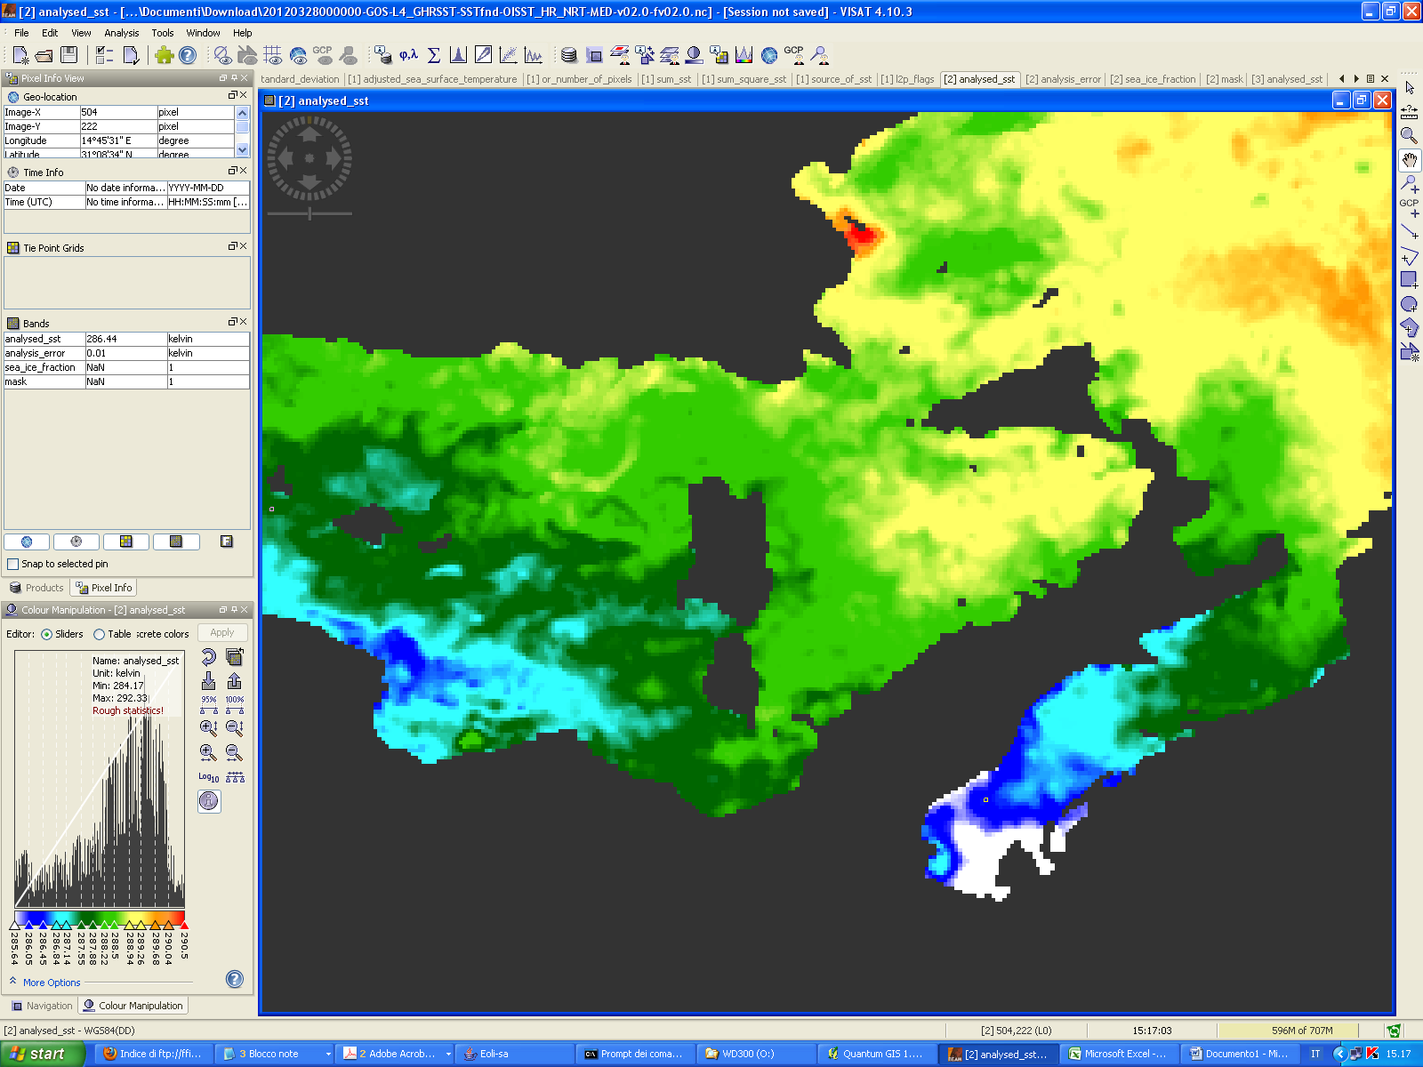
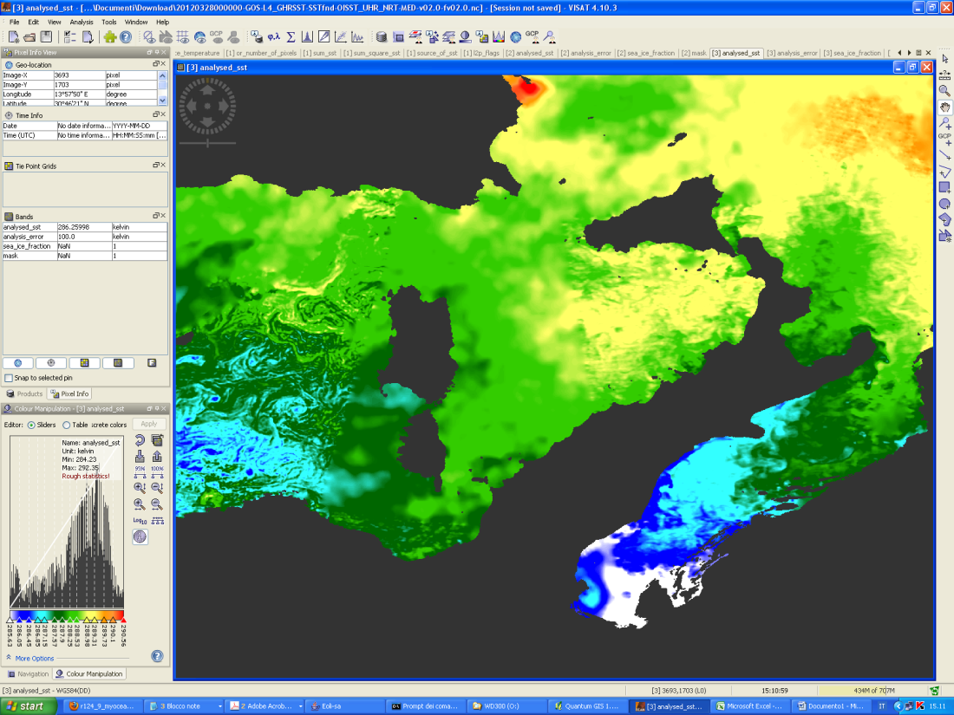

Sea Surface Temperature
SST products are based on the night-time images collected by the infrared sensors mounted on different satellite platforms, and cover the Southern European Seas (i.e. the Mediterranean Sea (MED product), including the eastern Atlantic Ocean, and the Black Sea (BS product).
SST_MED_SST_L4_NRT_OBSERVATIONS_010_004_a_V2:
1/16 degree (about 5000m)
The ISAC-GOS processing chain includes several modules; from the data extraction and preliminary quality control, to cloudy pixel removal and satellite image collating/merging.
SST_MED_SST_L4_NRT_OBSERVATIONS_010_004_c_V2:
1/100 degree (about 700 m)
A two-step algorithm finally allows to interpolate SST data at high (HR 0.0625°) and ultra-high (UHR 0.01°) spatial resolution, applying statistical techniques.

Slide 19
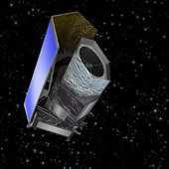
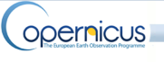
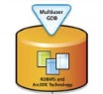
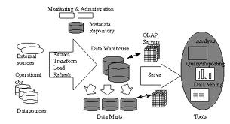
Downstreaming and Value Added Product Generation
EO DATA & PRODUCTS
COPERNICUS PRODUCTS
Data & Products
Fusion
Optical
Bio optical parameters
SAR
Physical observation
Data Processing
Assessment of products quality using in-situ data
SST
KD490
TSM
CHL
WIND
NATURE 2000
EUNIS
CORINNE
PATTERN and PROCESS
Temporal series of maps
Spatial series of maps
ADDED VALUE PRODUCTS
DATABASE
DSS
Notes:
The uptake process will ensure more and more added value products through the earth observation coupled with INSITU measurements. Temporal and spatial series of biophysical map will ensure the ability of mapping in coastal dynamics.

Slide 20
Processing Chain for MERIS
PROCESSING
ADDED VALUE
L1
DOWNLOAD MERIS
L1b (CAT-1 ESA)
EXTRACTION from .tar to .N1
- Full Resolution processing
- Non-standard product improvements (Kd490)
- Experimental algorithm (Neural Network in Case 2 water SPM-CDOM- CHL)
L2
ODESA processing
L1b -> L2
(MEGS 8.1 processor)
L3
BEAM binning processor
L2 -> L3
Extent and product selection
GDAL band extraction
netCDF product assembling
- Metadata
- Processing information
Notes:
An example of processing chain to obtain a time series of SST from MERIS. This level of information cannot be included into the product but it is easy to implement it into the decision process.

Slide 21
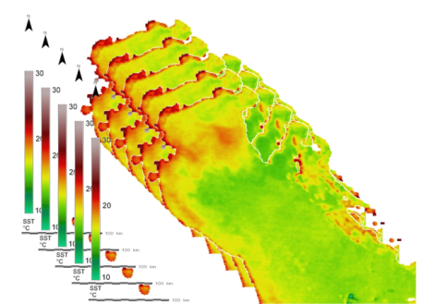
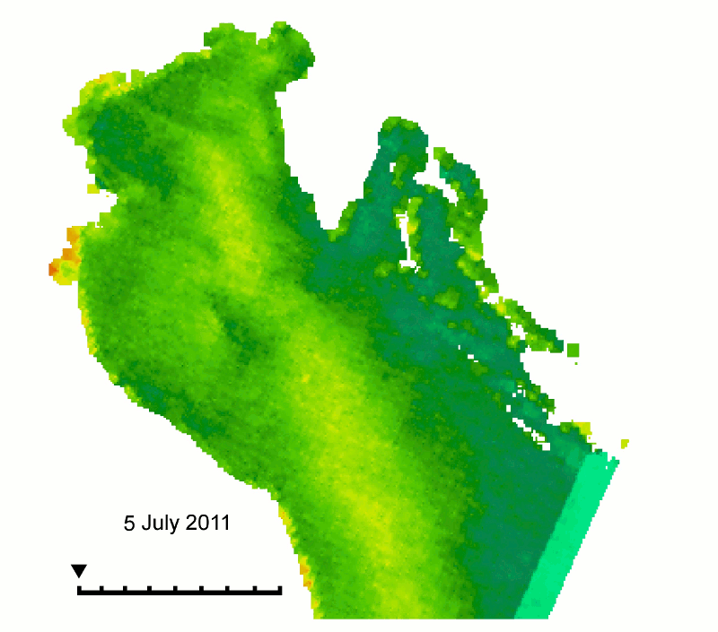
Area 1: North Adriatic Sea Water
ADDED VALUE PRODUCTS:
SST TIME SERIES
MODIST_201107_SST.tif:
Sea Surface Temperature from MODIS TERRA satellite. Image stack for multitemporal product, acquired during July 2011
(31 days).
GeoTIFF format,
Float32,
CRS: WGS84,
EPSG:32633.
SST IS A USEFUL PARAMETER TO DESCRIBE BOTH SPATIAL VARIABILITY AND SEASONAL-INTERANNUAL CHANGES. THIS CAN BE USEFUL FOR BOTH BIOLOGICAL ANALYSIS (TEMPERATURE AS A DRIVER OF BIOLOGICAL ACTIVITY) AND MODELING. i.e WE CAN GENERATE TIME SERIES OF SST RELATIVE TO THE 31 DAYS OF JULY 2011.

Slide 22
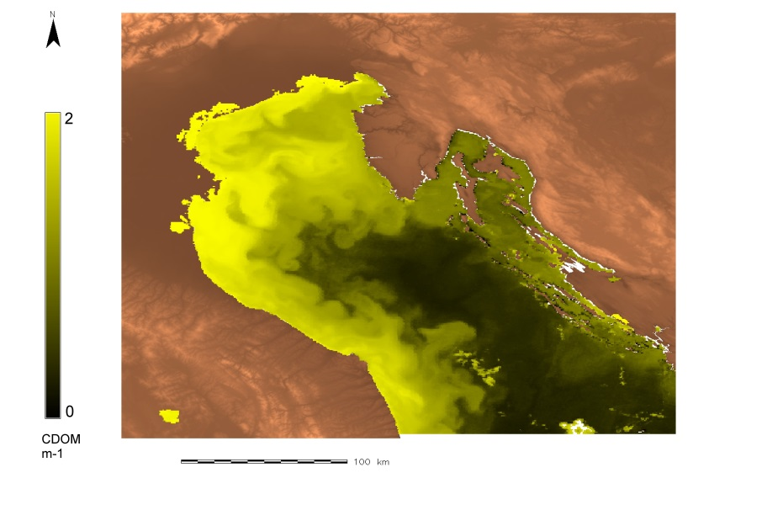
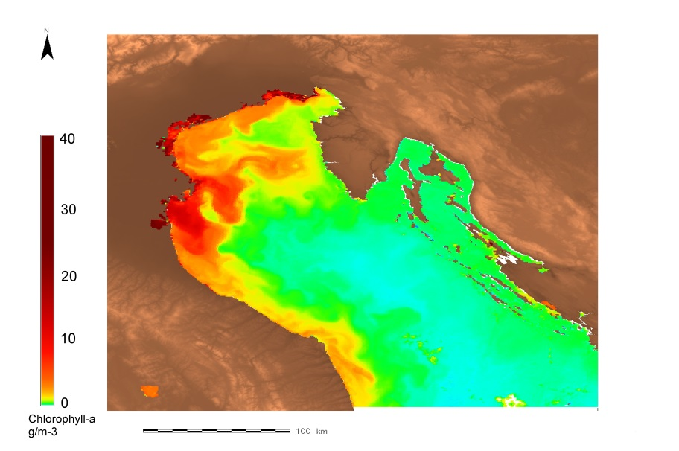
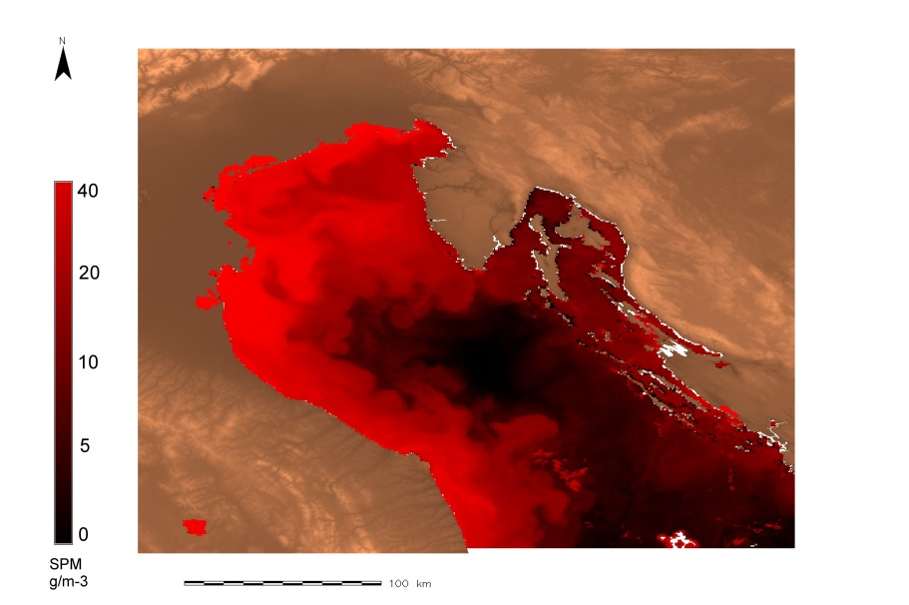
Added Value Products: Multi Parameter Analysis
A MULTIPARAMETER ANALYSIS OF THE SAME AREA CAN PROVIDE AN ESTIMATE OF HOW BIOPHYSISCAL PROPERTIES ARE SPATIALLY DISTRIBUTED. THE GENERATED PRODUCT IS OBTAINED BY PRODUCING EACH PARAMETER WITH ITS SPECIFIC ALGORITHM (CDOM, SPM, CHL from 08/05/2011 MERIS). TREND ANALYSIS WILL BE INTEGRATED IN A MULTIPARAMETER TREND ANALYSIS STACK

Slide 23
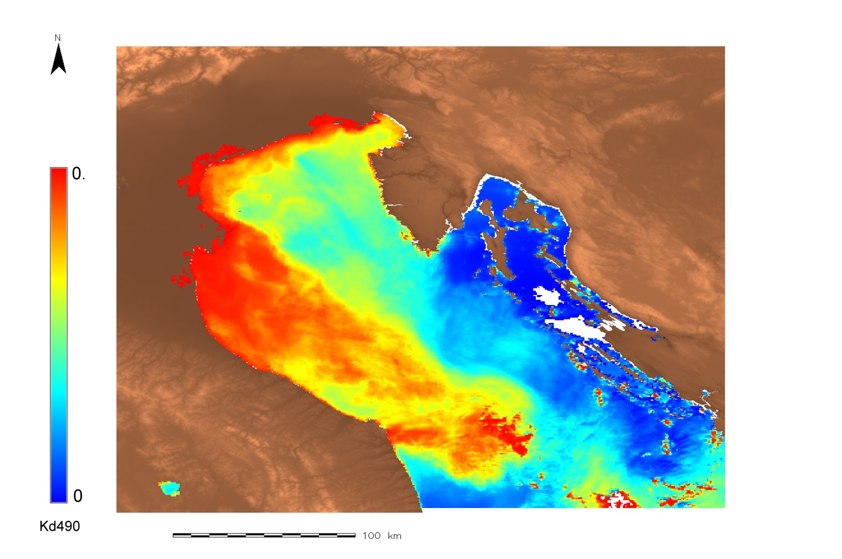
Value Added Products: Kd490
KD490 IS RECOGNISED AS AN INTERESTING INPUT IN HYDRODINAMIC MODELING
IT IS CONSIDERED AS A PROXY FOR WATER COLUMN TURBIDITY (448 - 490 - 547-560)
IT CAN BE CONSIDERED AS SUMMARY INDEX OF THE CASE 1 AND CASE 2 WATERS OPTICAL/QUALITY PROPERTIES

Slide 24
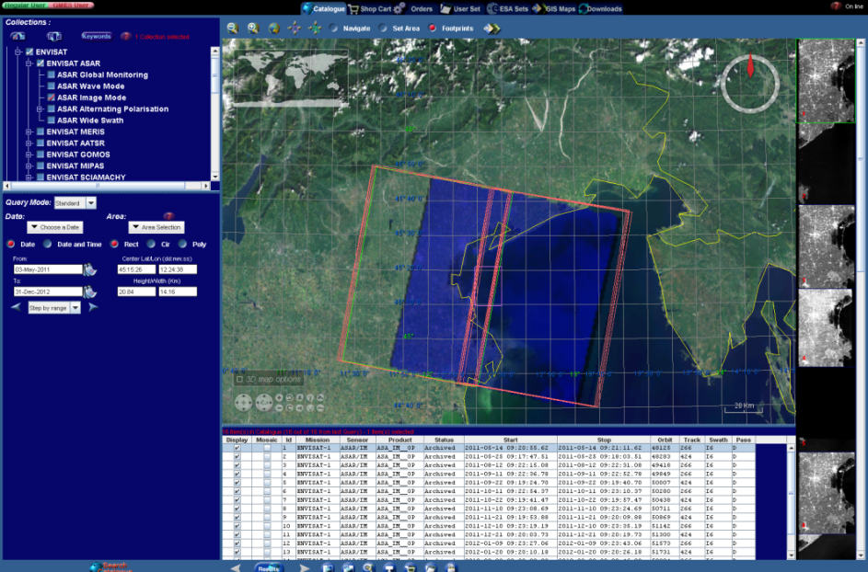
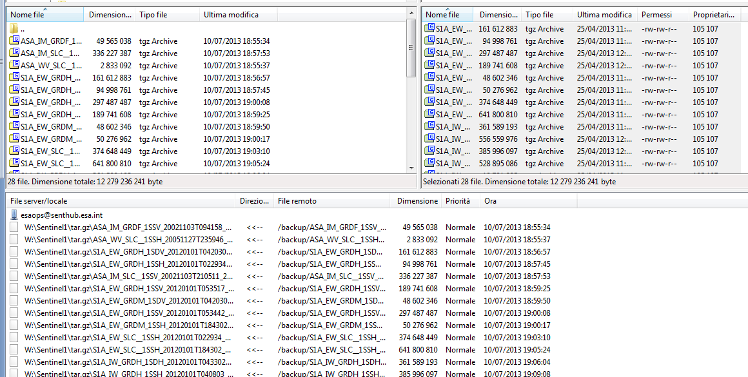
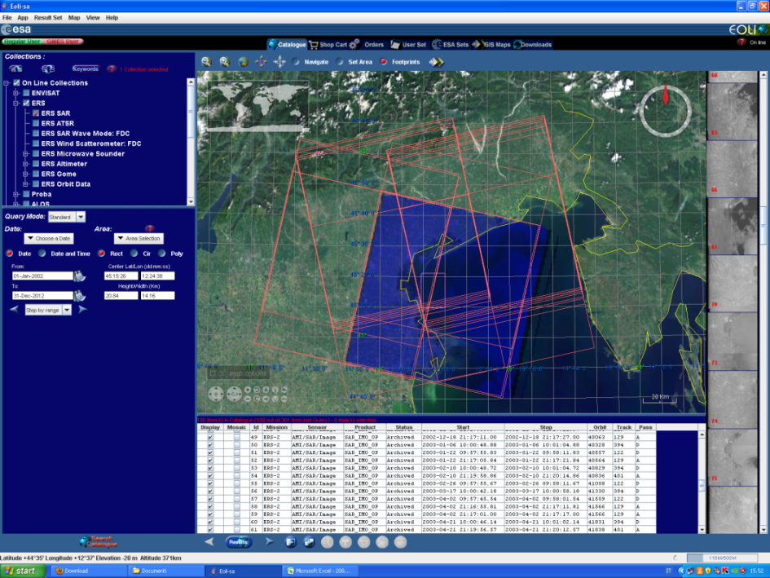
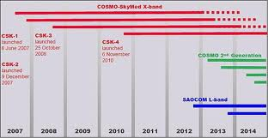
Downstreaming EO SAR Data Availability – Northern Adriatic Sea
I2 swath - ERS2 01/01/2002 – 09/02/2011 - Track 122 (D), 129 (A), 394 (D), 401 (A)
SENTINEL SIMULATED DATA ACCESS: senthub.esa.int
The performance of the Sentinel-1 mission is simulated using ENVISAT ASAR data, to give users a hint of the dataset that the incoming satellite will provide. To date, simulated data are available for testing activities, they are in fact available to a restricted group of research institutions over Europe.
The public provision of datasets simulating the spectral characteristics of the instruments is a fundamental step to ensure the validations of such products, and to prepare today for the use of these data when the Sentinels will be launched (2014)
CosmoSKyMed from specific requests

Slide 25
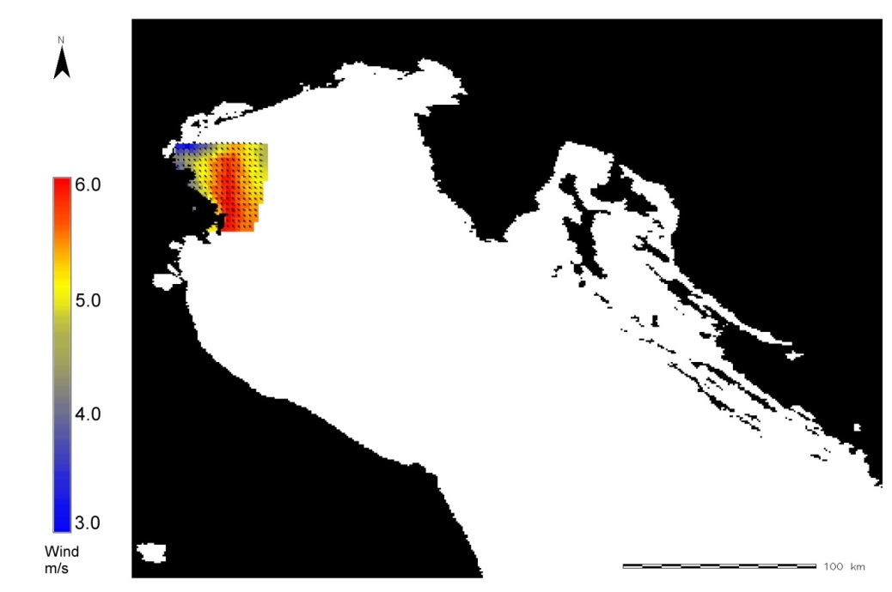
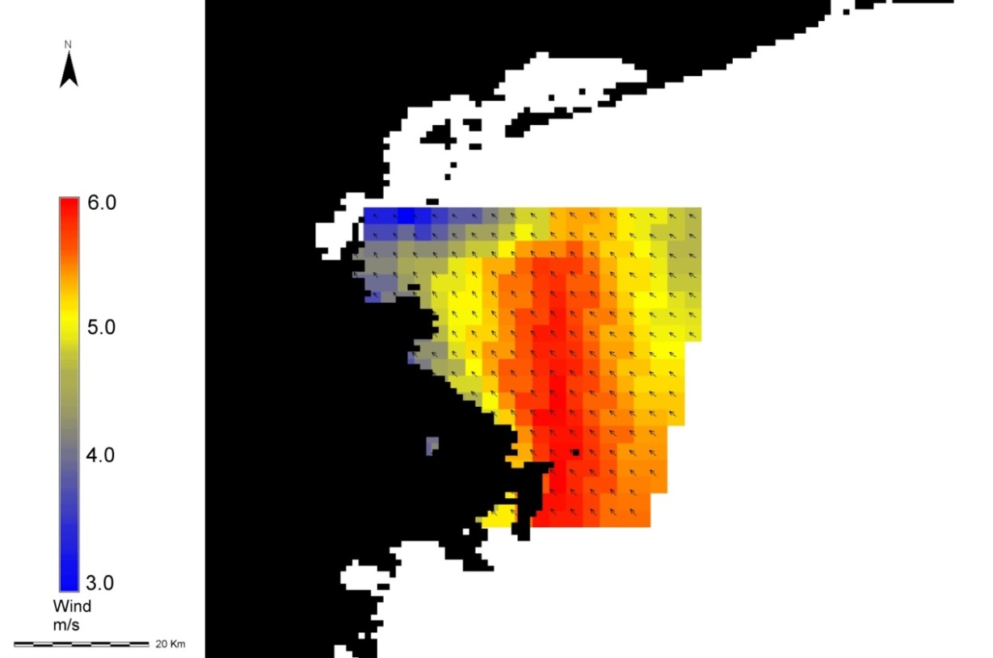
Value Added Product: Wind Speed and Direction
WIND SPEED AND DIRECTION ~ 300m CAN BE GENERATED FROM SAR DATA AND THEY CAN BE COUPLED WITH WIND (~ 1 km) CURRENTS (~ 5 km) (I.e. available from SOPRANO portal). THIS WILL PROVIDE THE POSSIBILITY OF SCALING UP AND DOWN PHYSICAL PARAMETERS FROM MYOCEAN PRODUCTS TO THE WIND ADDED VALUE PRODUCTS.

Slide 26
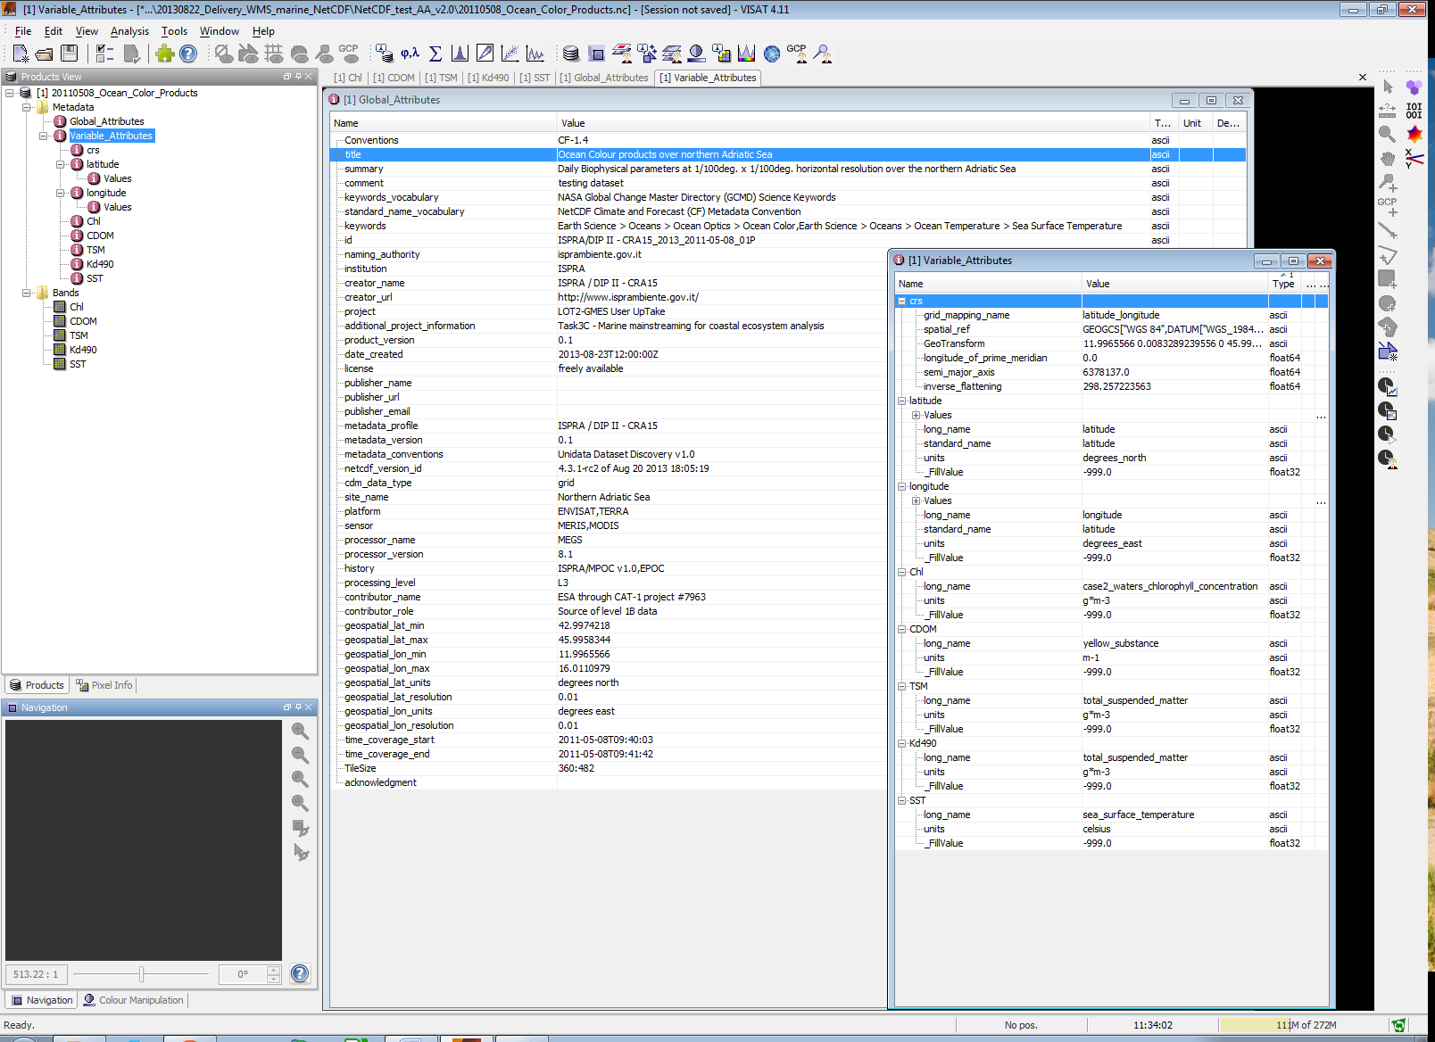
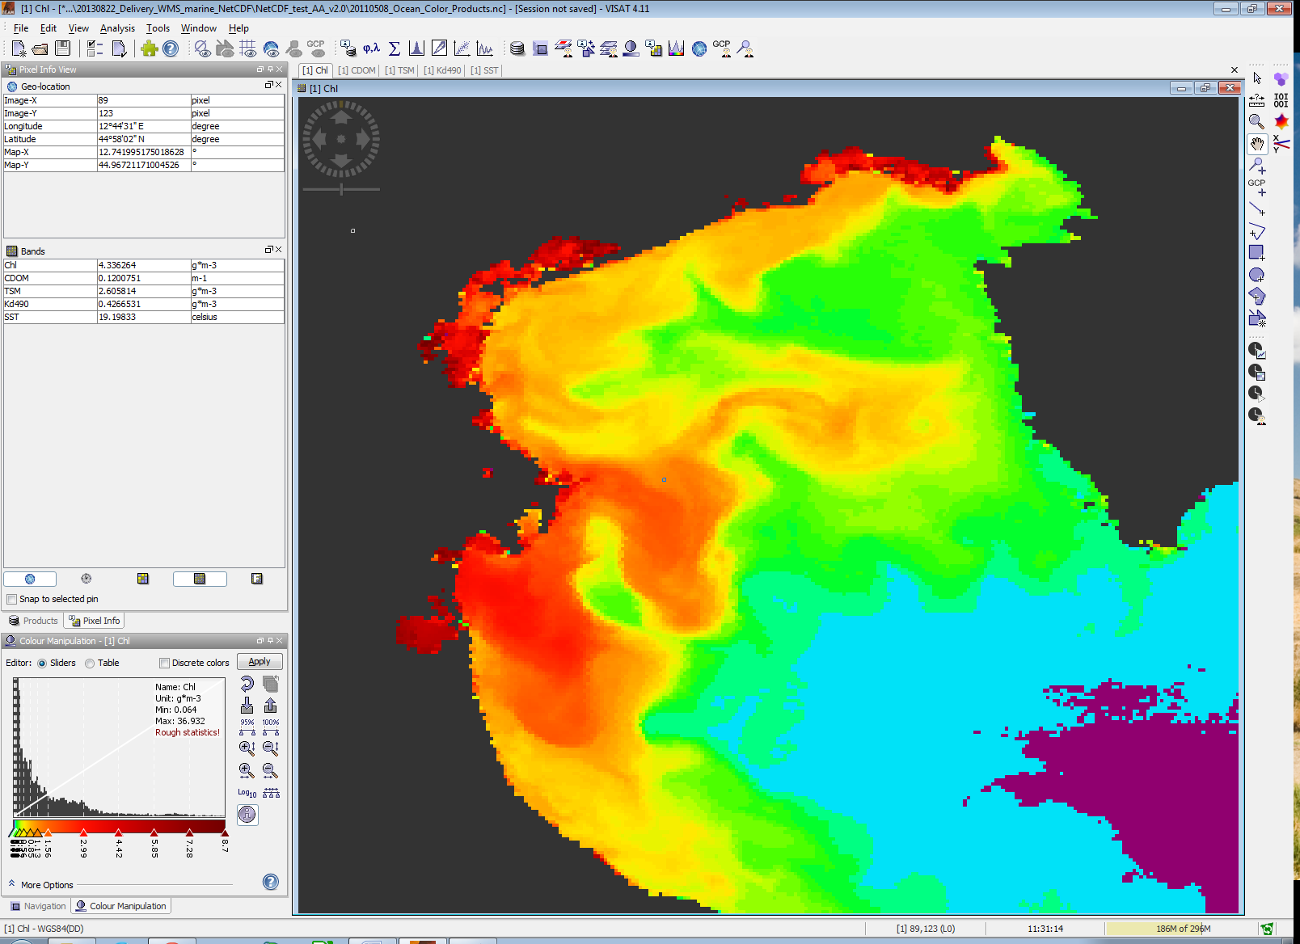
Attributes of Value Added Products
Notes:
Added value products will have global and specific attributes useful to describe how products are generated and where are the source of data, algorithms. Case 1 and Case 2 water can have different quality flags.

Slide 27
Web Mapping Service
Product/Added value product
Product version
Coordinate Reference System
Spatial resolution
Platform/Sensor/Algorithm
Keyword
Long name/Standard name
Units
Scale factor
Fill value/missing value
Creator name/Creator URL/Creator contact
Publisher name/ Publisher URL/ Publisher contact
WMS
A Web Mapping Service (WMS) implemented to deliver products generated to supply the main and downstreaming of Copernicus Earth Observation products for coastal ecosystem analysis. The deliverables will include series of maps based on existing MyOcean and GeoLand services integrated with Earth Observation and in-situ data with both biological and physical layers/indicators at different spatial and temporal scales.
Notes:
Added value product pubblication and sharing through web mapping tools and services.

Slide 28
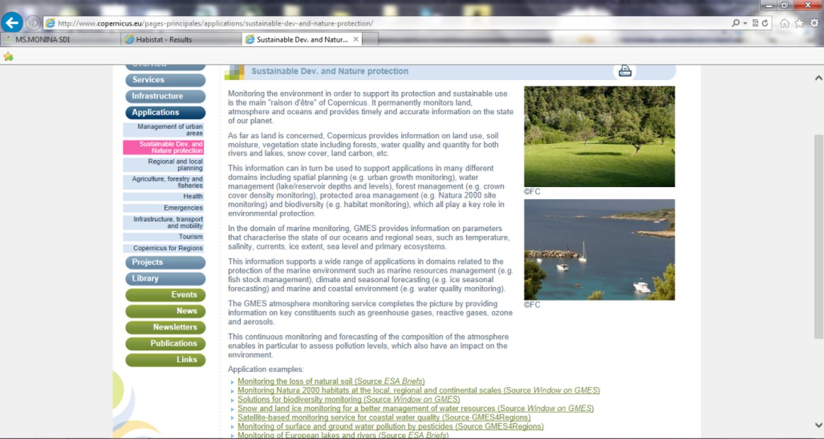
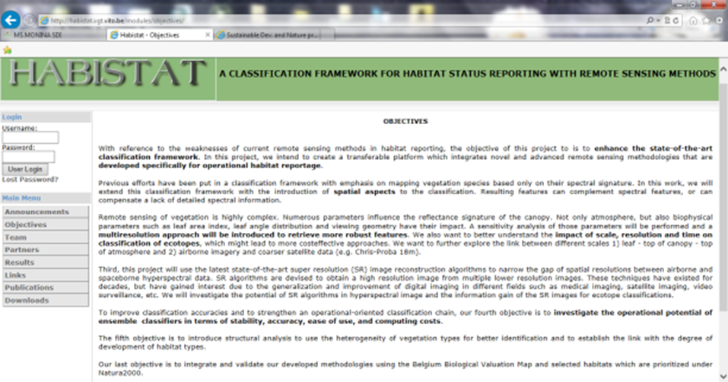
Coastal Habitat Mapping: Products from GeoLand (and related Link)
http://habistat.vgt.vito.be/

Slide 29
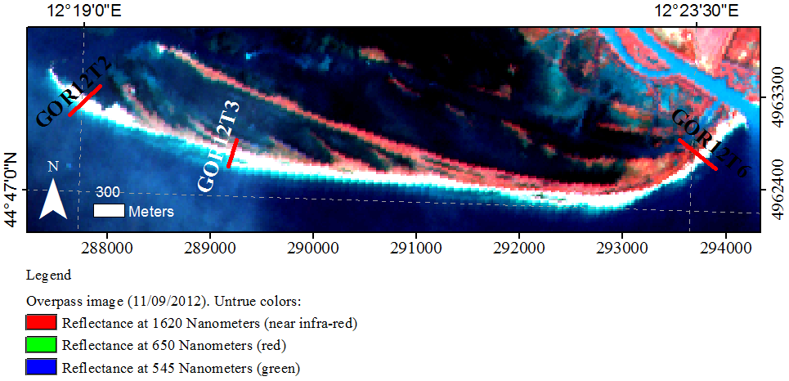
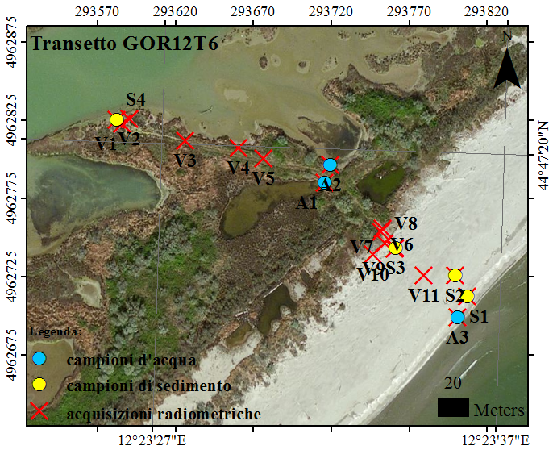
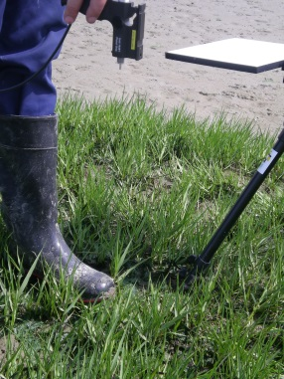
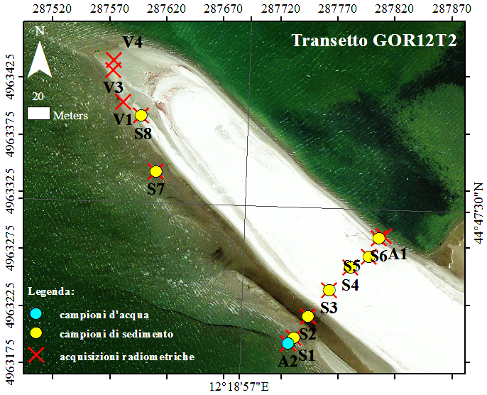
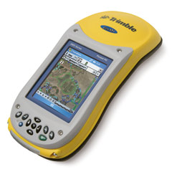
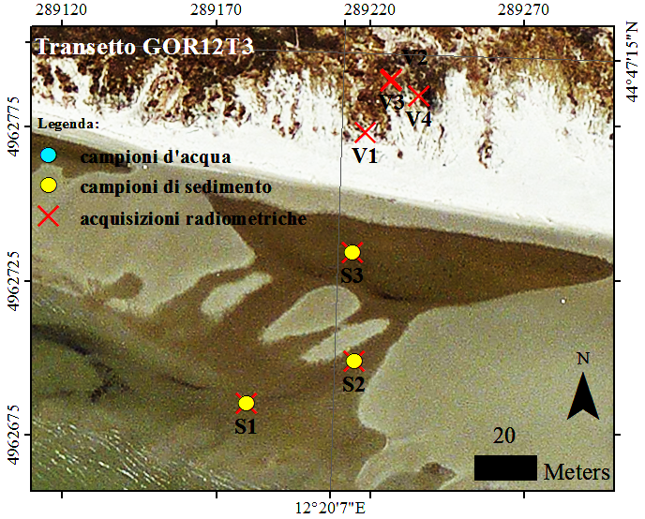
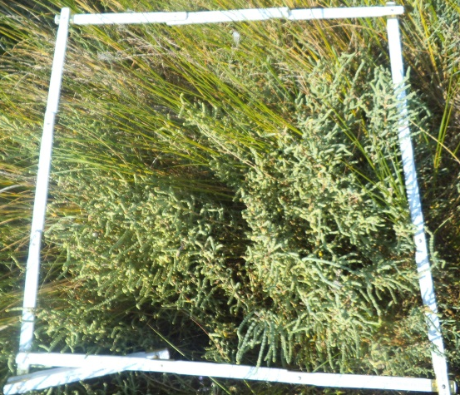
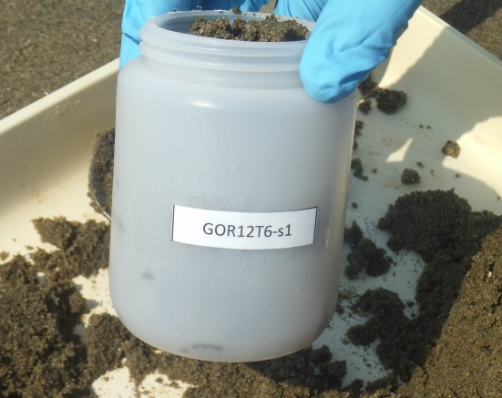
Area 2: Goro spit - High resolution ecological mapping coupled with
Insitu and laboratory measurements
41 point:
Field-Spectral Radiometer Pro for spectral libraries collection and implementation
GPS (Trimble GeoExplorer® GeoXHTM):
Vegetation selecting and classification
Camera to collect tagged gps photos
Laboratory (Chl-a e Feo-pig and sediment properties; TSS; DOC; aCDOM 280 – 355 waters)
Notes:
Cover and density of vegetation as well as sediment typologies are the drivers of coastal dynamics under marine and climate. In the case study of Goro lagoon the radiometric characterization of the targets allows the sub pixel analysis of spot satellite images available from ESA through the Category 1 application. Spot is the sensor that provided the Corinne Land Cover!

Slide 30





In Situ Spectral Libraries
SPECTRAL LIBRARIES AND FIELD MEASUREMENTS ARE COLLECTED INTO TARGET FORMS WHERE ALL INFORMATION IS RECORDED
Notes:
Examples of spectral charaterization from insitu measurements

Slide 31








Implementing Processing Chain
SUBSET OF MULTISPECTRAL SATELLITE IMAGERY
MASKING
(REFLECTANCE 830 nm > 0,06866)
PC2
SAND
MLLH ANALYSIS
VEGETATED &
NOT VEGETATED
VEGETATION
PC1
PC3
VEGETATION
Sparse vegetation
(Pearson corr. 0,93)
1
Maximum Likelihood
3 VEGETATION TYPOLOGIES
Reeds and Spartina (Pears. c. 0,98)
2
3
Ammophila (Pears. c. 0,99)
PC2
Notes:
Application of the unmixing models on optical satellite data (i.e SPOT) with the specific target on vegetation and sand that represents two of the main descriptors of coastal dynamics in sedimentary environment.

Slide 32

Added Value Products
Notes:
Vegetation presence, cover and typology (invasive species too), sediments typologies and water optical properties through the spectral libraries obtained by insitu measurements

Slide 33


Added Value Products
Notes:
Sand and sediments typologies

Slide 34

Added Value Products
Notes:
Habitat Natura 2000 (1:5000)

Slide 35

Added Value Products Implementation Intermediate Products
Notes:
EUNIS (EUropean Nature Information System) classification, is a hierarchical informative system, realized to be connected with the other important European classification systems, is devised on the basis of the CORINE with opportune redefinitions and insights.

Slide 36
Area 3: Temporal Chages in FOCE BEVANO
SUBSIDENCE
Morphometric Parameters
Multi-temporal
analysis and
integration
procedure
Interferometry
Vegetation Monitoring
- NDVI
- Fraction map
Change detection
EOF
Taramelli, A.; Valentini, E.; Cornacchia, L.; Mandrone, S.; Monbaliu, J.; Thompson, R.; Hogart, S.; Zanuttigh, B. (2013), Modelling uncertainty in estuarine system by means of combined approach of optical and radar remote sensing, accepted paper fot Coastal Engineering scientific journal.

Slide 37









2005
2008
1991
1976
1943
1954

Slide 38


Multi-temporal Dataset
Landsat
ERS
Bands | Spectral Resolution | Wavelength | Spatial Resolution (pixel)
Band 1 | Visible | 0,45 – 0,52 µm | 30 m
Band 2 | Visible | 0,52 – 0,60 µm | 30 m
Band 3 | Visible | 0,63 – 0,69 µm | 30 m
Band 4 | Near Infrared | 0,76 – 0,90 µm | 30 m
Band 5 | Near Infrared | 1,55 – 1,75 µm | 30 m
Band 6 | Thermal | 10,40 – 12,50 µm | 120 m
Band 7 | Mid Infrared | 2,08 – 2,35 µm | 30 m
Band | Spectral Resolution | Wavelenght | Spatial Resolution (pixel)
C | Microwaves | 3,75 – 7,5 cm | 30 m

Slide 39


DInSAR SBAS and PiNSAR Small Baseline Subset
Small movement in line of sight
Deformation rate
ERS SAR
Subsidence map
34 SAR images from 1992 to 2000
Taramelli, A.; Manzo C., Valentini, E.; Cornacchia, L., Pieralice F., (2013), Coastal Subsidence: Causes, Mapping, and Monitoring, Invited Chapter to Encyclopedia of Natural Hazards, Wiley & Sons, Ltd.

Slide 40

Subsidence Temporal Evolution

Slide 41
Vegetation Temporal Evolution
NDVI
Normalized Difference Vegetation Index
Change detection
Fraction map
SMA
Spectral Mixture Analysis
EOF
Empirical Orthogonal Functions
SCALING DOWN

Slide 42




Change Detection Method
T1- T0
Time 1
Calculated at 2010
Time 0
Δ image
Change map using percentile (Zurlini, 2001)
Calculated at 1991

Slide 43


Normalised Difference Vegetation Index (NDVI)
Notes:
Indice di vegetazione che misura la biomassa fotosinteticamente attiva
Mette in relazione l’assorbimento spettrale della clorofilla nel rosso con la tipica riflessione del vicino infrarosso, dove è fortemente influenzata dal tipo di struttura fogliare

Slide 44




Fraction Map from SMA – Spectral Mixture Analysis
Vegetation
Pinewood
Waters
Soils
Sands
Pearson | %
Halophiltes | 0,96
Sands | 0,95

Slide 45




In Situ Data
200 metri

Slide 46









In Situ Data
Ammophila littoralis
Agropyron junceum
Limonium narbonense
Medicago marina
Salicornia veneta
Pinus pinaster

Slide 47



Change Detection NDVI
1991 - 2001
1991 - 2010
2001 – 2010
Notes:
Vegetation gain and lossess through supervised classifications

Slide 48


Change Detection SMA
FRACTION | n° pixel |  | %
Loss | 504900 |  | 15,08%
No change | 2673900 |  | 79,84%
Gain | 170100 |  | 5,08%
Notes:
Vegetation gain and losses across time and space through a subpixel analysis

Slide 49




Time Series: Subsidence and Vegetation Changes
Taramelli, A.; DiMatteo, L.; Ciavola, P.; Guadagnano, F.; Tolomei, C. (2013), Temporal evolution of patterns and processes of the coastal area in Bevano Estuary (Northern Adriatic) - Italy. Submitted to NHESS

Slide 50


Ongoing Mainstreaming and User Engagement
General users context at the European Space Expo 2013 - Rome
Scientific context at the ECSA 2013 Conference in Shanghai

Slide 51

MODELING
INDICATORS
ANALYSIS
SERVICES
RISK VALUES
MONITORING TOOLS
STAKEHOLDERS
USERS
PUBLIC PRIVATE INTERESTS
MAINSTREAMING
USER UP TAKE
Notes:
Open floor up to questions and needs

